Slide 1
Stryker.com
Publisher role
Training series

Slide 2
Getting started with AEM
Business requirements
Access
Site Hierarchy
Template basics
Brand architecture
Standard components overview
PUBLISHER role

Slide 3
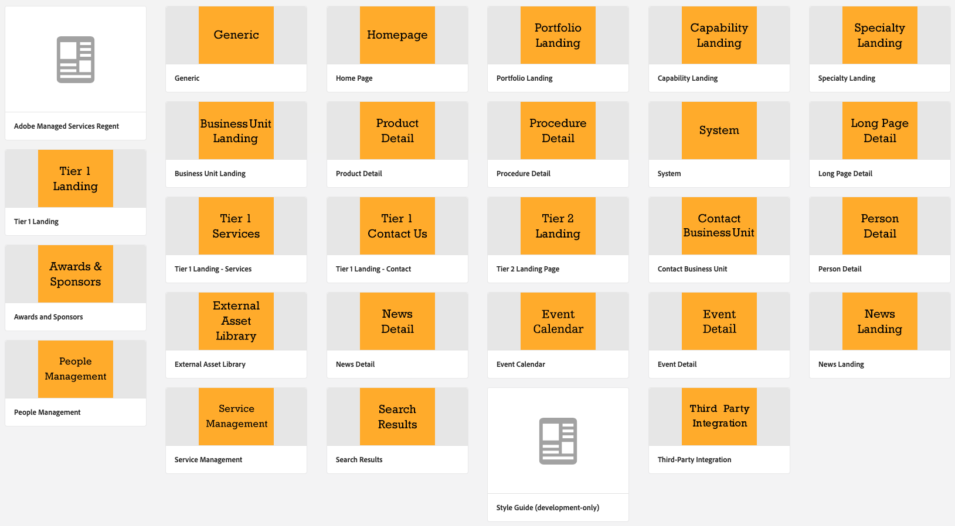
Definitions
AEM – Adobe Experience Manager, the platform Stryker.com is built upon
Page type – A category of page based on its template and content
Brand architecture templates (Portfolio, Capability, Specialty templates)
Product page templates (Product, System, Procedure templates)
Business pages (Business unit landing, contact, news, awards)
General content templates (Tier 1, Tier 2, Long page details)
Notes:
AEM stands for Adobe Experience Manager, our platform that we use to build templated pages on stryker.com.
Pages types are those templated pages that we build in AEM. They include the product detail, portfolio pages, and business unit pages

Slide 4
Business Requirements
In order for a business to have a presence on Stryker.com, a Business point of contact must be identified.
Business point of contact (BPOC)
Responsibilities
Owns the content under their business ‘folder’
Authorizes
Creation of new pages
Content changes
Publishing pages
Who gets what permissions

Slide 5
Roles
Business POC Authorizes who gets what type of access to their folder in AEM
Publisher Has ability to create pages for their business. Can publish or unpublish pages so that they are live on external website or are removed from visibility on external website (AEM platform).
Updater Once a page is created, the updater can edit content, including required page content: Page properties: Title, subtitle, abstract, content ID, Thumbnail, Hero options, short description, related categories (tags), contact button
Role type | Edit | Create Pages | Publish/Unpublish
Updater | Yes | No | Can only request
Publisher | Yes | Yes | Yes

Slide 6
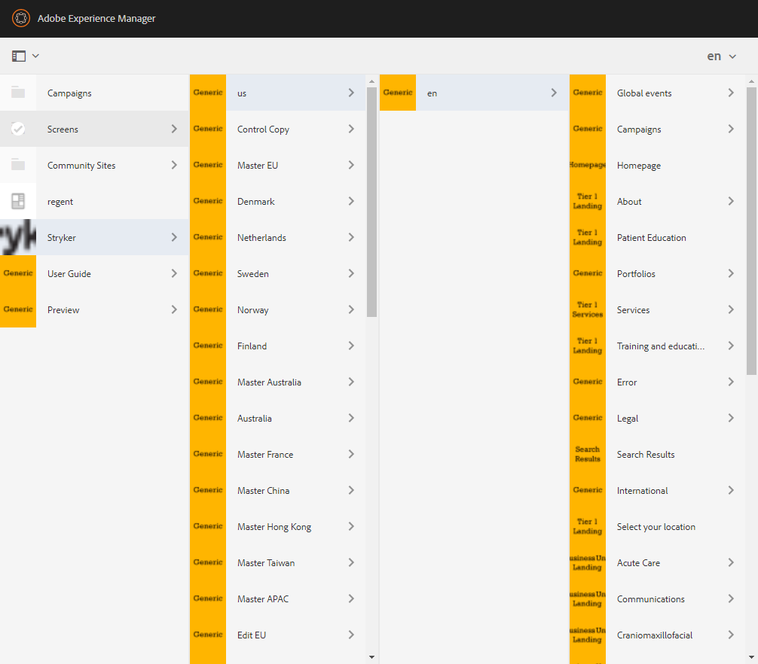
Site Folder Hierarchy
Shared
Company
Three categories of content on Stryker.com
Shared Content
All roles can edit
Company content
BPOCs may have edit rights
Digital communications team owns content/ publishing
Business Unit Content
BPOC owns content
Business

Slide 7
Brand architecture
Product navigation

Slide 8
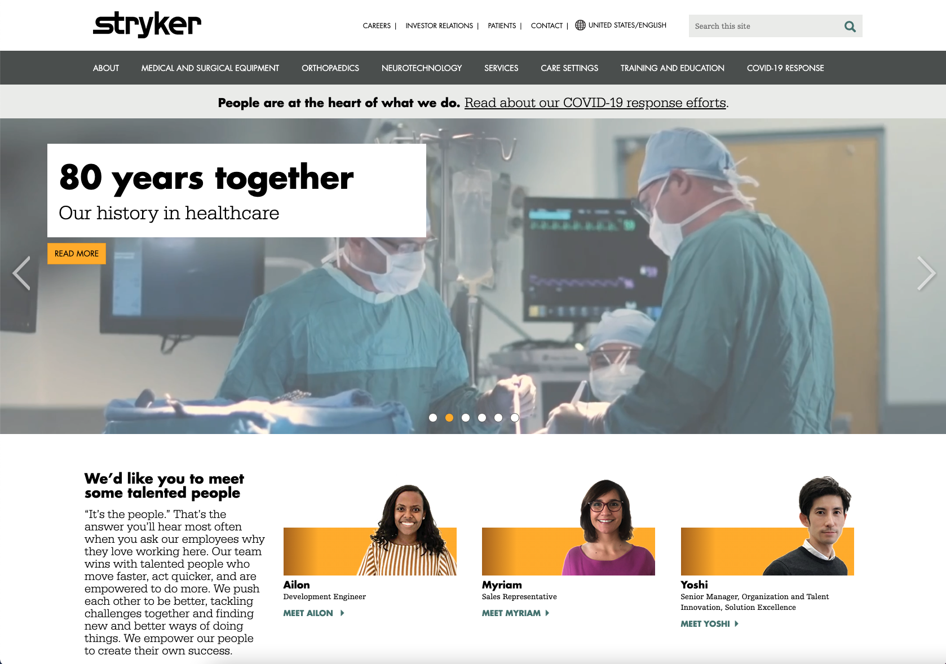
Product Hierarchy
Visitors will access product pages primarily through the Brand Architecture.
While pages are created based on input from businesses, the Company Brand/Communications team has final oversight on content and publication:
Portfolio
Capability
Specialty
https://www.stryker.com/content/userguide/us/en/references/brand-architecture-and-ownership.html

Slide 9
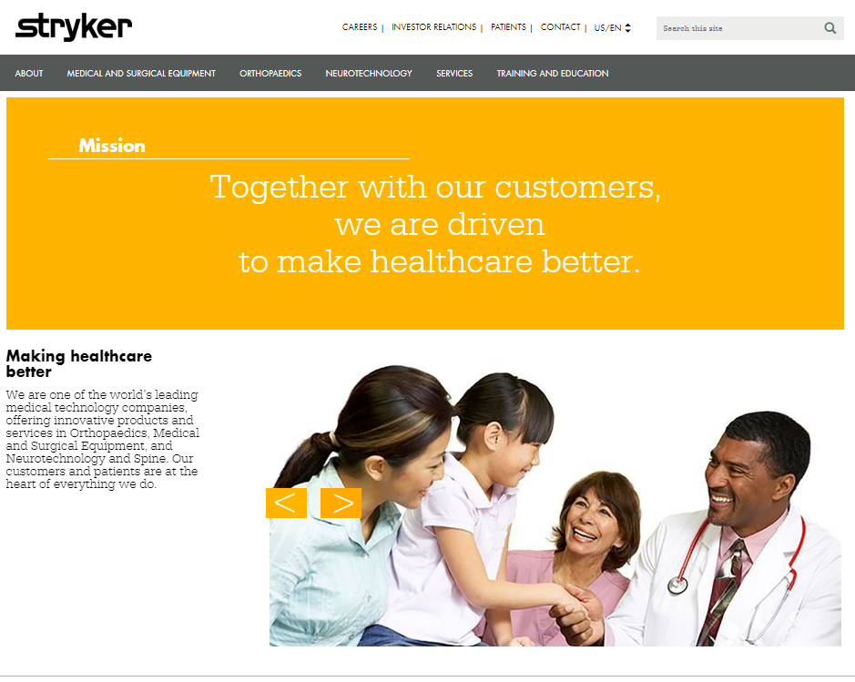
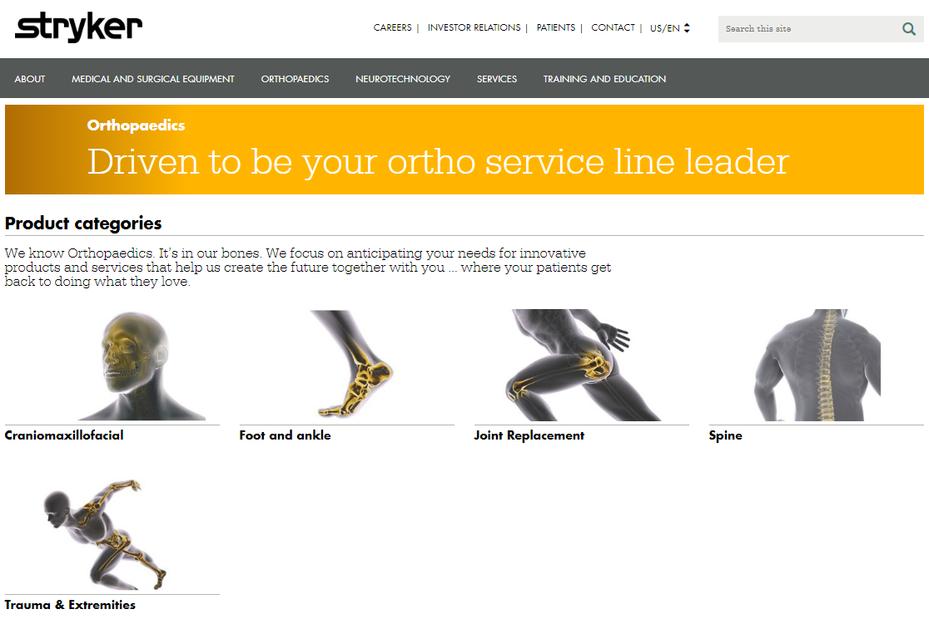
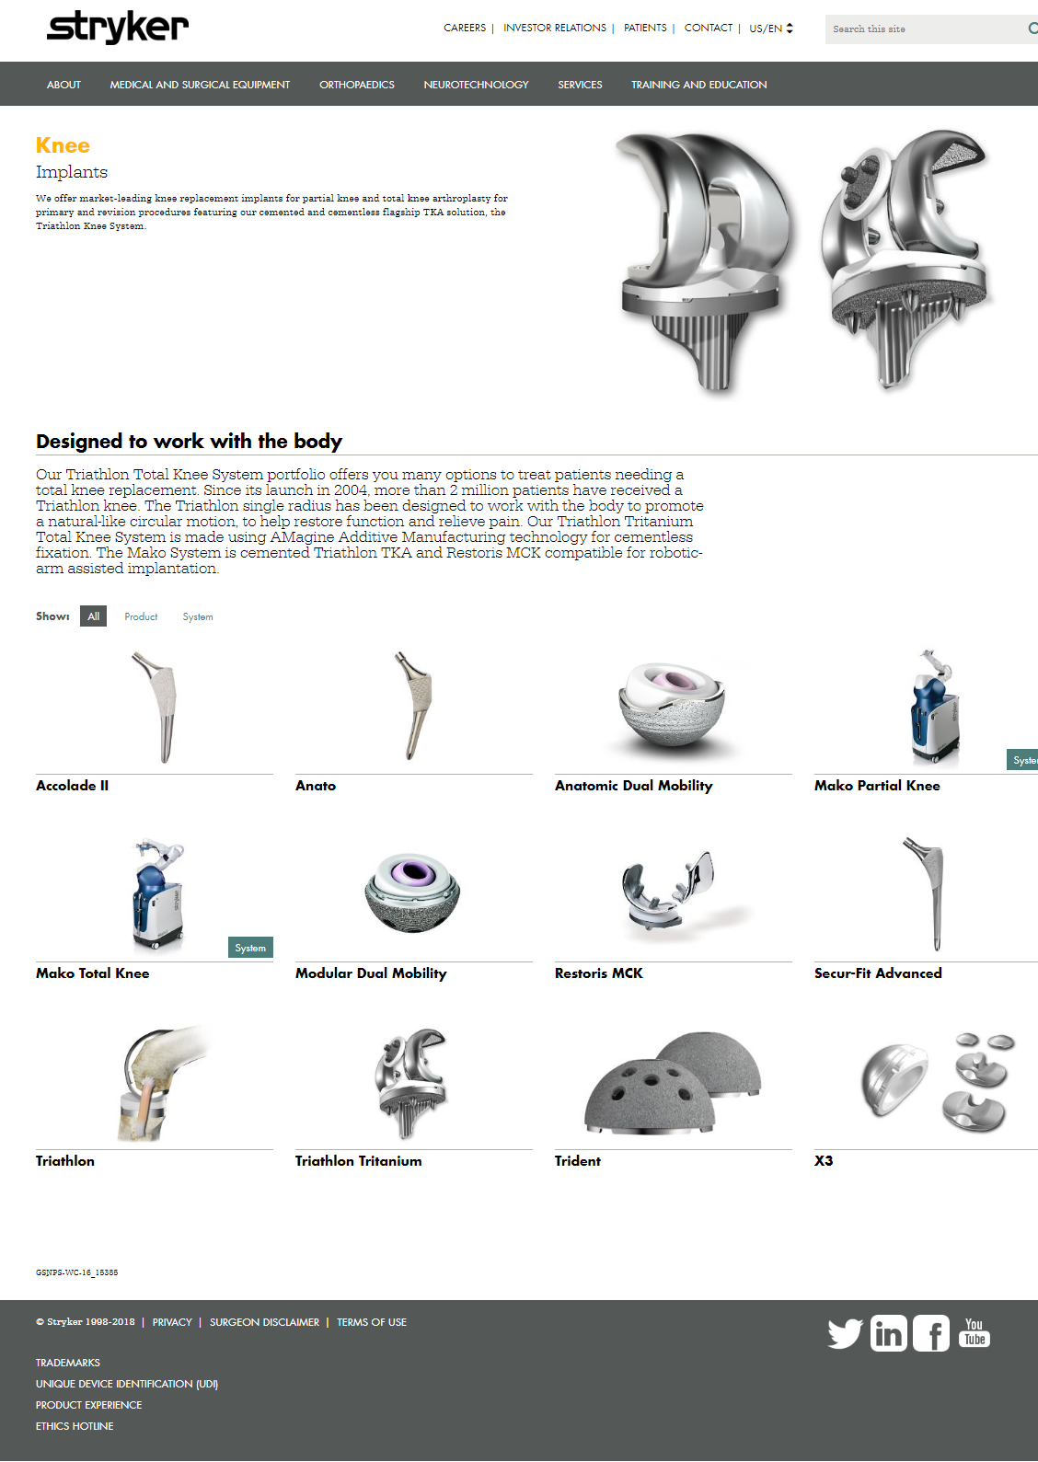
Visitor Experience: Brand Architecture
Homepage
Level 1
Level 2
Level 3
Portfolio
Capability
Specialty
Product, system, procedure
What is a portfolio, capability and specialty page?
These are the three page types that form the product Brand Architecture section of the site.
The page types form a loose rather than a strict hierarchy because an item or product can exist in more than one place.
For example, the Spine capability appears in both the orthopaedic and neurotechnology portfolio.

Slide 10
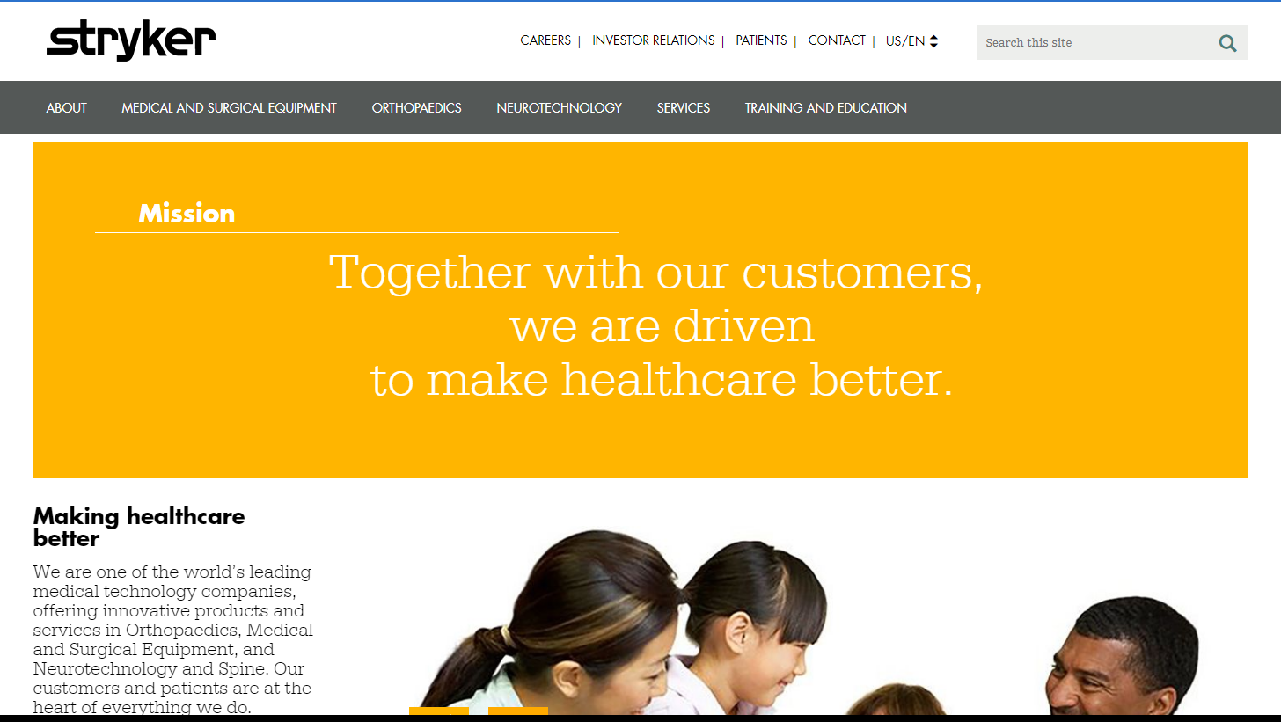
How products appear on Stryker.com
All Products appear under a Portfolio
Portfolios are determined by the Brand Architecture which is defined by the Company Brand team.
What is a portfolio?
First level of the hierarchy
Portfolio pages reflect the main product segments of Stryker's offering
There are only four portfolios on the site: medical and surgical equipment, orthopaedics, neurotechnology, services
Portfolios

Slide 11
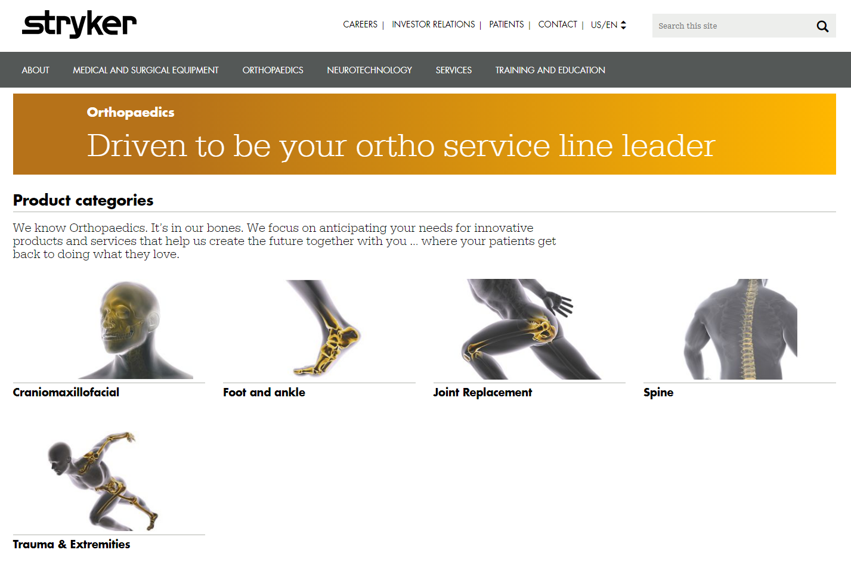
How products appear on Stryker.com
All Portfolios have Capabilities
Capabilities are defined by the Company Brand team with input from businesses
What is a capability?
Second level of the hierarchy
Capability pages represent product groups within a given portfolio
The labels within this group generally use functional or operational terms (e.g. bedframes, joint replacement, CMF implants, etc.)
Capabilities

Slide 12
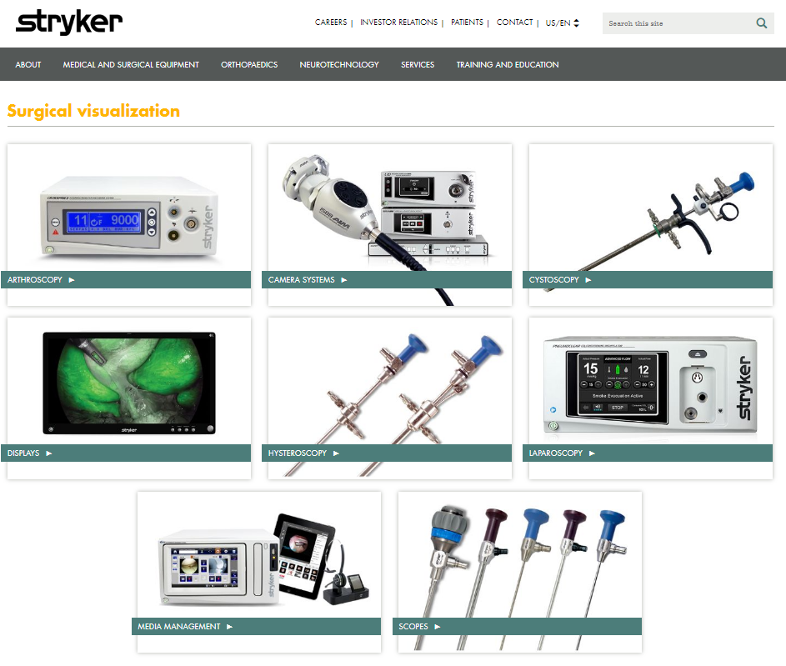
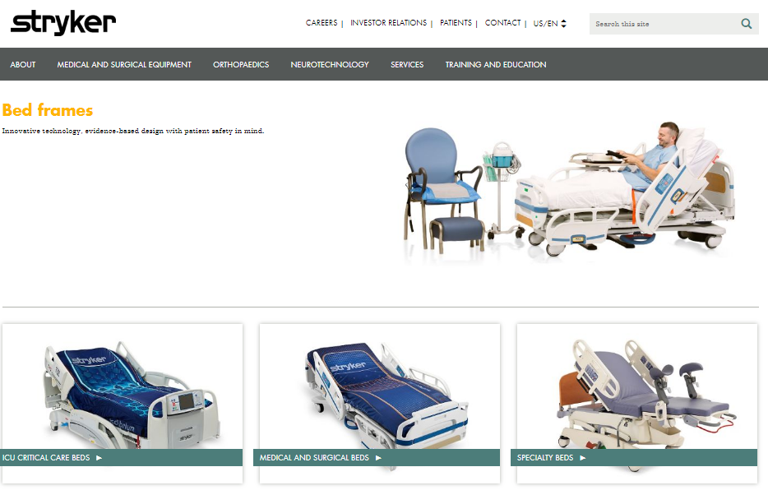
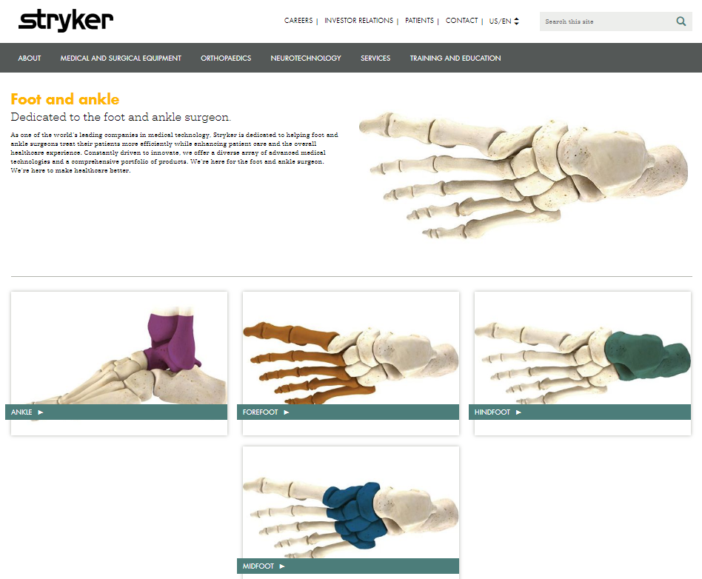
How products appear on Stryker.com
All Capabilities contain products which may be grouped into Specialties; Specialties are determined by the brand team and business units.
What is a Specialty?
Optional third level of the hierarchy
Specialty pages communicate sub-categories based on language customers would use to classify products and services within the capability
Specialties

Slide 13
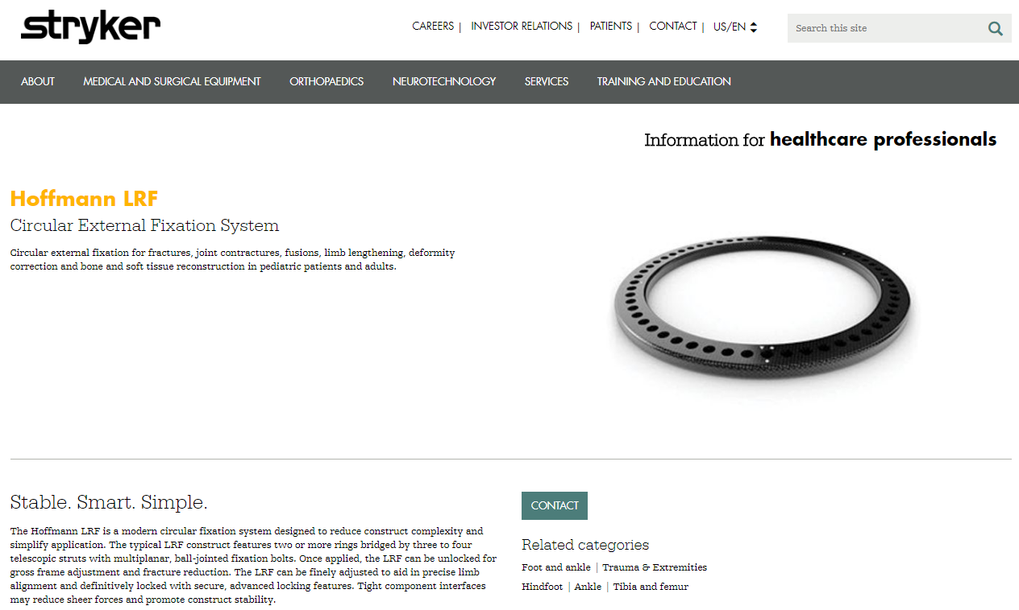
How products appear on Stryker.com
Businesses can ‘push’ products to respective Brand Architecture pages based on how a product is tagged.
Products on a
Capability page
Products on a
Specialty page
Product page
Capabilities
Specialties
Notes:
We’ll go over tagging product pages later in the presentation.

Slide 14
Business unit folders
Product and business content

Slide 15
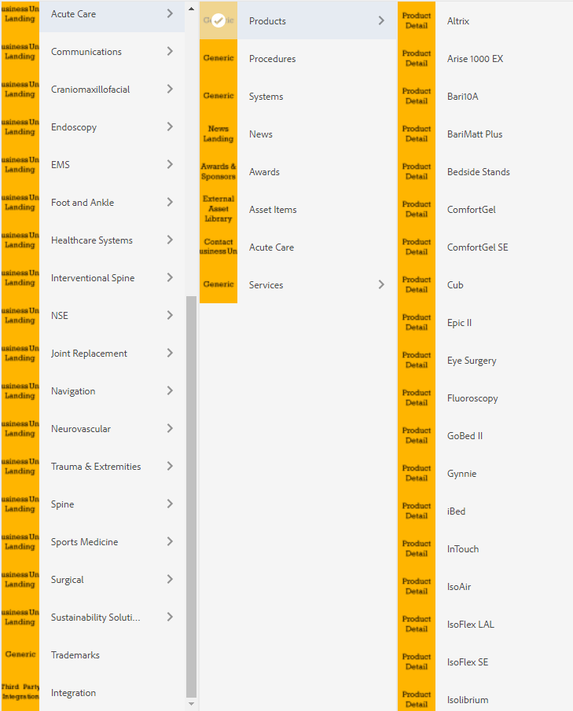
Business Unit Hierarchy
Products
Each business unit folder consists of the following sections:
Business unit landing page
Contact Information page*
Optional
Products
Procedures
Systems
Services
News
Awards
Asset Library
Etc.
* = required for a presence on Stryker.com
Notes:
Each business unit folder contains sections that hold specific pages types, such as products, contact information, and procedure pages.

Slide 16
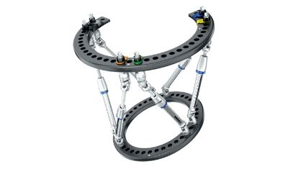
Template basics: Product Content-types
https://www.stryker.com/content/userguide/us/en/faqs/authoring1.html
Page type | Usage
Product page | Most likely associated with a single SKU Contact information is aligned to a single business Call to action drives to a business' contact info
Procedure page | Identifies a group of products used for a procedure Contains collateral and media specific to a procedure Call to action drives to individual product pages
System page | Identifies group of products that may be sold together to illustrate a continuum of services/care Positioned to "upsell" Offering can span multiple businesses, portfolios and/or capabilities Call to action drives to individual product pages
Notes:
This is a list of the product based page templates for you to reference

Slide 17
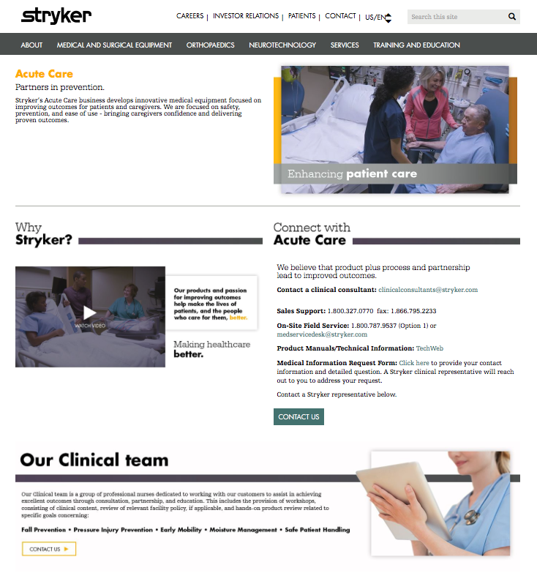
BU landing page template
The business unit landing page is where specific units can develop content that speaks directly to their customers, employees and partners. This landing page should include basic “About Us” content for the business unit but also include content to for product launches, campaigns and other marketing efforts.
This page will be available via the global navigation under the "About - Our businesses" section of the megamenu.
Alternatively, businesses that want to promote their page externally can request IS to have a subdomain setup, (e.g. stryker.com/[business unit].) that will point to the business unit landing page.
The content owner is responsible for populating and maintaining content via the CMS for the business unit. Division heads with Digital Communications are responsible for determining whether a business requires a unique landing page. All content shall be routed through their divisional collateral material review process. For training and content or image specifications refer to pages within this site.

Slide 18
Overview
Standard Components

Slide 19
Standard components overview For additional components, information and governance around components, please visit: https://www.stryker.com/content/userguide/us/en/components.html
I want to… | Component to use | Details
Add text to a page | Rich Text Editor | Enables authors to create free form paragraphs of text that reflow when the browser is resized. This will be the primary component authors will use to create page copy. The configuration details for this component are described below. Show dimensional box: Renders a drop shadow effect around the RTE box Background color: Renders a solid color or gradient behind the text Gradient Direction: Sets the direction of the gradient Invert Gradient Direction: Reverses the direction of the gradient set above
Create word art or a large typographic effect | Large headline | Enables the author to create vibrant headers with different color and design options with text that resizes when the browser resizes. You are able to even create infographics with this component The configuration details for this component are described below. Title: Defines the first line of text Description: Defines and second line of text Background color: Select background color; options are solid color or gradient Gradient direction: Sets the direction of the gradient Invert gradient: Reverses the direction set above

Slide 20
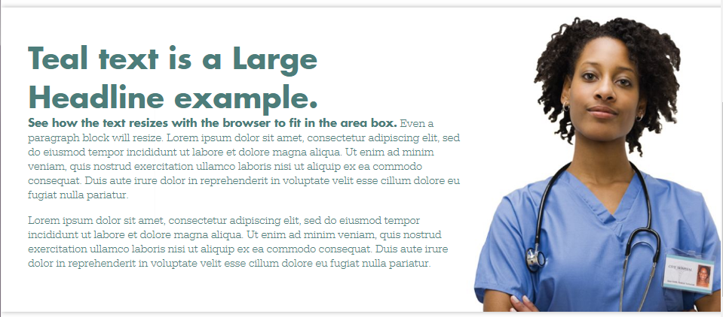
Comparison: Large Headline with RTE
Large headline
RTE
Text resizes on smaller screens so layout remains generally consistent even on smaller screens.
Text stays the same size and reflows on smaller screens; can overflow as shown in the gray area.

Slide 21
Standard components overview (cont’d) For additional components, information and governance around components, please visit: https://www.stryker.com/content/userguide/us/en/components.html
I want to… | Component to use | Details
Add an image | Stand alone image | Enables authors to curate a free form image from the DAM. This is the primary component authors can use to place images on pages.
Add a video | Stand alone video | Allows the content author to place and play inline video from the DAM or embed a video from YouTube.
Link to documents stored on a 3rd party server | External Asset library | The external asset library allows authors to manage details of assets hosted on an external site (e.g. GCS/CDN or another 3rd party server) or the AEM DAM for use in a single place for reuse in various Resources and Downloads components.

Slide 22
Publisher role
Key
Responsibilities

Slide 23
Publishers only: Creating a Product/System/Procedure Page
As a publisher, you have the rights to publish and unpublish a page. If you need to delete a page or asset please submit a request on Workfront.
As a publisher, if you are working with UPDATERS you will need to create the folders, pages and tags before UPDATERS can begin editing/uploading content.
There are 3 steps to create a page in AEM.
Step 1: Create a folder for the new product in the DAM
Step 2: Create product tags
Step 3: Create a new product page

Slide 24
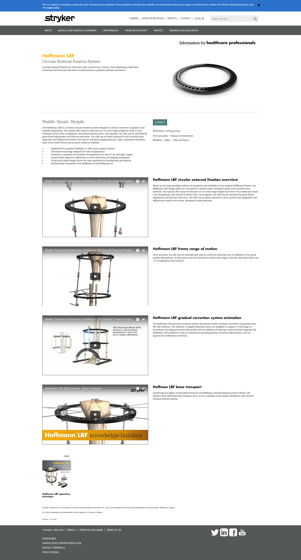
Product Page sections
Required Content
HCP content banner
Page title
Subtitle
Description
Hero Image
Short Description
Contact button
Tags
Customizable area
Disclaimer
Content ID
= important for Search Engine Optimization (SEO)

Slide 25
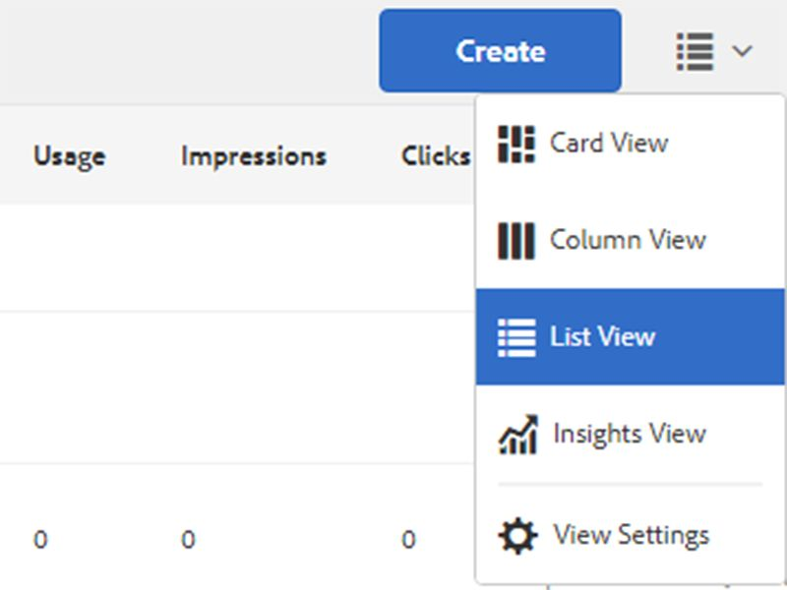
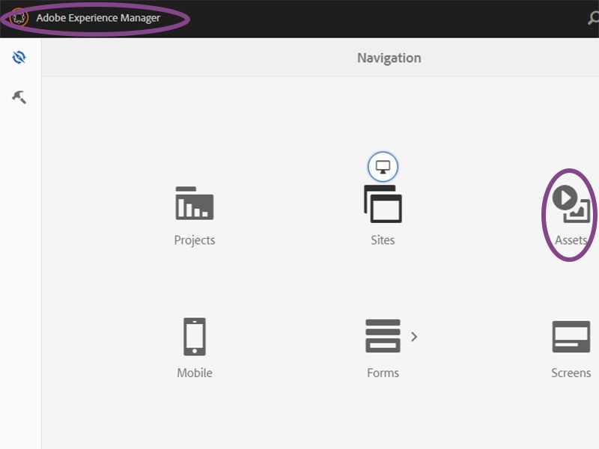
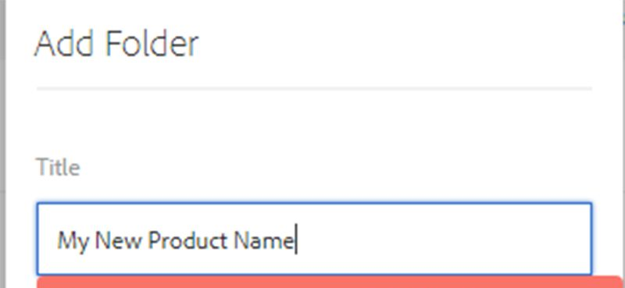
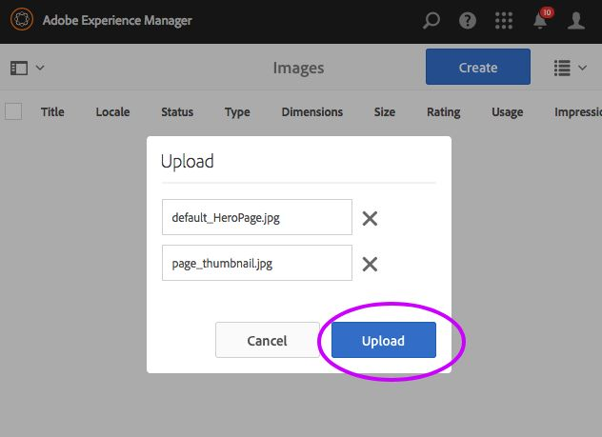
Step 1: Create a folder for the new product in the DAM
1. Click the AEM icon and select "Assets" or click the link below to go to directly to the DAM. Digital Asset Manager (DAM)
2. Change to "List view".
3. Browse to your businesses' folder in the DAM and navigate to the products folder. (e.g. Stryker > (Business unit) > Products)
Create a folder named after the brand name of your product.
4. Navigate to the new product folder. Inside the folder, create 3 new folders titled: Images, Videos, Resources.
5. Upload a thumbnail and optional hero image into the Images folder for the product. (drag and drop)

Slide 26
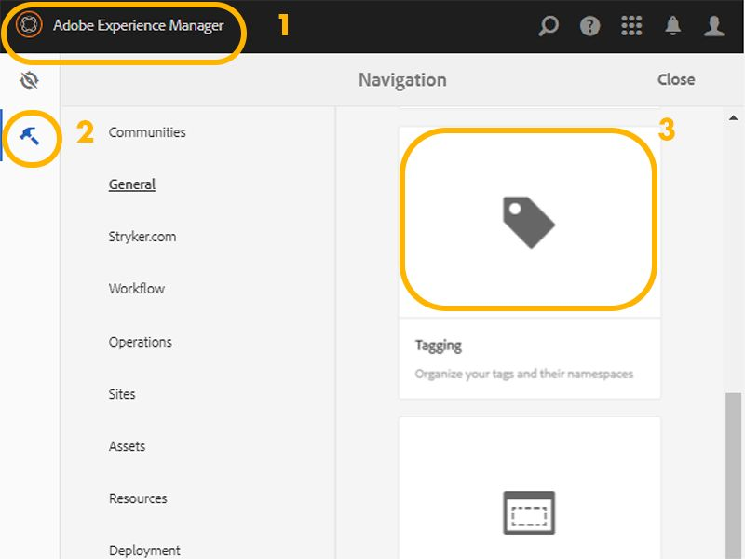
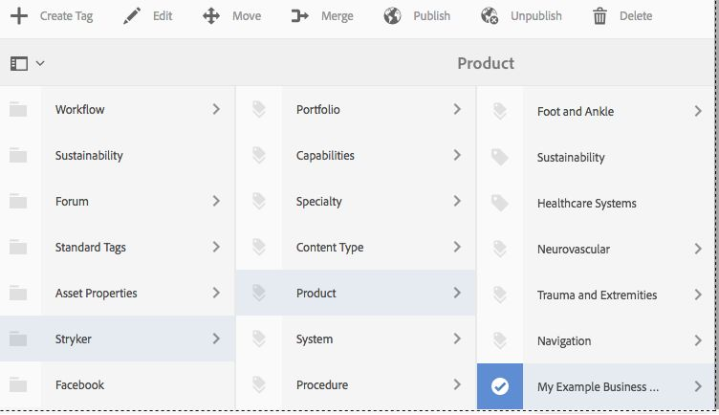
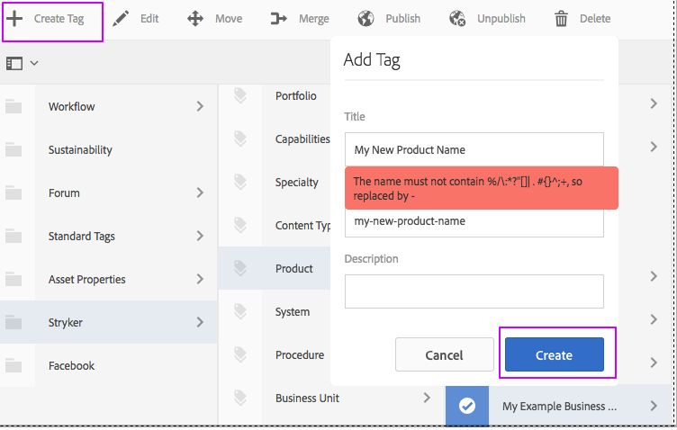
Step 2: Create tags
1. Click the AEM icon and click the tool icon and select the Tagging application icon or click the link below to go directly to the product tags. PRODUCT TAGS
2. Navigate to the Products folder for your business unit. (e.g. Stryker/Products/<business unit>) and click the folder icon next to it so a checkmark appears.
3. Click "Create Tag" and create one for the new product you will be azdding. Each product page must be associated with a unique tag.
Click on the tag(s) that was just created and click "Publish"

Slide 27
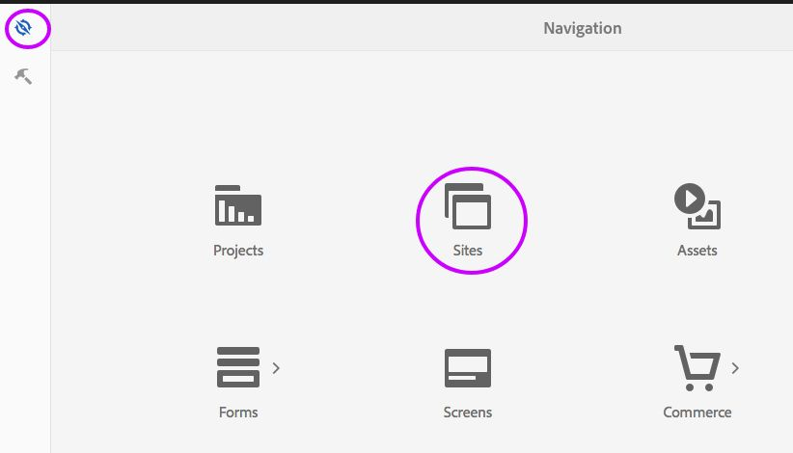
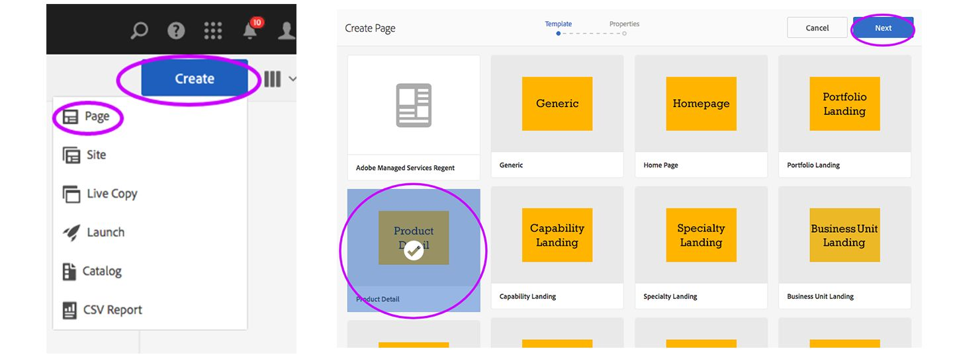
Step 3: Create a new page
1. Click the AEM icon and click the tool icon and select the Sites icon.
2. In Sites, navigate to the Products folder for your business unit. (e.g. stryker/us/en/<business unit>/products) and click products folder so it turns blue.
3. Click "Create " and create a new page using the Product Detail template.
4. Enter the product brand name as the page title
5. Content type and HCP content tags will automatically be added to the page.
Continue to next slide…
.

Slide 28
Step 3: (continued) Create a new page
Add the following tags:
Business unit tag: The business unit tag determines how the Contact button will behave.
Product Tag: Add the product tag you just created, this product tag drives things like related products, ProCare badges.
Click "Create".
Continue to next slide…

Slide 29
Step 3: (continued) Create a new page
7. Select to "Open" the page and navigate to the page properties and populate the required items: Thumbnail, subtitle, description and Content ID. Click the checkmark to save the changes.
8. Populate the required page content: Hero image and short description.
Add any optional components to the customizable area.
Once the content has been approved by your local business processes you may publish the page.

Slide 30
Page Creation Checklist for Publishers
Create a new folder in the DAM under Stryker/(business unit)/(respective folder)
Upload an image that will be the thumbnail = image that would appear when the page is referenced in the capability and specialty pages
Create new tags in the tag application under Stryker/(business unit)/(respective folder)
Create the new page in AEM using the respective template, and populate the required items under Page Properties:
Thumbnail = image of the product that would appear when the page is referenced in the capability and specialty pages
Page title = name of the product, system, procedure
Subtitle = what the product “is” using keywords a person may type into a search engine.
Description = Product abstract; 1 – 2 sentences that describes the product that in a way that would appear in Google search results;
The description will be reused throughout the site when the page is referenced by other components. Do not make any marketing claims that would require references or a disclaimer
Content ID = ID that’s provided when it goes through divisions routing and approvals
Tags: - Content type: Product (prefilled) - Business unit: (selecting your business unit defines the Contact button)
When the page has been created, populate the required page content:
Hero image
Short description
For additional information, please visit our resource center.

Slide 31
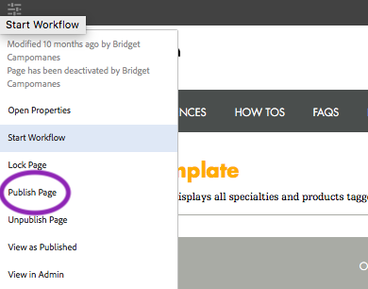
Publishers only: Publishing a page
Make sure to go through and check off each point on Checklist for Publishers (next slide)
2a) Navigate and make sure the page is selected (check mark) and click publish in the navigation bar
2b) Click the hamburger menu on the top left hand corner of the page you want to publish and click publish page.
-or-
If a page is published multiple times within a short period, it may take several minutes for the latest changes to be reflected on the live site.

Slide 32
Publish Checklist
Verify the page has all required information completed
Page title = name of the product, system, procedure
Subtitle = what the product “is” using keywords a person may type into a search engine.
Description = Product abstract; 1 – 2 sentences that describes the product that in a way that would appear in Google search results;
The description will be reused throughout the site when the page is referenced by other components. Do not make any marketing claims that would require references or a disclaimer
Content ID = ID that’s provided when it goes through divisions routing and approvals
Product/System/Procedure pages
Thumbnail = image of the product that would appear when the page is referenced in the capability and specialty pages
Tags: - Content type: Product (prefilled) - Business unit: (selecting your business unit defines the Contact button) - Portfolio, Capability (Speciality)
Hero image
Short description

Slide 33
All roles
General
Responsibilities

Slide 34
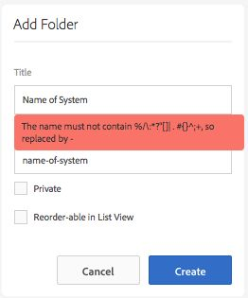
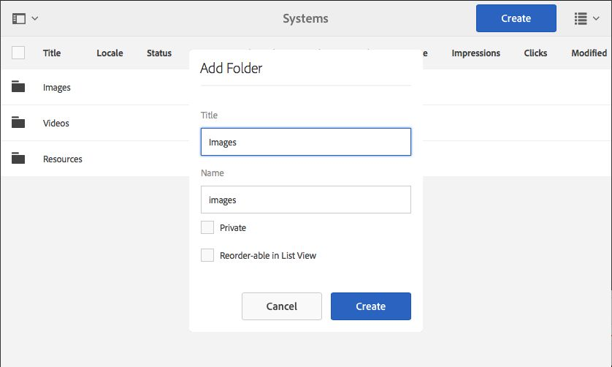
Uploading resources and assets
1. Click the AEM icon and select "Assets" or click the link below to go to directly to the DAM. Digital Asset Manager (DAM)
2. Change to "List view".
3. Browse to your businesses' folder in the DAM , navigate to the respective folder or create a new folder.
4. Open and/or create the folder you want to add the assets in.
5. Drag and drop the assets into the window and click “Upload”
6. Select the image and click “View Properties” in the tool bar. Add a description of the image in the “Alternate Text *” box.
= important for Search Engine Optimization (SEO)

Slide 35
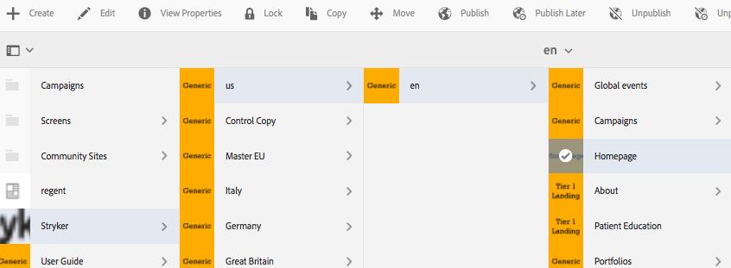
How to edit an AEM page
1. Navigate to the page you want to edit. Click the page you want to edit making sure there’s a check mark and on the nav bar, click “Edit”
2. Most times the page will open in “Preview” mode. Change to ”Edit” mode by clicking Edit on the top right hand corner

Slide 36
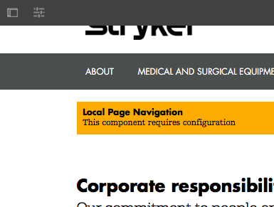
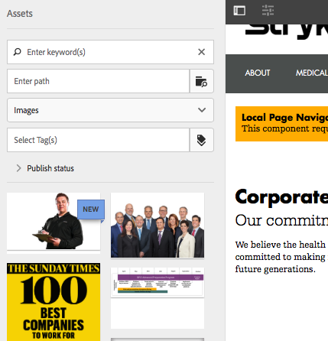
Adding images to pages
Any assets, e.g. images, on stryker.com will need to be loaded into the DAM (Digital Asset Manager). To add an image on a page, first insert a component that supports the display of an image. To find an image to place in a component:
1. Click the ”Toggle side panel“ icon in the tool bar.
2. Click the folder icon to browse the “DAM > Stryker” structure. Images will appear in the side panel; click and drag images into the component.
Notes:
Show image size guidleines

Slide 37
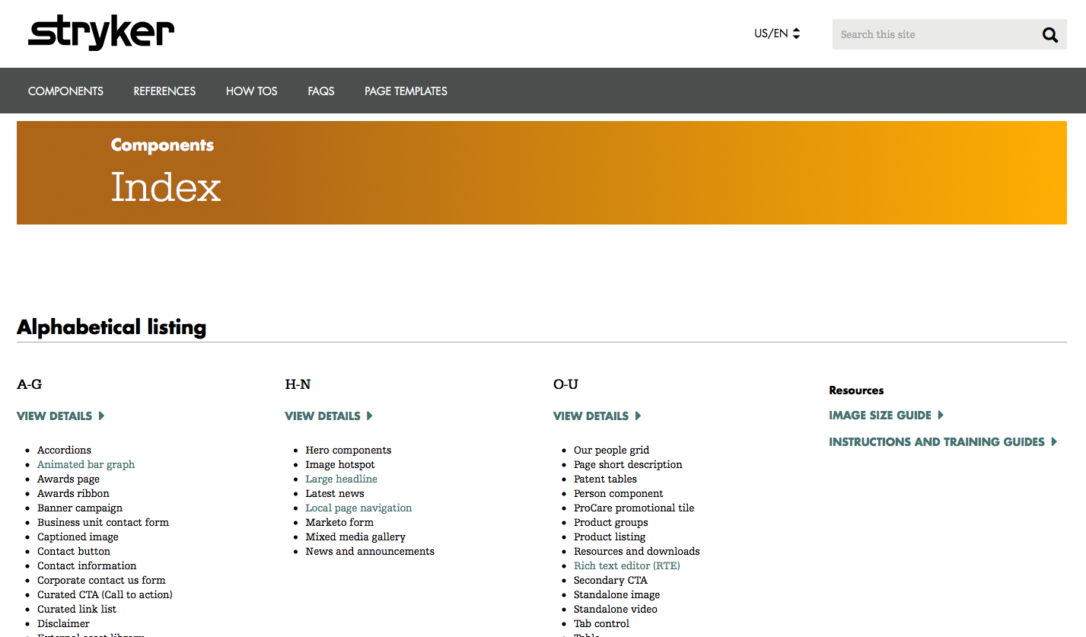
Stryker.com Resource Center
https://www.stryker.com/content/userguide/us/en/components.html
Stryker.com Resource Center is constantly being updated with new/updated components (which includes - overview, governance, user manuals and examples), how to’s, and information on specific page templates.
For additional support please reach out to us on Workfront.

Slide 38
Contact us
For all further inquiries please find us on Workfront and submit a request.
https://www.stryker.my.workfront.com

