Slide 1


Experience Fragments
Resized for Mobile
Notes:
Brittany
Mention project jungle gym was part of this list but put on hold

Slide 2
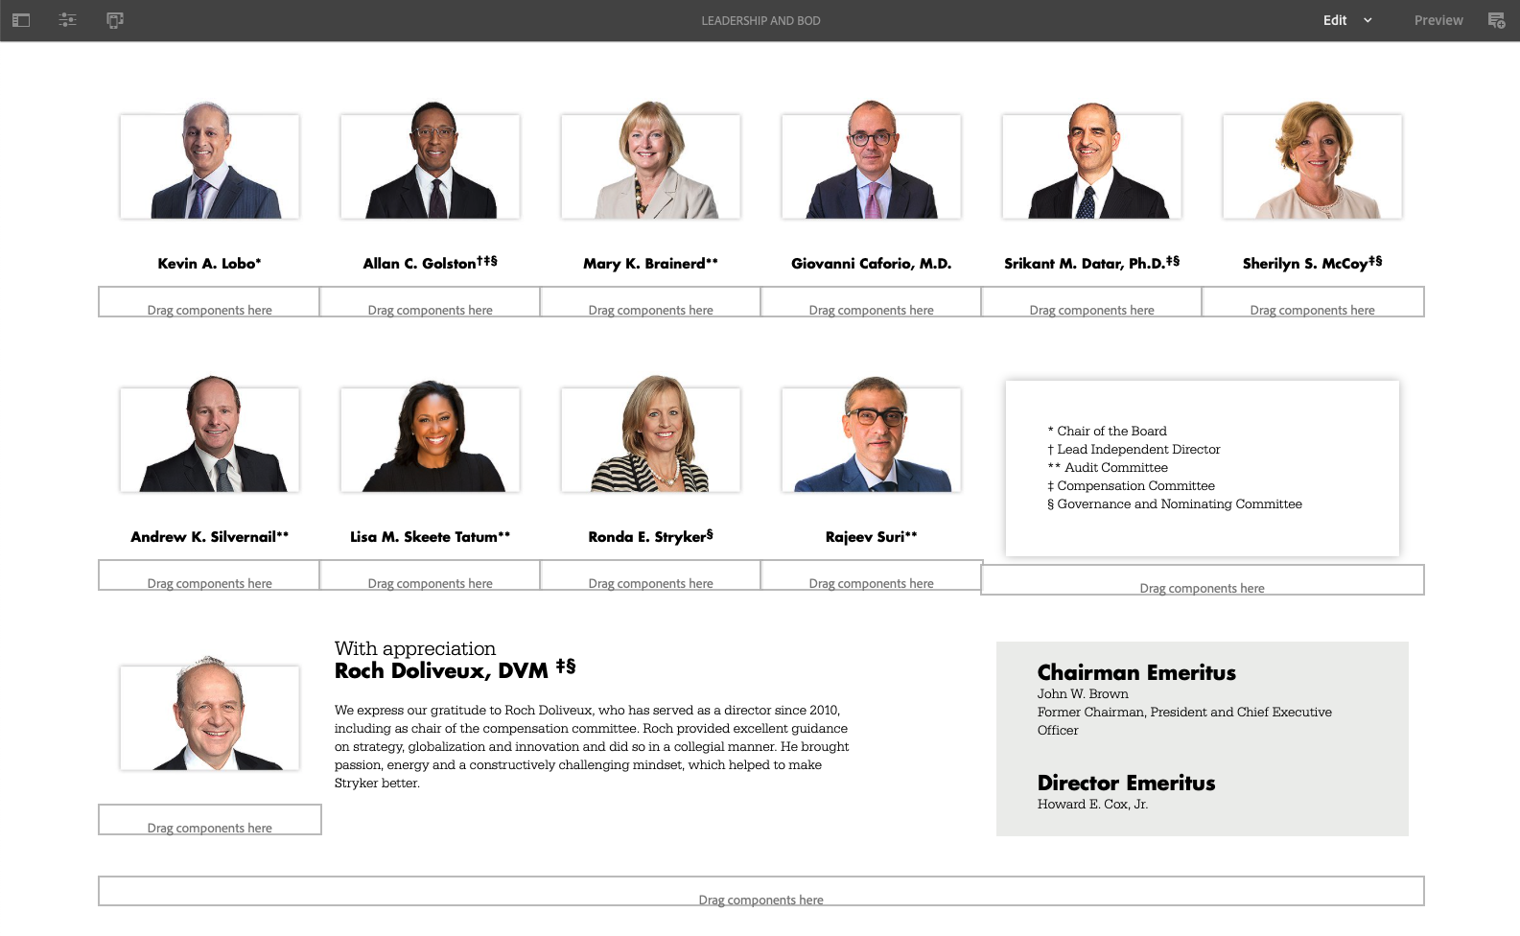
Optimizing your experience fragment design for both Desktop and Mobile is extremely important and if neglected will result in a poor experience for most Mobile users.
Step 1.) To get started click the “Emulator” icon at the top left of your experience fragment page.
Notes:
Brittany
Mention project jungle gym was part of this list but put on hold

Slide 3
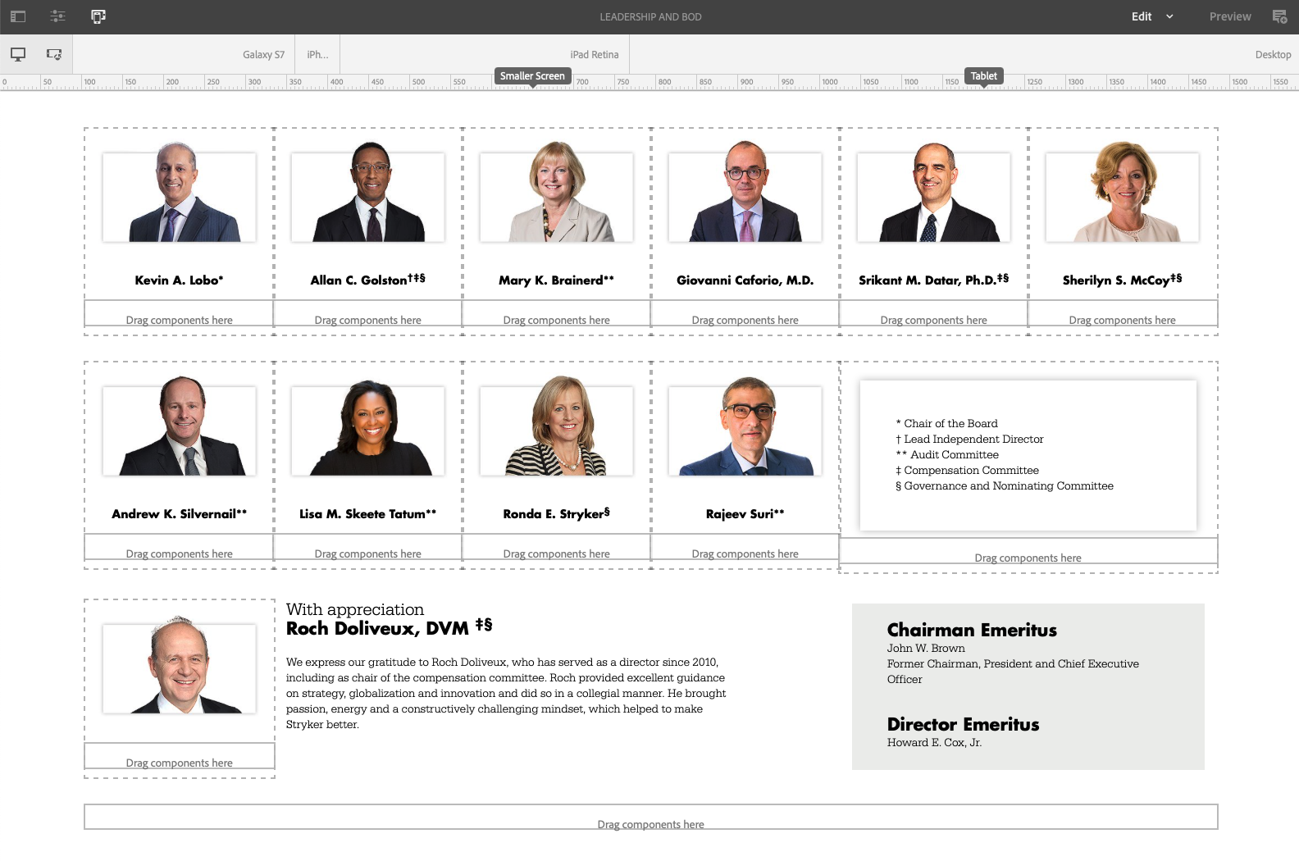
Step 2.) The Emulator panel should appear at the top of the page. Here you have options to see what your design will look like for “Desktop”, “iPad”, “iPhone” or “Galaxy”.
Notes:
Brittany
Mention project jungle gym was part of this list but put on hold

Slide 4
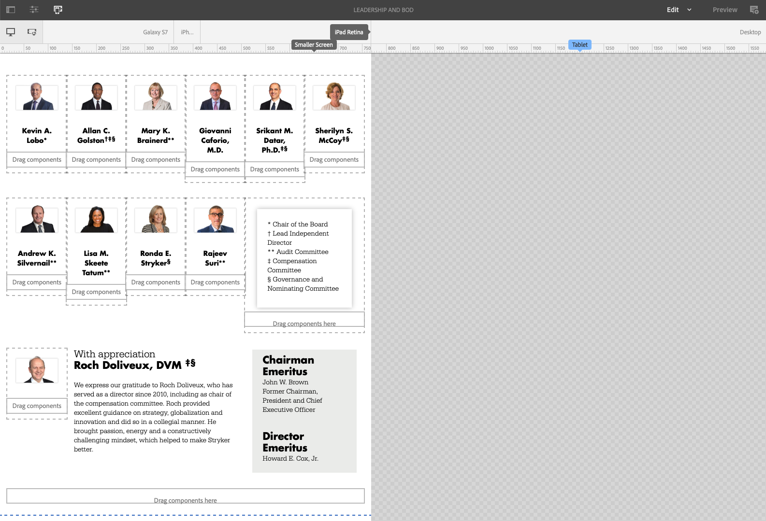
Step 3.) Select one of the new sizes and your page will be shrunk down to the adjusted size. Here you can see how your page will look, while also being able to adjust the design.
Notes:
Brittany
Mention project jungle gym was part of this list but put on hold

Slide 5
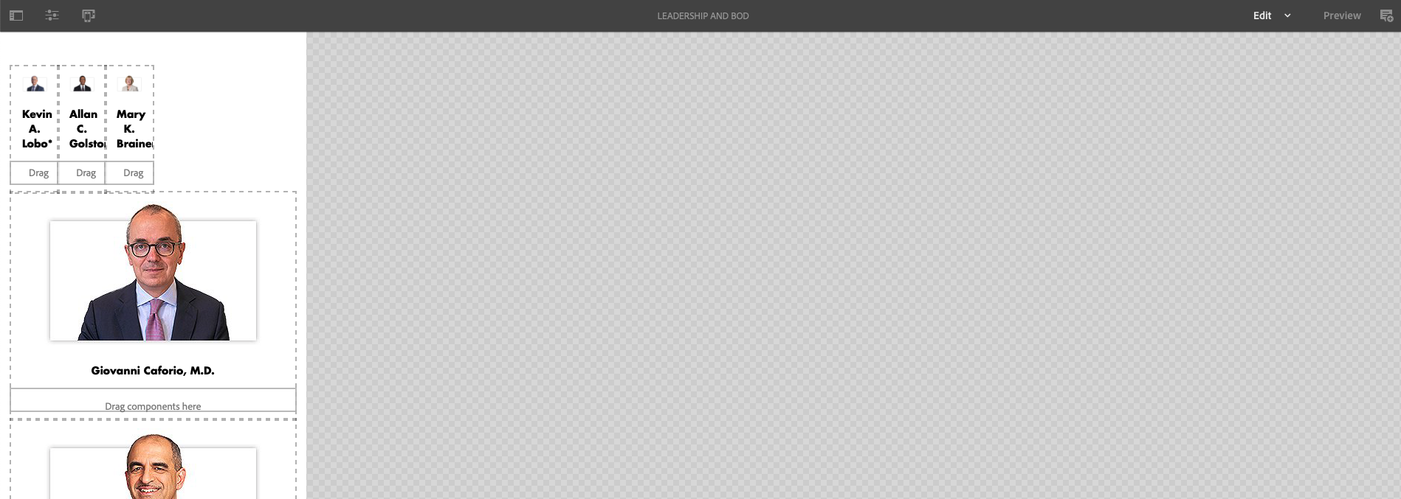
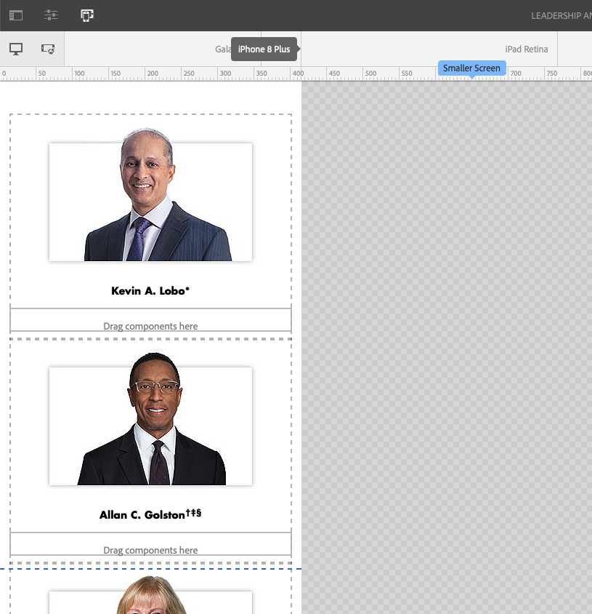
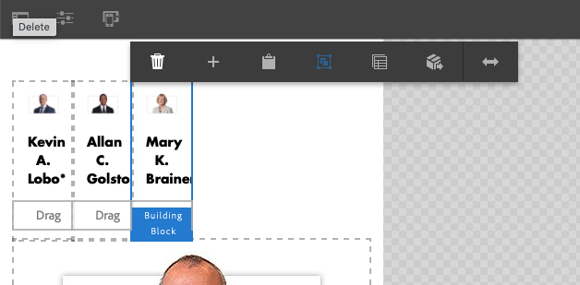
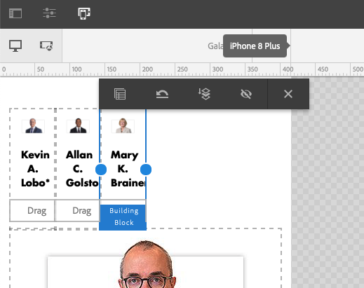
Step 4.) If the new page size displays images or content that is grouped poorly, you can select the component you want to adjust, then clicking the “Layout” icon from the toolbar, and then adjust its size by pulling the blue dots to the left or right.
Once adjusted, you can click through each view and see your newly adjusted design.
Sidenote). Any edits such as reordering components, will be reflected across all sizes. This includes, text edits, image swaps, or color changes.
Notes:
Brittany
Mention project jungle gym was part of this list but put on hold

