Slide 1


Creating Full Width Carousel’s
With Experience Fragments
Notes:
Brittany
Mention project jungle gym was part of this list but put on hold

Slide 2
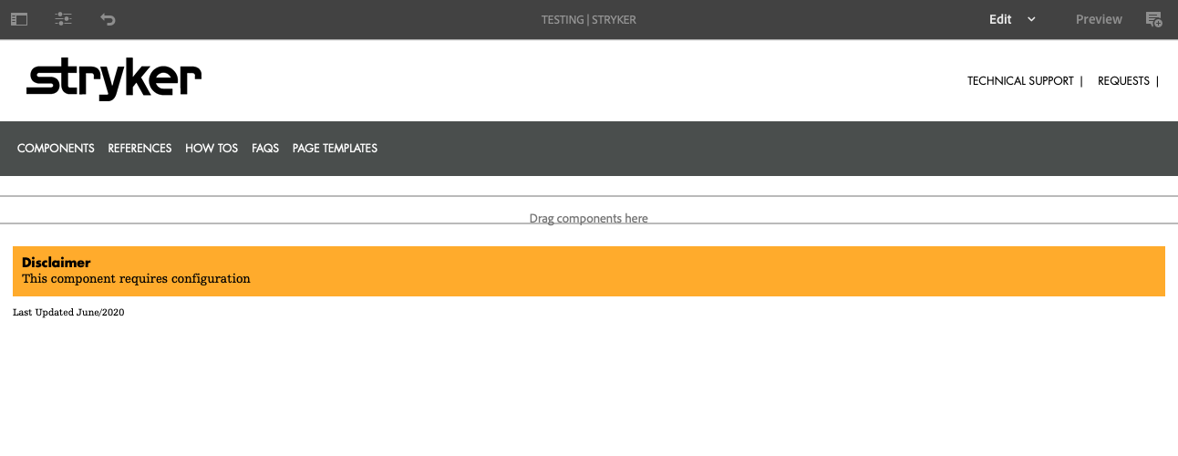
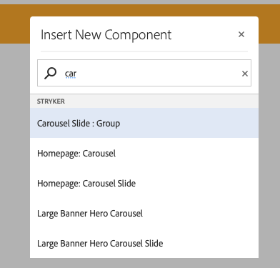
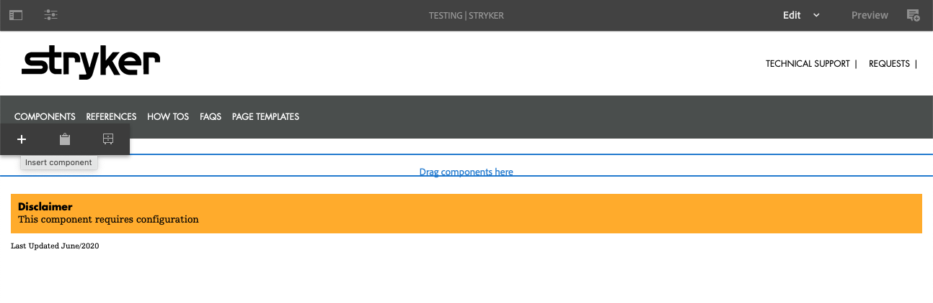
Step 1.) Open the page where you would like to insert the full width carousel and click the “Drag components here” section.
Step 2.) Select the “+” symbol from the pop-up menu. Then select the “Carousel Slide : Group” from the popup selections.
Notes:
Brittany
Mention project jungle gym was part of this list but put on hold

Slide 3
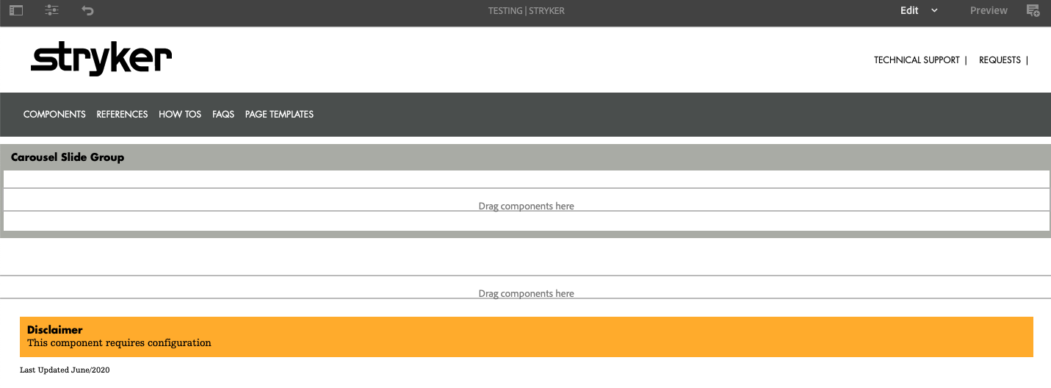
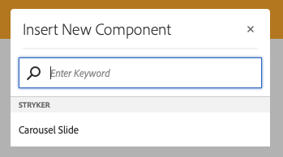
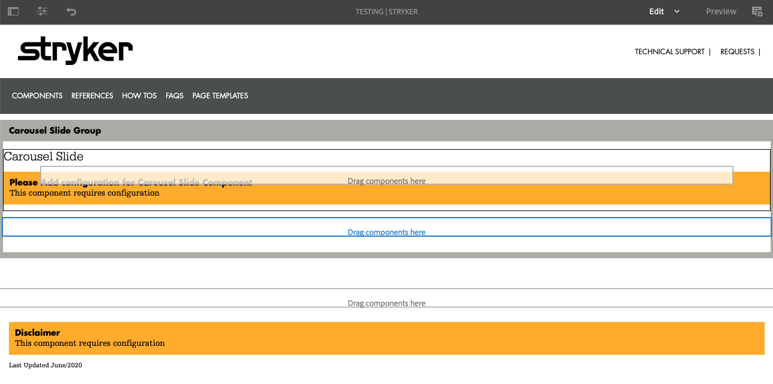
Step 3.) Click the “Drag components here” section that now sits inside of the “Carousel Slide Group” that was added to the page, and add the “Carousel Slide” component.
Step 1-3 Recap.) Once the above steps are completed your page should looks similar to this example slide, and you can start step 4.
Notes:
Brittany
Mention project jungle gym was part of this list but put on hold

Slide 4
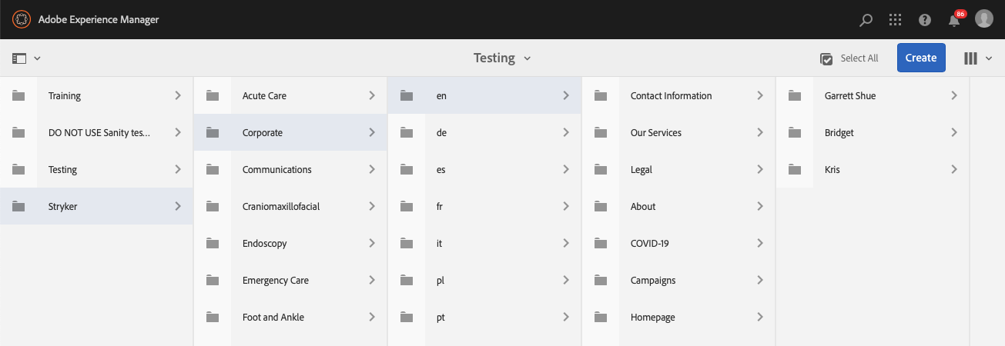
Step 4.) Navigate to https://author-stryker-prod.adobecqms.net/aem/experience-fragments.html/content/experience-fragments
to create the experience fragment needed for the full width carousel. Keep in mind you will need specific rights to create experience fragments for your business.
Navigate to the desired folder location for your experience fragment and select “Create”.
Notes:
Brittany
Mention project jungle gym was part of this list but put on hold

Slide 5
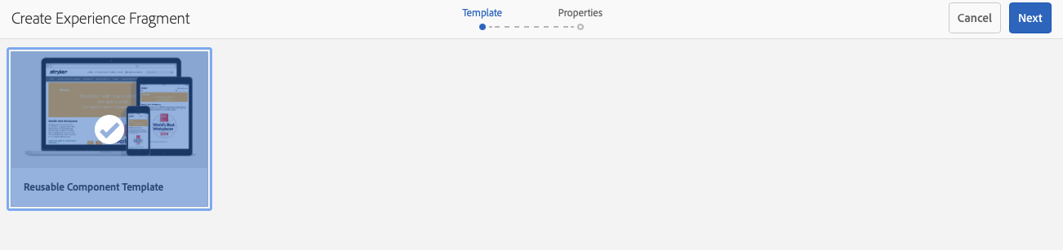
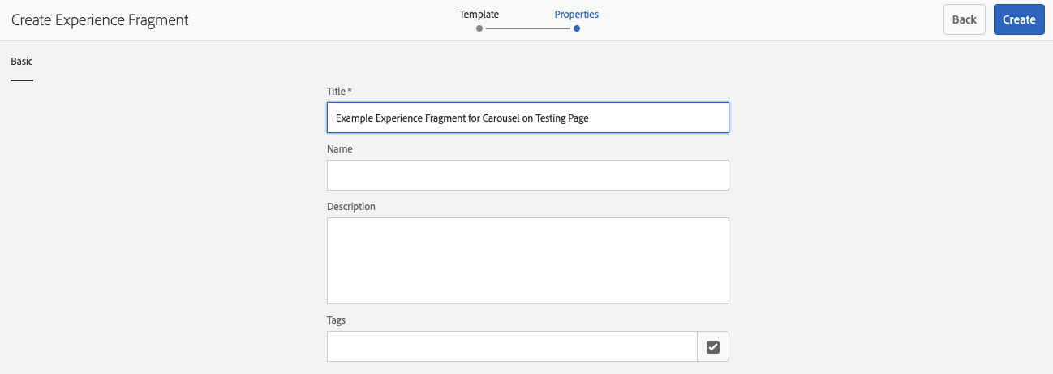
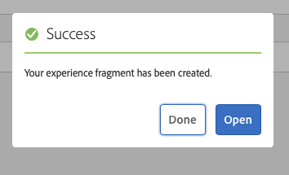
Step 4.) In the pop-up menu select “Reusable Component template” and then select “Next”.
Step 5.) Enter a name for your Experience Fragment and keep in mind case sensitivity. Then select ”Create” and “Open”.
Notes:
Brittany
Mention project jungle gym was part of this list but put on hold

Slide 6
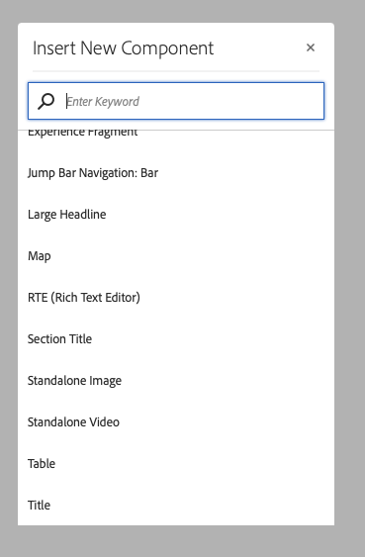
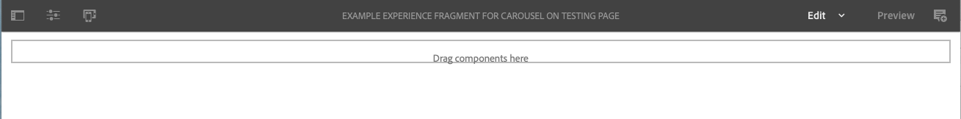
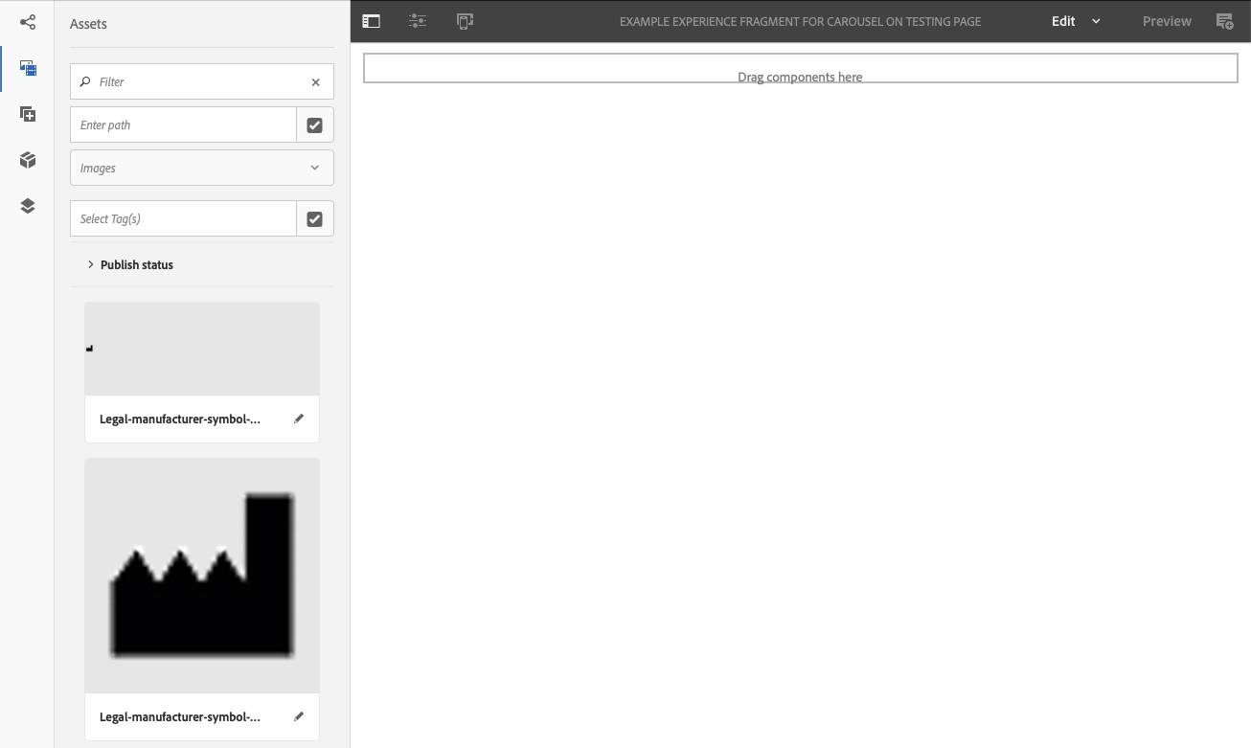
Step 6.) A new page will be opened for your experience fragment. Click the “Drag components here” box and select either a “Standalone Image” or “Standalone Video” depending on if you want your carousel to be a video or image. (For GIF files use the “Standalone Image”).
Step 7.) In the top left corner select the “Toggle Side Panel” Option, and then in the pop up side bar select the second icon labeled “Assets”.
This area is where you can see any assets that have been uploaded to the Stryker.com DAM. Recently uploaded images/GIFs will show up right away, while to see videos you will have to swap from “Images” to “Videos” in the 3rd customization area.
If the asset you are looking for is not recently uploaded you can use the “Enter Path” section to navigate to the folder where your asset is stored.
Notes:
Brittany
Mention project jungle gym was part of this list but put on hold

Slide 7
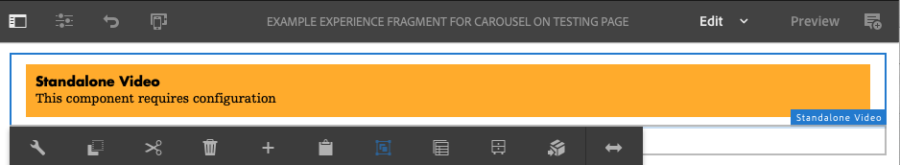
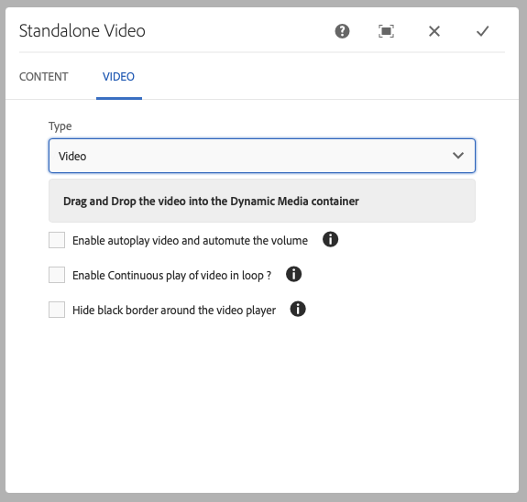
Step 8.) Once you have your asset in the side bar, you can start to configure your on-page component. For this example, we will be configuring a ”Standalone Video” component. Click on the component and select the “Wrench” icon. In the following pop-up menu select “Video” and you will be shown a few different options.
Step 9.) For videos you have the options of using a YouTube video or and asset from the Stryker.com DAM. For the carousel we recommend using a DAM asset.
Under type, select “Video” to enable DAM use. You will also see 3 other options boxes for customizing your carousel experience. These include:
Auto-playing the video for ambient video choices
Looping the video to play continuously for ambient video choices
Hiding any black borders that may appear around your video for an edge-to-edge look and feel.
Once you have made the selections you are content with select the “Check Mark” in the top right corner.
Notes:
Brittany
Mention project jungle gym was part of this list but put on hold

Slide 8
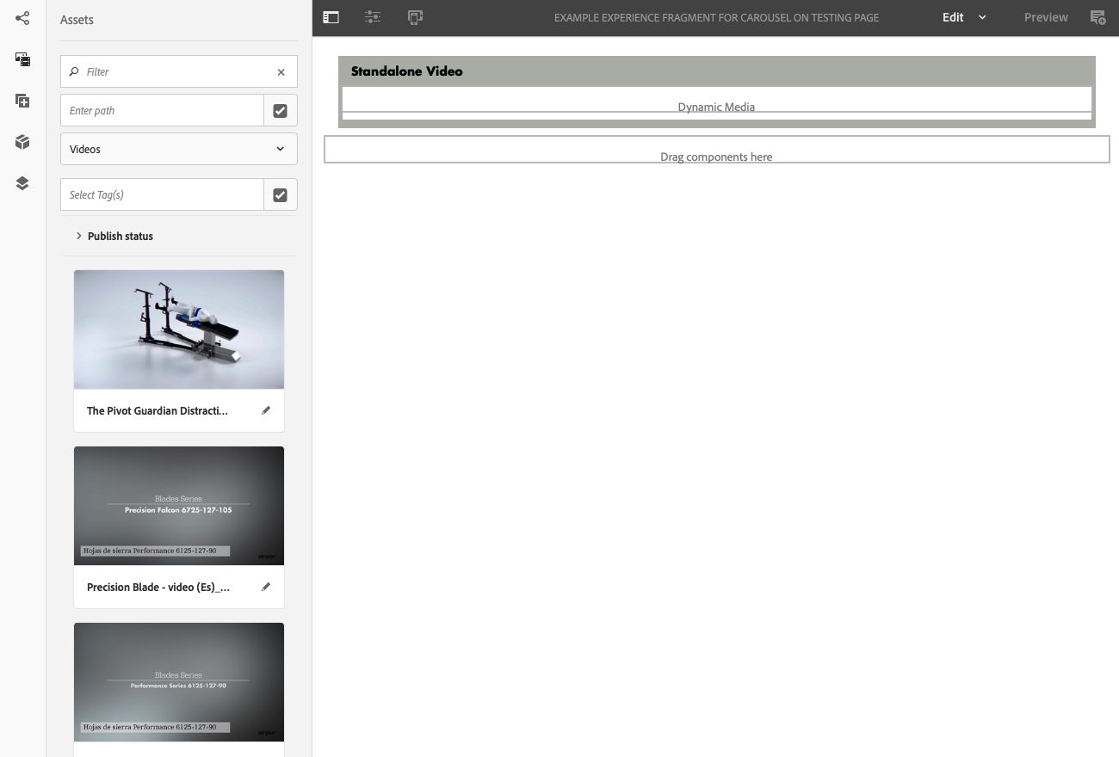
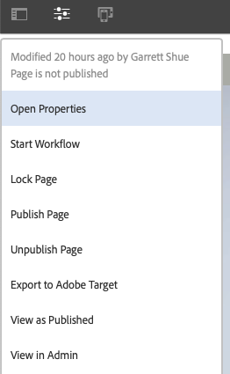
Step 10.) Your page should now resemble the page below. Drag and drop the video of your choice into the “Dynamic Media” section of the “Standalone Video” component. This will be the last step for the experience fragment and will place your video as a component on the page. The video will appear across the page but will not be edge to edge.
Sidenote .) When done editing your experience fragment, make sure the experience fragment as well as its video or image assets are published. If this asset is not published, then it will not appear in the production “View As Publish” proof. (This does not affect the Live page but will affect the proofing backend. )
To publish select the “Page Information” icon in the top left and then select “Publish page”
Notes:
Brittany
Mention project jungle gym was part of this list but put on hold

Slide 9
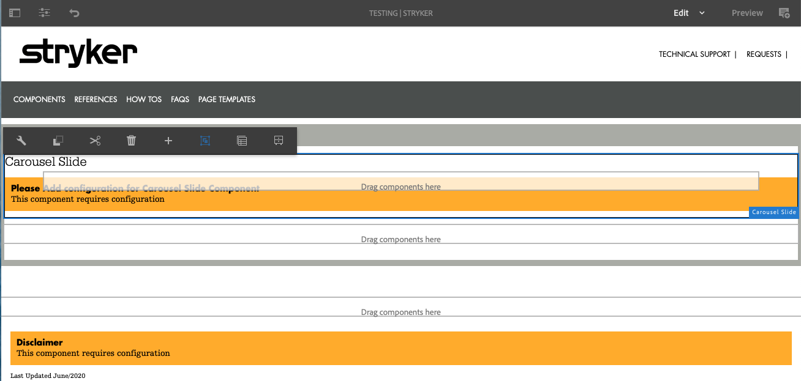
Step 11.) Navigate back to your original page where you created the “Carousel Slide Group”. Select the “Carousel Slide” and click the “Wrench” icon.
Notes:
Brittany
Mention project jungle gym was part of this list but put on hold

Slide 10
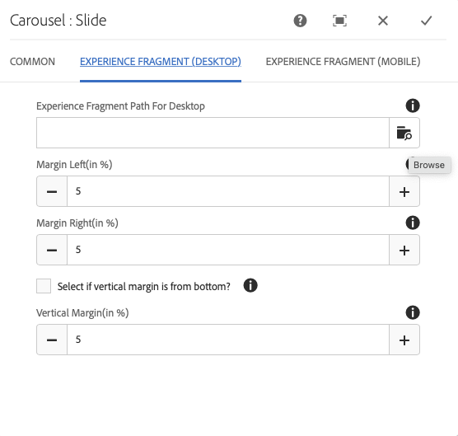
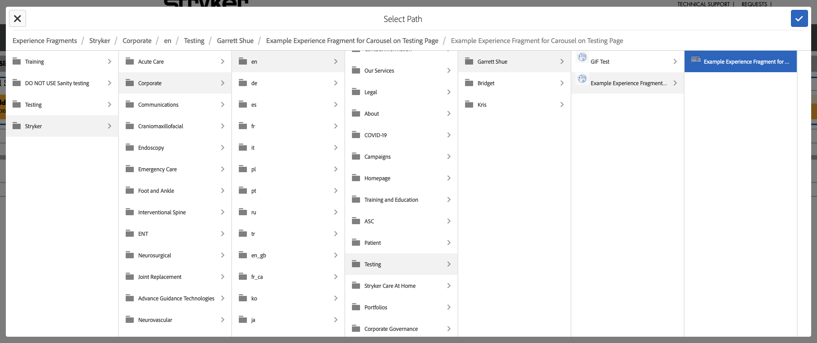
Step 12.) In the pop up menu select the ”Experience Fragment (Desktop)” tab option. Here you can
configure where text will appear overlaid on your video/image by adjusting the Margins for the text.
Under “Experience Fragment Path For Desktop” select the “Browse” icon and navigate to the location of your experience fragment. Make sure to select the child experience fragment and not its parent folder. Then click the “Checkmark” at the top right.
Sidenote .) You can create an experience fragment for Mobile view that differs from your desktop. Simply follow the same steps above to create a Mobile experience fragment, and then link it under the “Experience Fragment (Mobile)” tab option the same way you linked the desktop version.
Notes:
Brittany
Mention project jungle gym was part of this list but put on hold

Slide 11
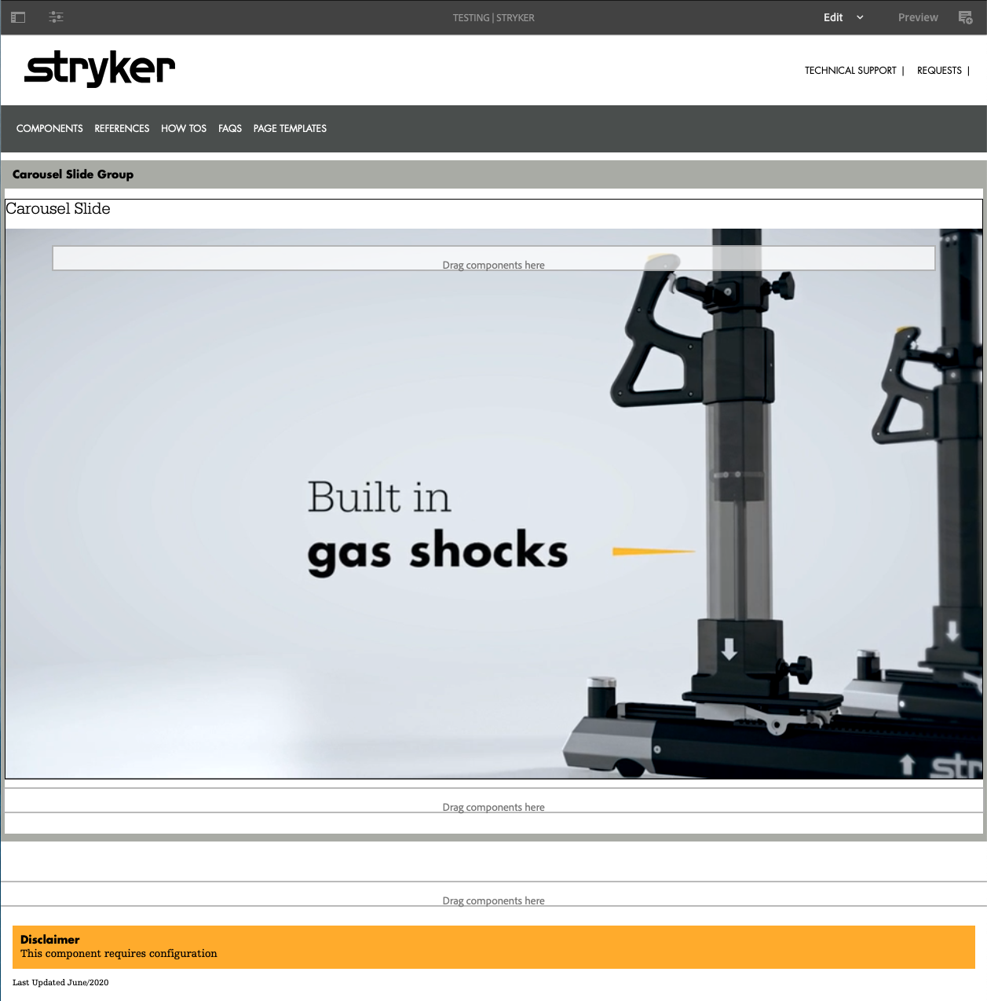
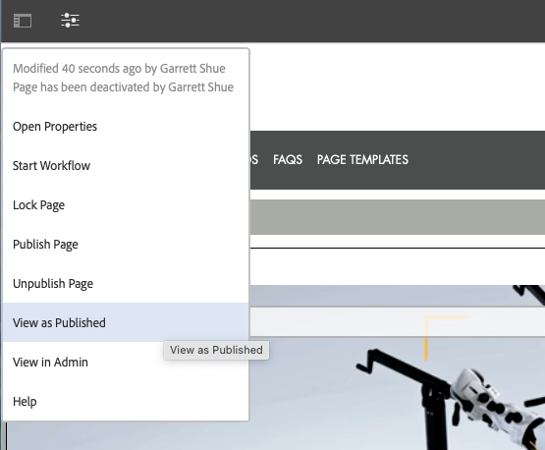
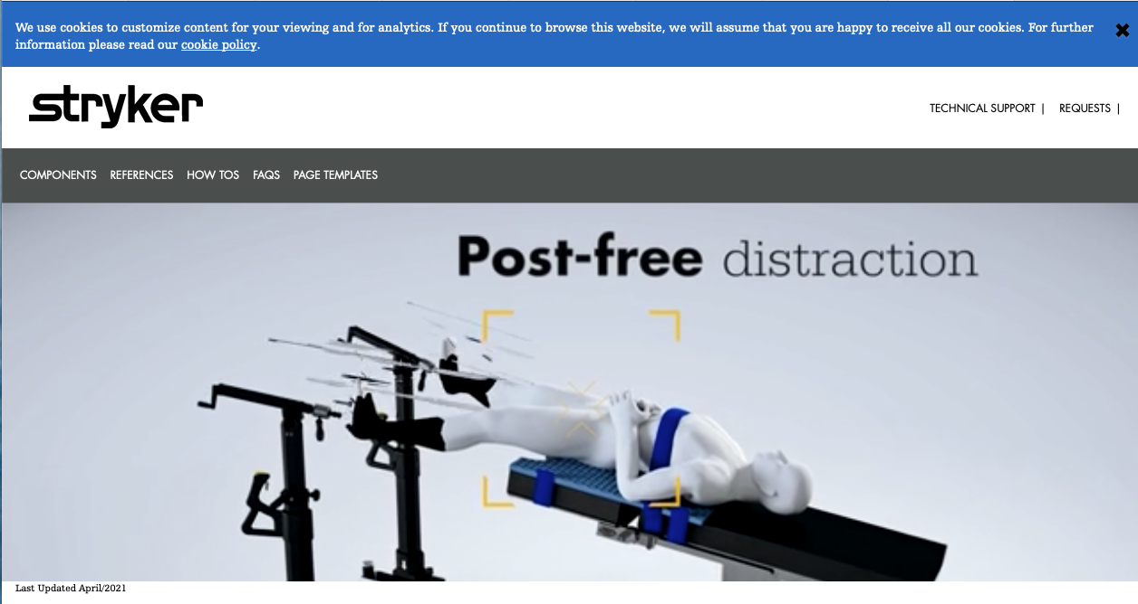
Step 13.) Once completed you page should have the video/experience fragment on page and any text you have added. Select the “Page Information” icon in the top left and then select “View as Published”. This will show you a proof example of your carousel as it will appear on the published version of the page.
Final Product
Notes:
Brittany
Mention project jungle gym was part of this list but put on hold

