Slide 1
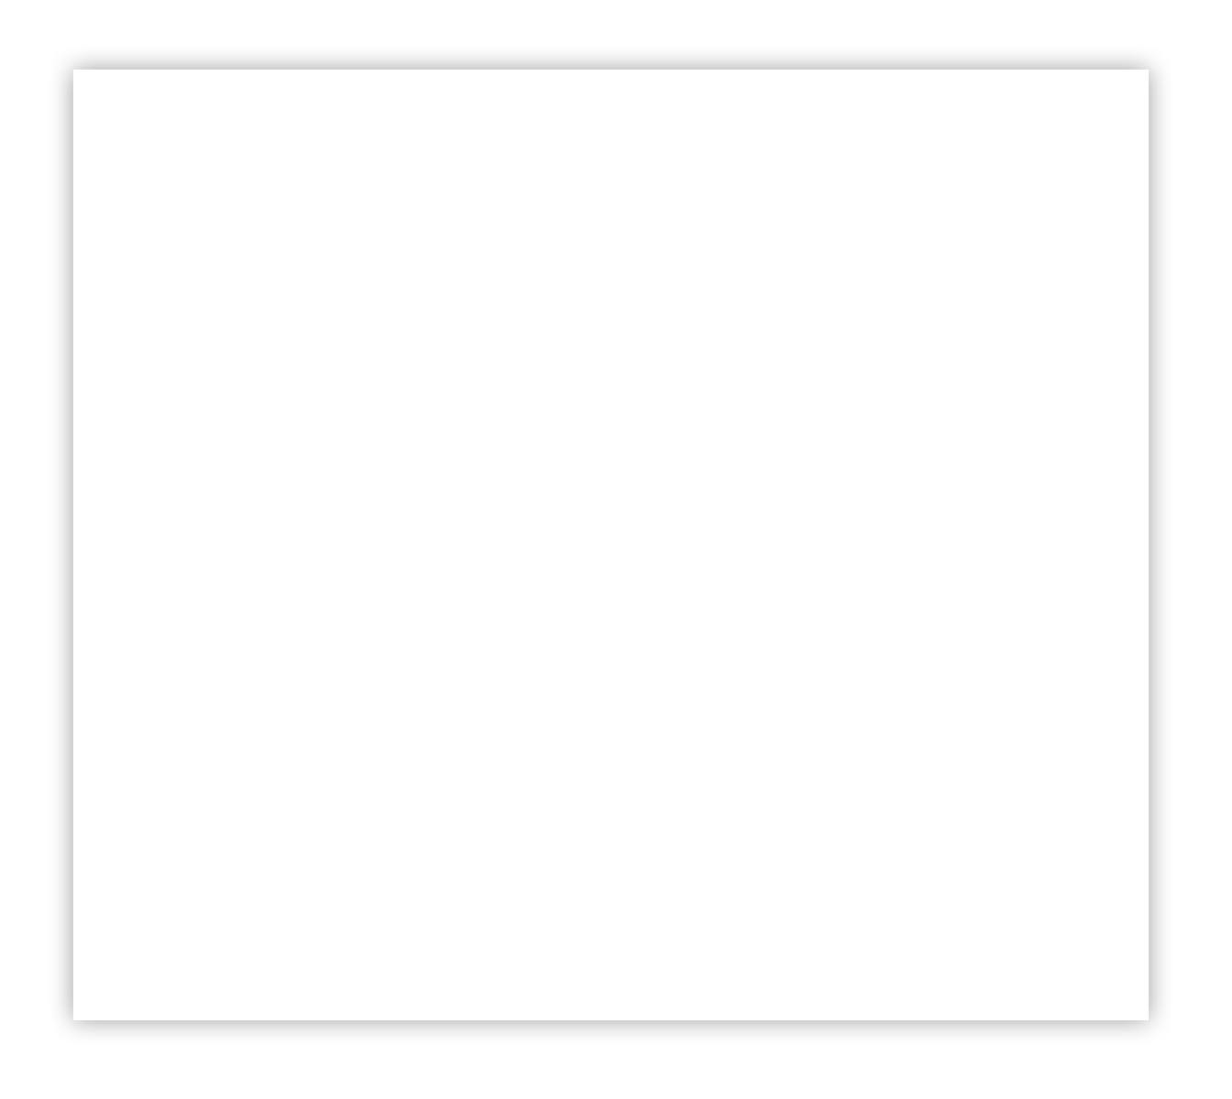

Creating
Building Blocks
Notes:
Brittany
Mention project jungle gym was part of this list but put on hold

Slide 2
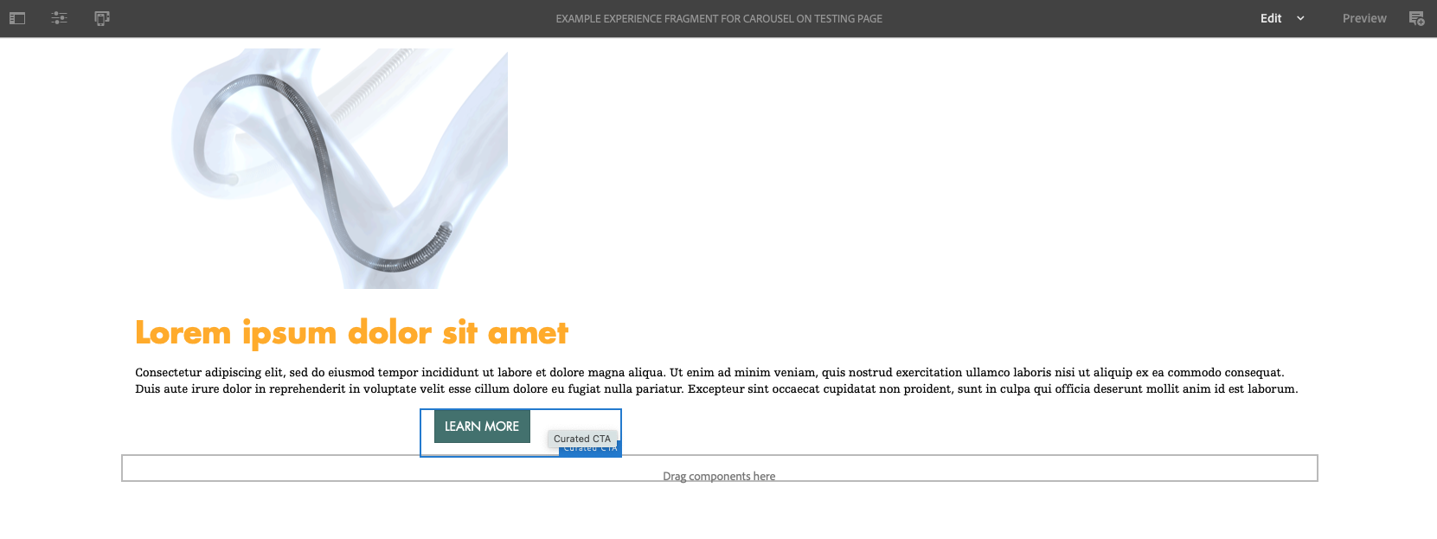
Sometimes when you are creating experience fragments you might have trouble getting your content to align. This can be solved by creating a “Building Block” that functions as an on-page container. This allows for more variation and adjustments with your on-page design.
Notes:
Brittany
Mention project jungle gym was part of this list but put on hold

Slide 3
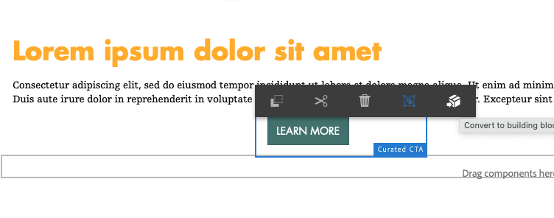
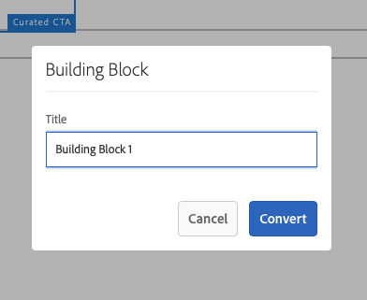
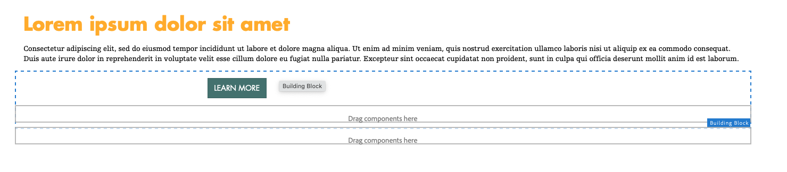
Step 1.) Select one of your components that is giving you trouble and click the “Building Block” icon from the pop-up menu.
Step 2.) Select one of your components that is giving you trouble and click the “Building Block” icon from the pop-up toolbar. A pop-up window labeled Building Block will appear and give you the option to name the building block being created. Once finished click Convert, and the new building block will appear on the page spanning full width. Building blocks appear as checkered boxes and serve as additional containers for your content.
Notes:
Brittany
Mention project jungle gym was part of this list but put on hold

Slide 4
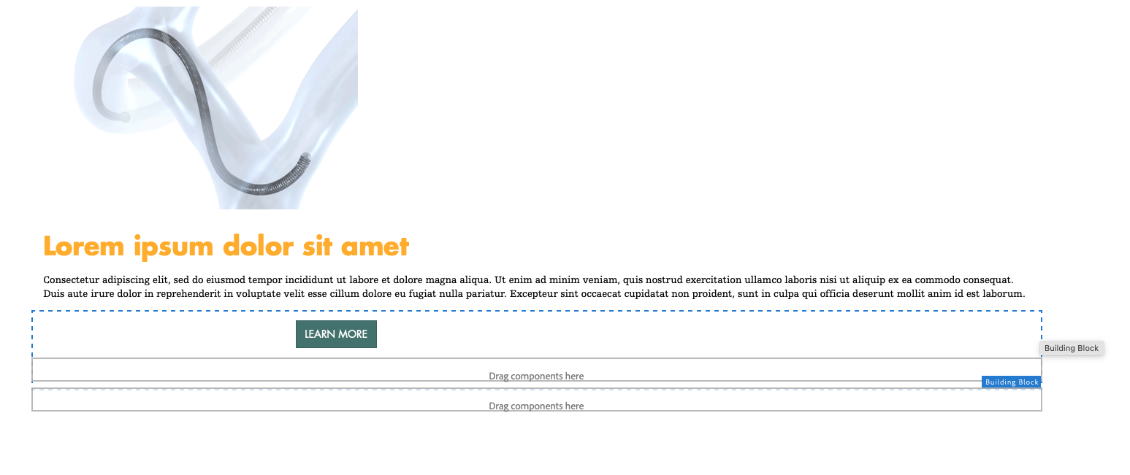
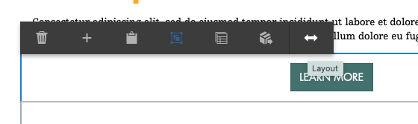
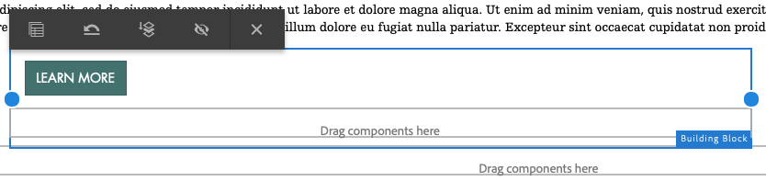
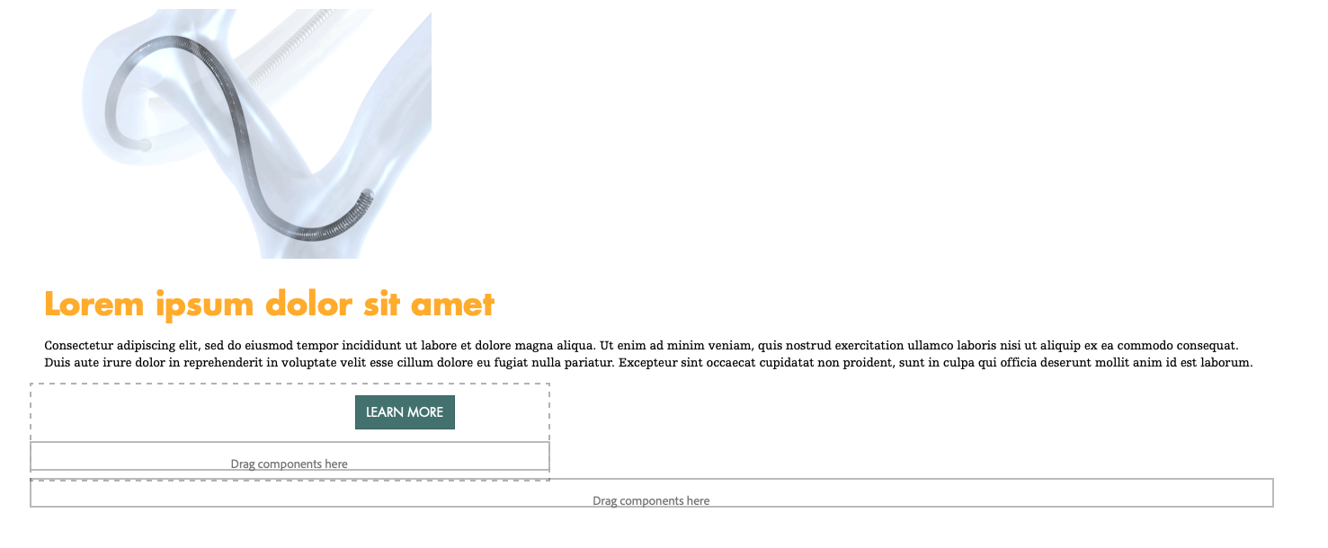
Step 3.) Once your building block is on page, you can adjust the size of it by clicking the component and selecting the “Layout” icon from the toolbar. Two blue dots will appear, that can be adjusted left or right until desired size is created.
Notes:
Brittany
Mention project jungle gym was part of this list but put on hold

Slide 5
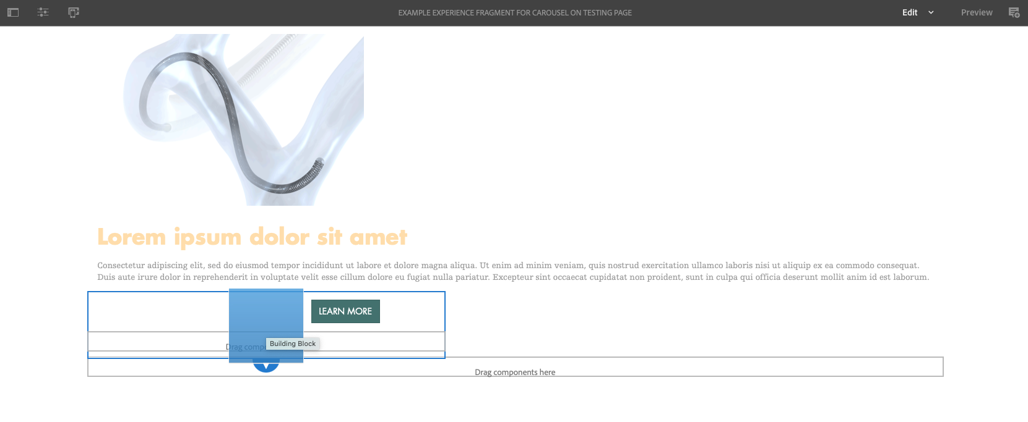
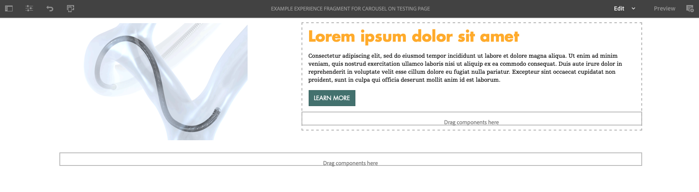
Step 4.) At any point once your building block is on-page, you can drag and drop other components into the block, and they still shrink down to fit inside of your newly adjusted building block.
This will leave you with a page that has more alignment than possible before, and can be better adjusted as future content is added.
Notes:
Brittany
Mention project jungle gym was part of this list but put on hold

