Slide 1
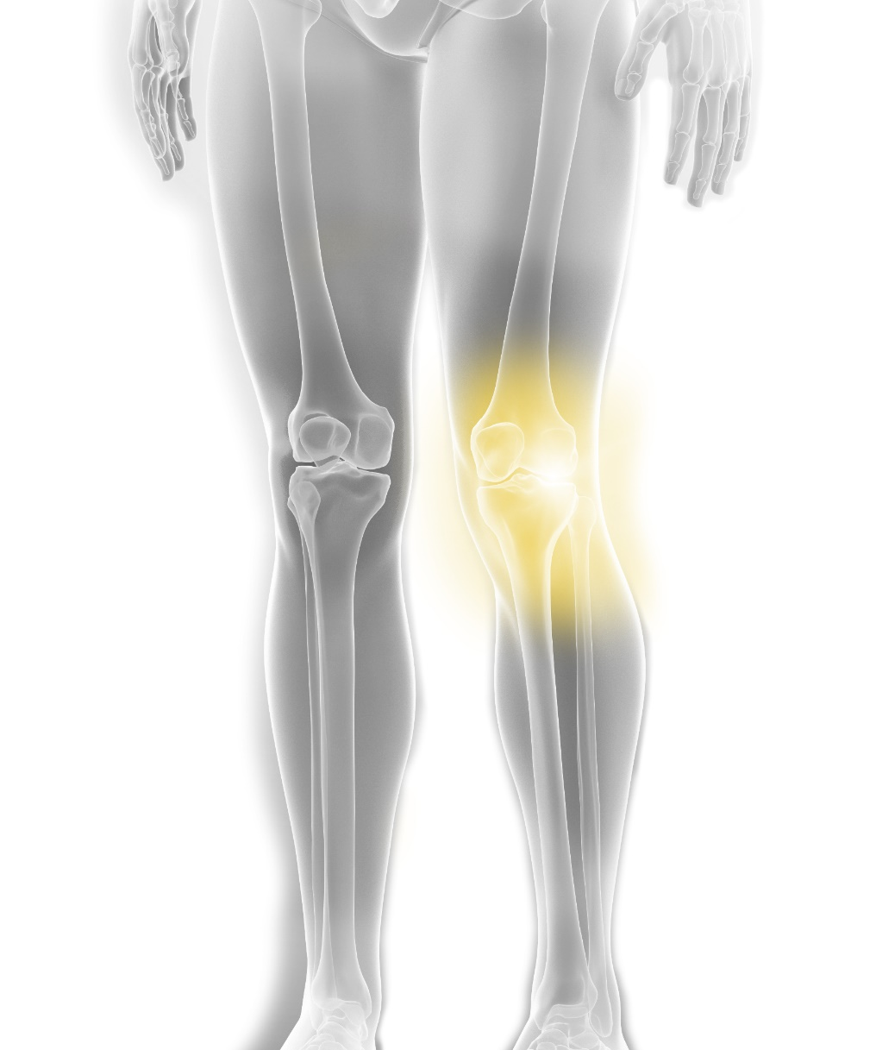
Stryker education
Take the next step
Cadaver course
Revision Knee Arthroplasty
AGENDA
Date:
April 29th – 30th
Time:
09:00 AM - 15:00 PM
Venue:
InSITE Center, Istanbul

Slide 2
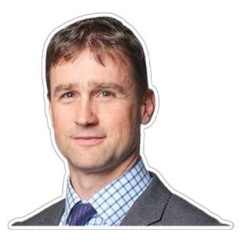
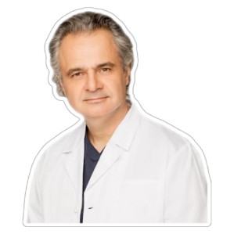
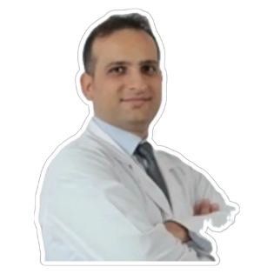
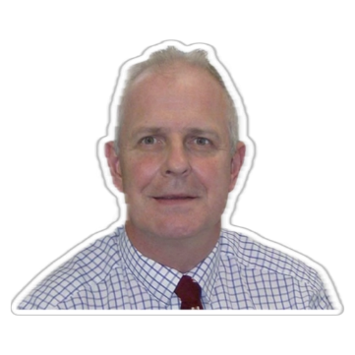
Take the next step
Stryker education
Meet the faculty
Dr. Phil Simpson - Chairman UK
Dr. Radu Prejbeanu Romania
Dr. Fatih Yildiz Türkiye
Dr. Niall Flynn UK
Course description
This training focuses on the complexities of revision knee arthroplasty procedures, providing in-depth knowledge and hands-on experience to address the challenges of managing failed primary implants. Participants will explore surgical techniques, advanced instrumentation, and strategies for joint line restoration, bone defect management, and implant stability. The course integrates theoretical insights with practical applications, enabling participants to refine their skills in revision procedures using Stryker's Triathlon Revision Knee System.
Course objectives
Master Revision Techniques: Equip participants with the skills to address instability, bone loss, and joint line reconstruction in revision knee arthroplasty.
Optimize Implant Selection and Placement: Emphasize the effective use of modular components, cones, and augments to achieve stable and durable outcomes.
Enhance Procedural Confidence: Provide participants with hands-on cadaveric sessions to apply learned techniques and manage complex revision cases effectively.
Promote Best Practices: Teach strategies to avoid complications, including infection management, soft-tissue balancing, and extensor mechanism repair.
Participant profile
Target Audience: Orthopedic surgeons experienced in primary knee arthroplasty and looking to expand their expertise in revision knee procedures.
Experience Level: Intermediate to advanced practitioners familiar with knee arthroplasty principles.

Slide 3
Revision Knee Arthroplasty
AGENDA
Cadaver Course
1st Day: 29 May, Thursday
09:00 - 09:20​ | Registration​ | ​ All
09:20 - 09:35​ | InSITE Center surgical floor tour​ | ​ All
09:35 - 09:45​ | Welcome & Course Overview | Stryker​
09:45 – 10:00 | Courses Expectations and Get-to-Know the Delegates | All
10:00 - 11:00​ | Case Presentation | Dr. Phil Simpson Dr. Niall Flynn Dr. Fatih Yildiz Dr. Radu Prejbeanu
11:00 - 11:30​ | Coffee Break | All​
11:30 – 12:30​ | 1st rotation ( 3 groups) Femoral Reconstruction Tibial Reconstruction Cone Augments | Dr. Phil Simpson Dr. Niall Flynn Dr. Fatih Yildiz Dr. Radu Prejbeanu
12:30 – 13:30​ | Lunch Break​ | All​
13:30 - 14:30​ | 2nd rotation ( 3 groups) Femoral Reconstruction Tibial Reconstruction Cone Augments | Dr. Phil Simpson Dr. Niall Flynn Dr. Fatih Yildiz Dr. Radu Prejbeanu
14:30 - 15:30​ | 3rd rotation ( 3 groups) Femoral Reconstruction Tibial Reconstruction Cone Augments | Dr. Phil Simpson Dr. Niall Flynn Dr. Fatih Yildiz Dr. Radu Prejbeanu​
15:30 - 16:00​ | Coffee Break | All
16:00 - 16:30​ | Triathlon Revision Surgical Demo Video​ | Dr. Phil Simpson Dr. Niall Flynn Dr. Fatih Yildiz Dr. Radu Prejbeanu
16:30 - 17:00​ | Ask the faculty | All
19:30​ | Group Dinner​ | ​ All

Slide 4
Revision Knee Arthroplasty
AGENDA
Cadaver Course
2nd Day: 30 May, Friday
09:00 - 09:30 | Welcome & OR Scrub Prep | All
09:30 - 10:30 | Surgical Exposures | Dr. Phil Simpson Dr. Niall Flynn
10:30 - 12:15 | Triathlon TS Cadaveric Lab Session ( 4 stations) | Dr. Phil Simpson Dr. Niall Flynn Dr. Fatih Yildiz Dr. Radu Prejbeanu
12:10 - 12:45 | Case study discussions | Dr. Phil Simpson Dr. Niall Flynn Dr. Fatih Yildiz Dr. Radu Prejbeanu
12:45 – 13:00 | Meeting wrap-up and close | Stryker
13:00 – 14:00 | Lunch & Transfer/Departures | All

Slide 5
Take the next step
Stryker education
Organisation and Contact information:
Aura Badea
Product Manager Joint Replacement, Romania
aura-maria.badea@stryker.com
Andreea Grosu
Lead Specialist, Events Planning, Romania andreea.grosu@stryker.com

