Slide 1
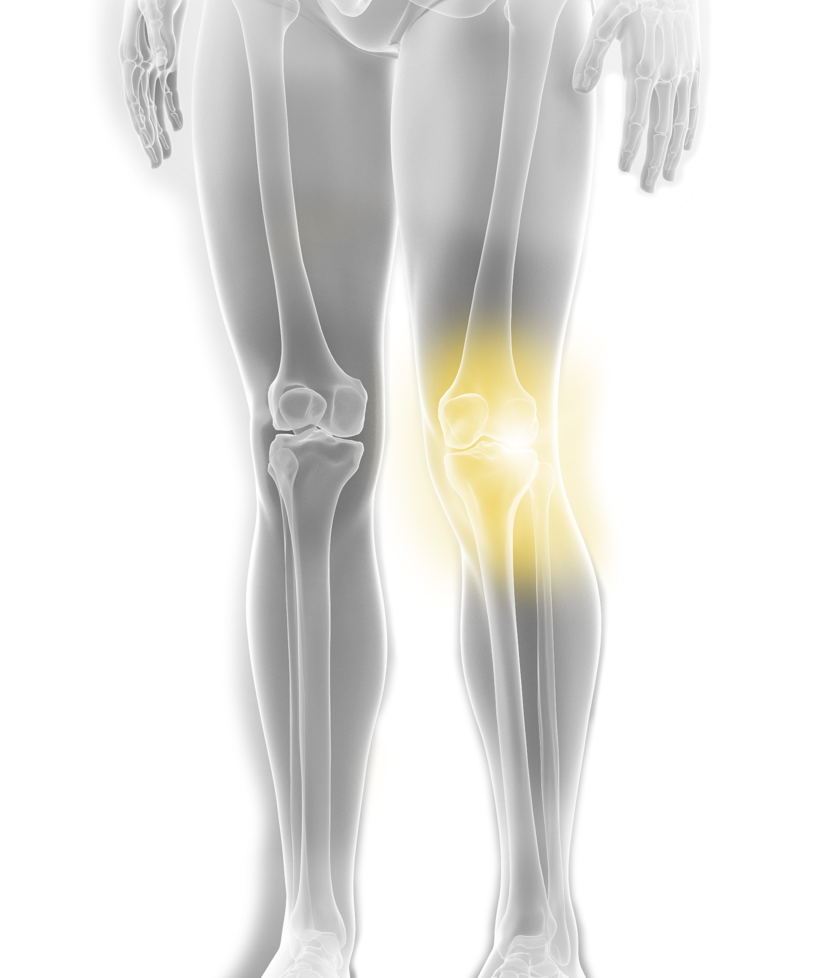
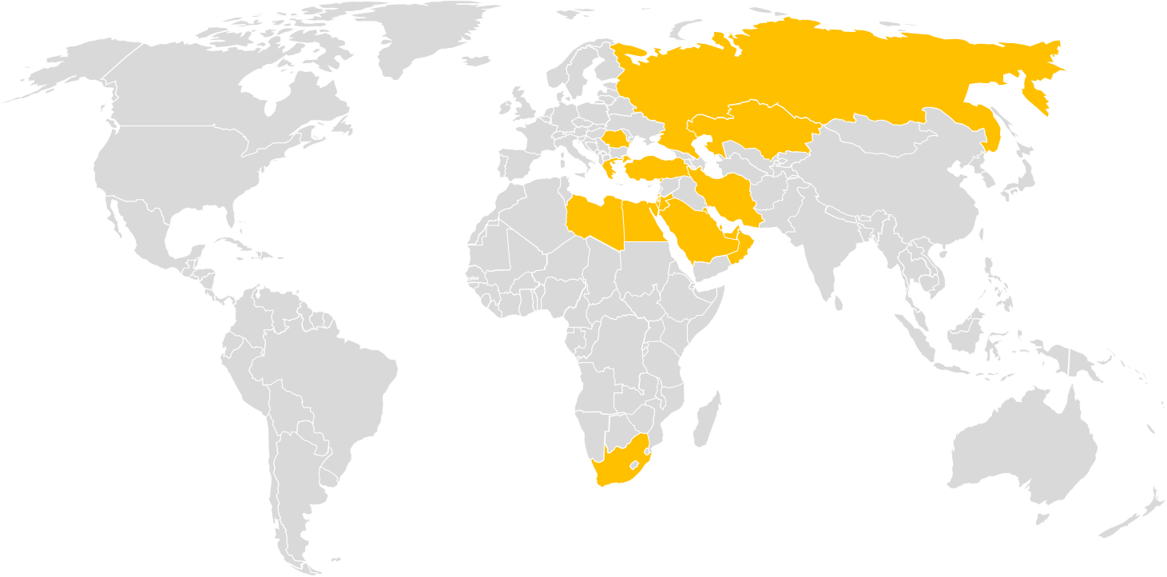
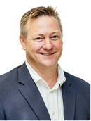
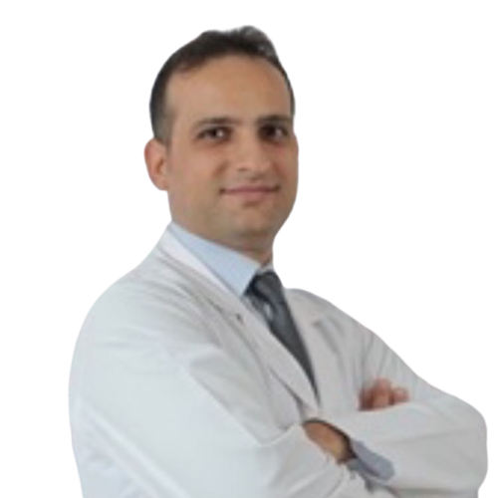
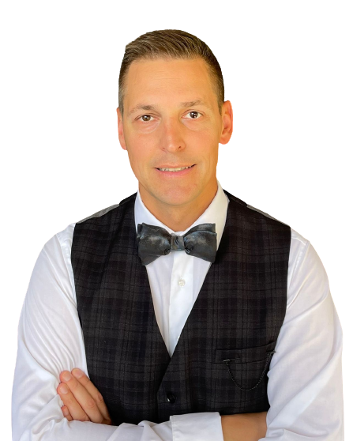
EEMEA Primary Knee Course
25-26 April 2023, InSITE Center, Istanbul- Turkey
Save the Date
Faculty
Jacobus D. Jordaan
South Africa
Fatih Yıldız
Turkey
Nickolay Kornilov
Russia
Product Focus
Triathlon
Delegate Registration
Please confirm your attendance to your Stryker rep until submit your delegate nominations until March 31, 2022
Registration link (internal use only)
Overview
To learn how to plan and perform a Triathlon knee replacement to a high standard, to discuss common indications and complications that may arise, and discuss the evidence underlying the choice of knee replacement.
Location:
InSITE Center, Istanbul Turkey
Contact Information
Cem Sever
Senior Manager, Marketing, Joint Replacement, EEMEA
E: cem.sever@stryker.com
Accommodation
Hilton Istanbul, Bakirkoy
Address: Sakızağacı, Kennedy Cad. No:103, 34142 Bakırköy/İstanbul, Türkiye
Course Logistics
Deniz Yonat
Medical Education Associate
E: deniz.yonat@stryker.com

