Slide 1


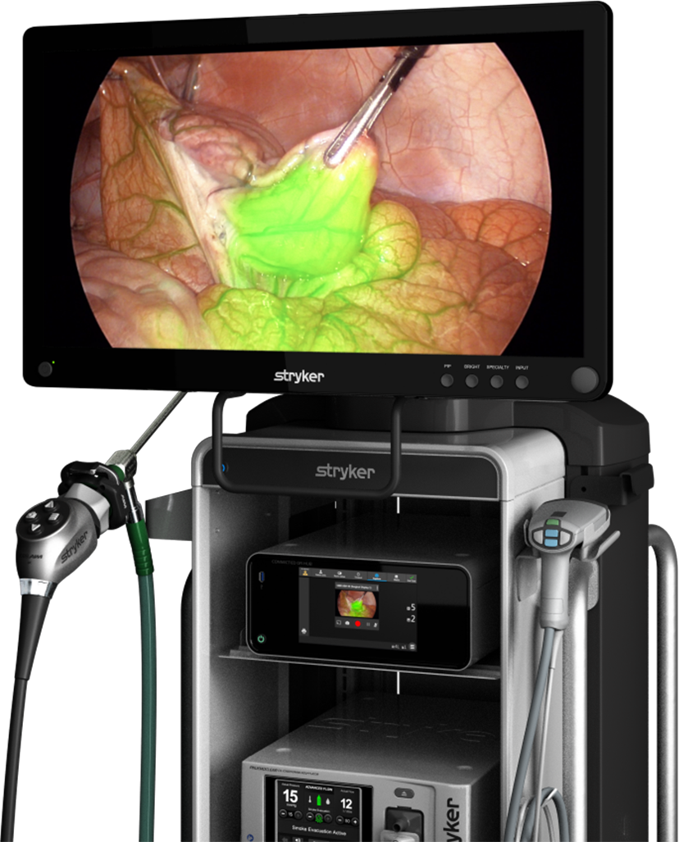
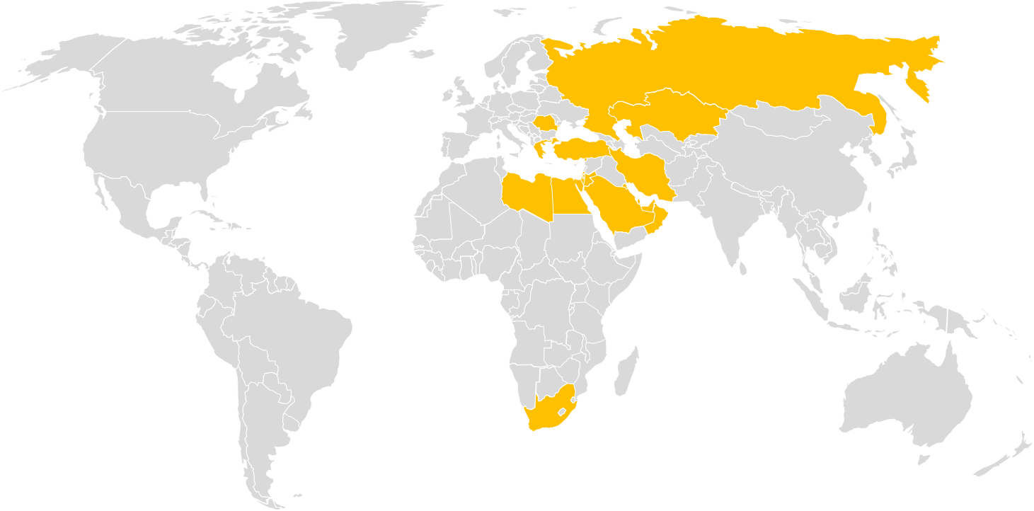
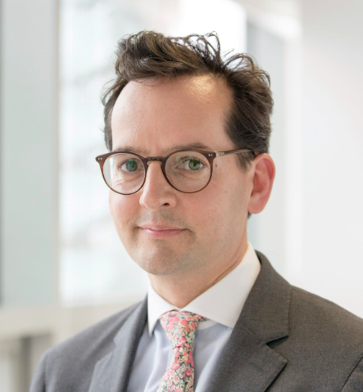


EEMEA Introduction to Fluorescence Imaging
Save the Date
8th March 2023, InSITE Center, Istanbul, Turkey
Faculty:
Delegate Profile:
This meeting is aimed primarily GYN & Breast Oncology consultant surgeons and breast plastic / reconstructive surgeons with an interest to understand more about where the use of fluorescence imaging could be considered.
Registration:
Deadline: February 15, 2023
Please confirm your attendance to your Stryker contact
System registration link to be used by Stryker employees
Mr. John Butler
London, United Kingdom
Breast Oncology
Turkey
Product Focus
1688 & SPY-PHI with ICG
Location:
InSITE Center, Istanbul Turkey
Overview
Introduction to use of fluorescence imaging across different specialities. The training will consist of lectures and hands on sessions run with P.O.P trainers and animal specimens.
Contact Information:
Dan Morris
Director, Medsurg, EEMEA
E: dan.morris@stryker.com
Course Logistics
Deniz Yonat
Medical Education Associate
E: deniz.yonat@stryker.com

