Slide 1
Goods Receipt Training Guide 2023

Slide 2
Agenda
Scope of Products and Documents
Demo
Goods Receipts

Slide 3
Goods Receipts
Once the product is received at Stryker, a goods receipt will be sent to the Ariba Network. This will indicate the time and date the product was received.
If the Inventory screen is used, it will transition the product listed as ‘in transit’ to now ‘on hand.’

Slide 4
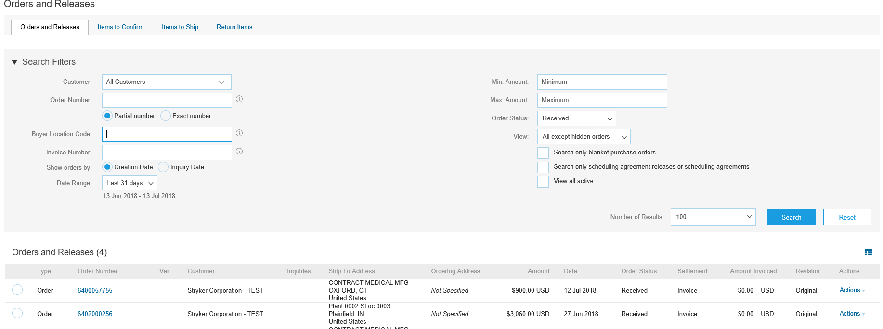
View Goods Receipts (Option 1)
Click arrow next to Search Filters to expand search criteria
Select Received from Order Status dropdown to view the list of orders that have been received, during the specified date range
1
2

Slide 5
View Goods Receipts (Option 2)
Click Inbox
Select Receipts from the dropdown menu.
1
2

Slide 6
View Goods Receipts (Option 2)
Click the Search Filters to expand the section
Enter the Purchase Order Number or the Receipt ID and Click Search
Click on the Receipt Number to view the detailed Goods Receipts
1
2
3

Slide 7
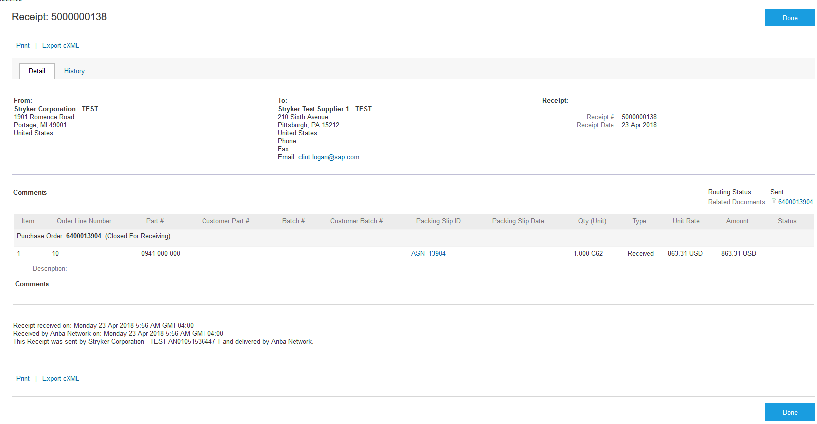
View Goods Receipts (Option 2)
Quantity received and date received can be viewed at the header and line level
Click Done to return to the previous screen
Quantity Received and Date Received
1
2
3

Slide 8
Thank you for joining the Ariba Network!

