Slide 1
Ariba® Network Training 2023

Slide 2
Agenda
Scope of Products and Documents
Demo
Purchase Orders

Slide 3
Purchase Order/Change/Cancel Call Outs
Revision ID- reference number to a specification that can be found by clicking on the line item details section. (Only present if applicable)
Price/Quantity- Cannot be changed by a supplier in the Ariba Network. Supplier must contact Stryker to correct the price/quantity and reissue a change purchase order. The original purchase order version will be obsoleted in the Ariba Network and the new version with the same purchase order number will be sent to AN.
Specific Notes to suppliers- found in header if applicable. Note: Custom Implants suppliers know to check the notes section for any shipment details or product lot numbers
Part number- cannot be changed by supplier in the Ariba Network. Stryker does not accept substitutions.
Order Routing- Please make sure your order routing is set and the correct email addresses are maintained.
Purchase Orders with more than 10 line items - will have 2 pages of line items to select from (Refer to slide 30)
Unit of Measure - Stryker is converting the UOM; all parts that were previously EA will now be PC

Slide 4
Purchase Order Call Outs
Purchase Group : Used to differentiate the Stryker buyer.
Purchase Order Type: drop ship, framework, discrete POs
Purchase Group Description : Description of the Purchase Group. Not relevant for portal or external B2B supplier. Only required for internal CM
Freight Text : This text field is in the “Specific Notes to Supplier” section of the header
Supplier Document ID : Supplier reference document number e.g. RMA number for return PO
Revision Level : If a material is revision managed then Revision level will be the revision number of the material Stryker intends to purchase from supplier e.g. Revision Level A or B or C
Revision Drawing: If a material is revision managed, then the revision drawing will inform the PLM of the drawing number of a material associated with the revision level.
Trackwise ID – will be sent on the PO line item if a quality issue existed on that part.

Slide 5
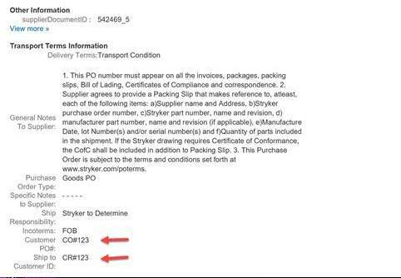
Additional PO Fields (Header Level Fields)
In header level of purchase order, specifically in other information section the below fields can be viewed in PO.
Header Level extrinsic customerOrderNo with Label Customer PO#
Header Level extrinsic shiptoCustomer with Label Ship to Customer ID
1
2

Slide 6
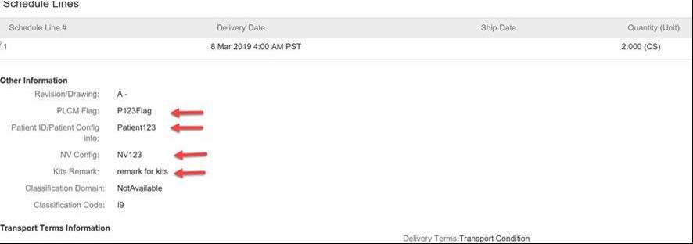
Additional PO Fields (Line Level Level Fields)
In header level of purchase order, specifically in other information section the below fields can be viewed in PO.
Line level extrinsic plcmFlag with Label PLCM Flag
Line Level extrinsic patientNumber with label Patient ID/Patient Config
Line level extrinsic classcode with label NV Config
Line level extrinsic kitsRemark with label Kits Remark
1
2
3
4

Slide 7
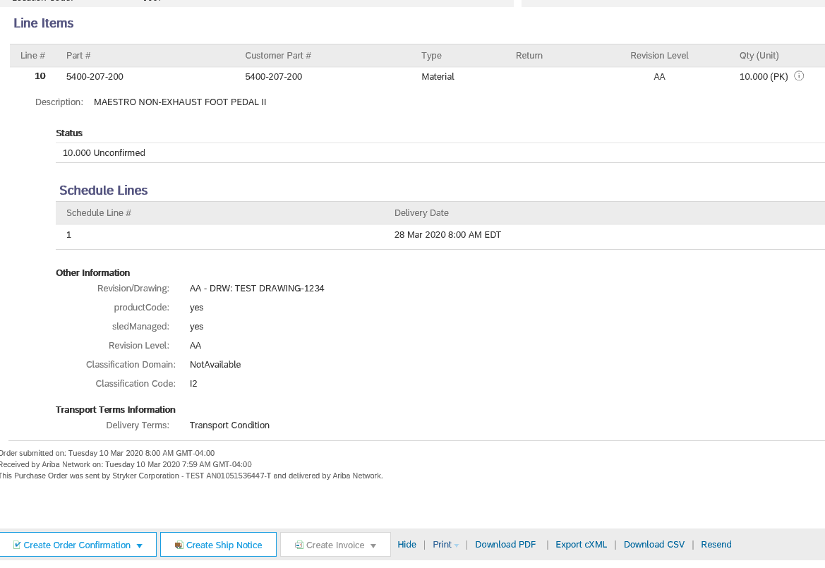
Additional PO Fields (Batch Managed Flag)
In line item level details, the following fields can be viewed:
Product Code – Tells supplier if line item is batch managed (Yes means the line item is batch managed)
SledManaged- Tells supplier if expiration date is required for line item
1
2

Slide 8
Additional PO Fields (Serial Managed Flag)
In line item level details, material lines are designated as Serial Managed via the following:
Serial Numbers- Tells supplier serial numbers are required in ship notice for this line item
1

Slide 9
Framework POs
Purchase order sent with a quantity of 1 with no tolerance.
This is used for Internal suppliers only, to be able to push out unlimited quantities of a particular part to replenish inventory levels.

Slide 10
Purchase Order - Status
Order Status
New/Changed/Obsoleted
Failed
Confirmed/Partially Confirmed
Received/Partially Received
Shipped/Partially Shipped
Invoiced/Partially Invoiced
Accepted/Rejected
Returned

Slide 11
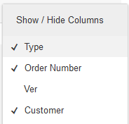
Manage Orders Locate Purchase Orders
Click on Inbox tab to manage your Purchase Orders/Scheduling Releases.
Click Orders and Releases from dropdown menu
Click the link on the Order Number column to view the purchase order details.
Search filters allows you to search using multiple criteria.
Click the arrow next to Search Filters to display the query fields. Enter your criteria and click Search.
1
2
4
3
Toggle the Table Options Menu to view ways of organizing your Inbox.
5
6
Can’t Find Your PO?

Slide 12
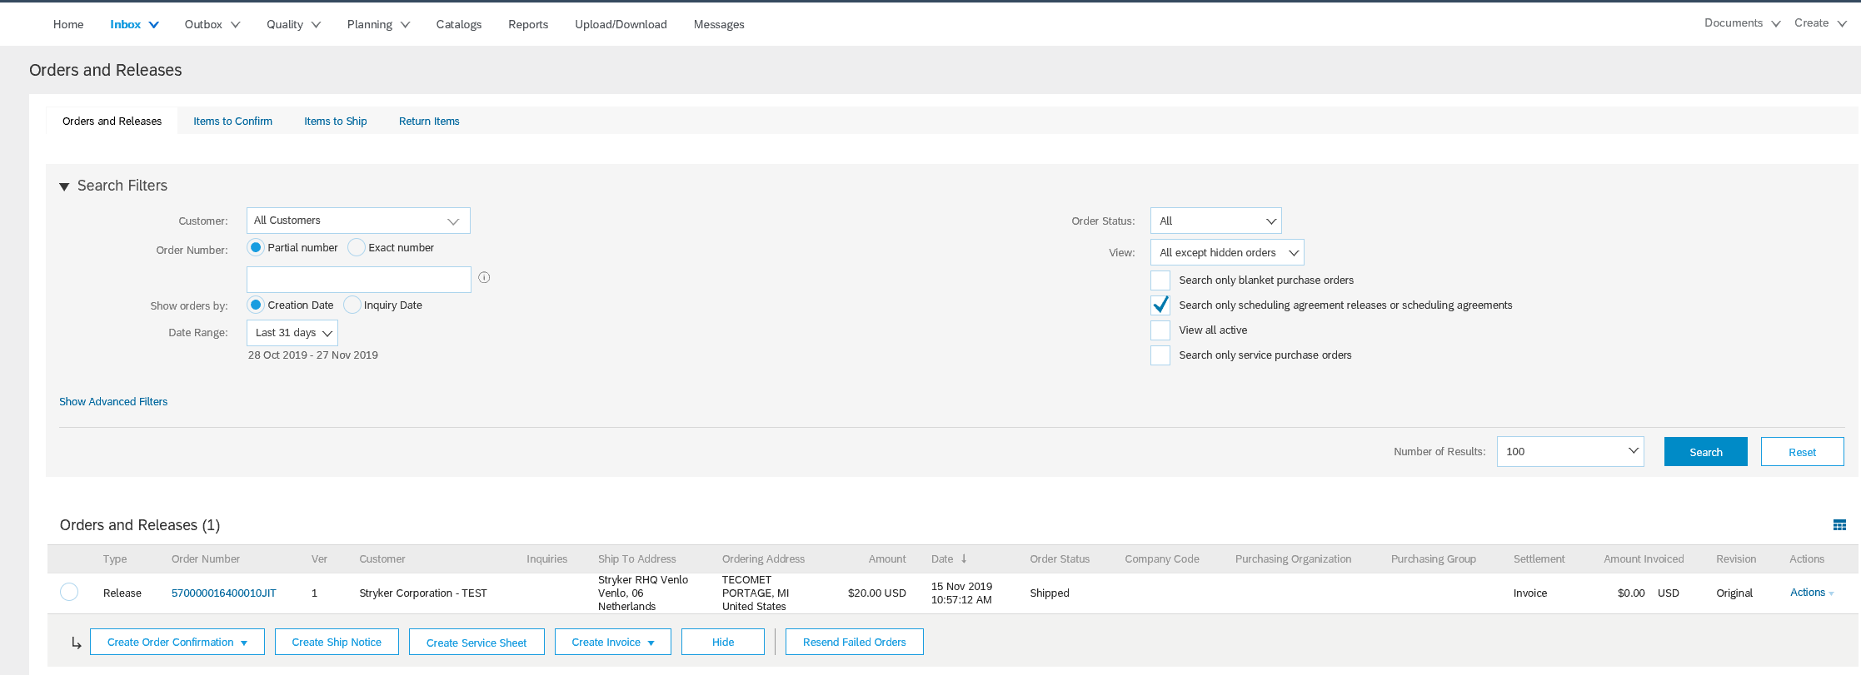
Manage Orders Locate Scheduling Agreement Releases
From the same Inbox, you can view Scheduling Agreement Releases by utilizing the Search Filter:
Select Search only scheduling agreement releases or scheduling agreements box. Select Search to view all SAR’s only.
Under Orders and Releases, view the selected Scheduling Agreement Release documents.
1
2

Slide 13
Manage Orders Purchase Order Detail
View the details of your order. The order header includes the order date and information about the buying organization and supplier.
Note: You can always Resend a PO which was not sent to your email address, cXML or EDI properly clicking Resend button. Additional options: Export cXML to save a copy of the cXML source information Order History for diagnosing problems and for auditing total value.
1
2
Line Items section describes the ordered items. Each line describes a quantity of items Stryker wants to purchase. Set the status of each line item by sending order confirmations clicking Create Order Confirmation. The sub-total is located at the bottom of the purchase order.

Slide 14
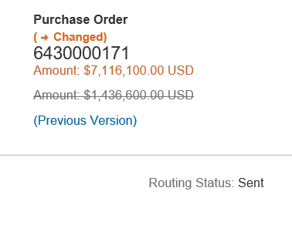
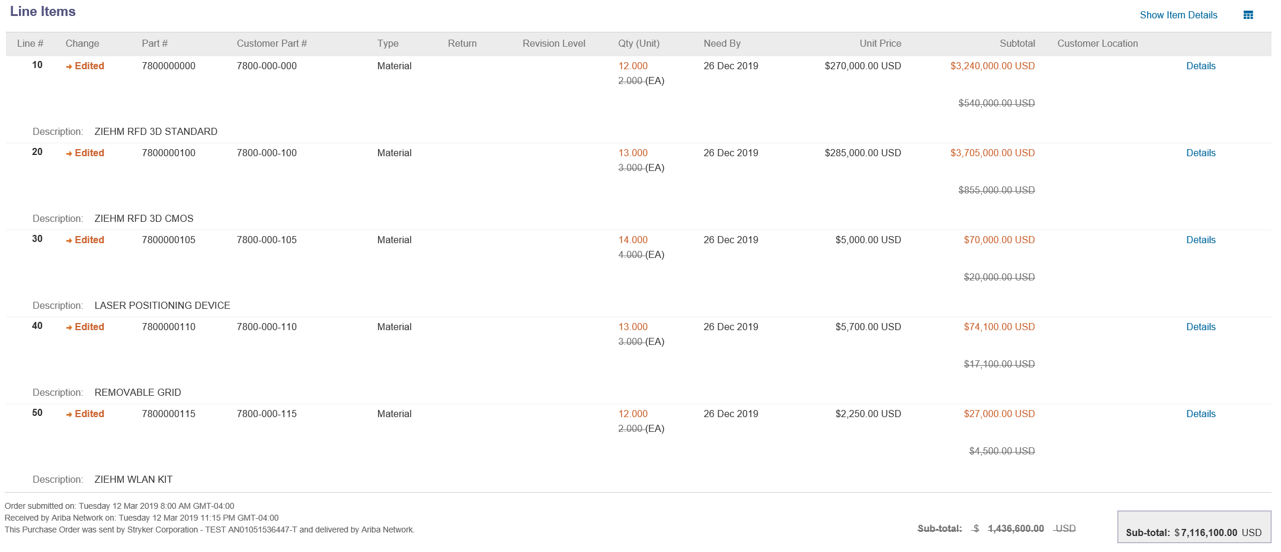
Manage Orders Change Purchase Orders
When a purchase order has been changed by Stryker, the Purchase order status will be updated to Changed.
In the Details of the PO, the status will also reflect as Changed.
Line items that have been updated on the purchase order will reflect and Edited status with the updates colored in orange font.

Slide 15
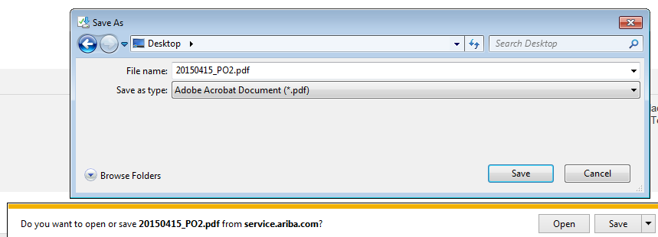
Manage Orders Create PDF of Order or Release
Select “Download PDF” as shown.
Note: If the document exceeds 1000 lines or is larger than 1MB size, details are not shown in the UI. Therefore the detail is not included in the PDF generated.
1

Slide 16
Thank you for joining the Ariba Network!

