Slide 1



Ship Notice Training Guide (Serialized Product)
2023

Slide 2
Agenda
Scope of Products and Documents
Demo
  Ship Notice (Serialized Product)

Slide 3
Advance Ship Notices
Required Fields
Required Fields
Packing Slip ID
Actual Delivery Date
Ship Qty
Batch ID if batched managed product (Lot Number)
Production Date
Serial Number if serial managed product
Additional Stryker Preferred Fields
Batch Sterilization Number *
Sterilization Company *
Country of Origin – Country where the product where is manufactured
Carrier Name *
Expiry Date if applicable
CE Mark
Notified Body - If Notified Body number is not listed, the supplier should choose NL(Not Listed)
Sterility Method *
Tracking Number / Bill of Lading (Limited to 20 character length)*

Slide 4
Advance Ship Notice (ASN) Call Outs
The Ship Notice is a required document before the invoice can be created. The Ship Notices will create an inbound delivery document in the Stryker system used for receiving the product.
To easily identify firm schedule lines that need to be shipped suppliers can use the ‘Items to Ship’ Tab.
Products are either batch managed or serialized managed (Not Both).
For batch managed product: Batch numbers, Batch Production Date, and Batch Expiration Date (If product has a shelf life) should be added to the line item of the Advanced Ship Notice. If more than one batch number exists for a line item (batch split), select “ADD SHIP NOTICE LINE”.
For serialized product: serial numbers, serial production date, and serial expiration date should be added to the line item of ASN. Click on add details to access second screen to enter this information.
CSV Upload option is available for uploading multiple serial numbers – it should not be used for batch managed items at this point.
If both batch and serial ship on the same ASN, enter batch AFTER the serials are uploaded. Please note Stryker’s a part numbers or either batch managed or serial managed and expect the same in the ASN for a part number, if you have any question on how Stryker has setup a part number, please contact Stryker buyer.

Slide 5
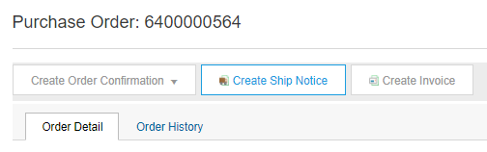
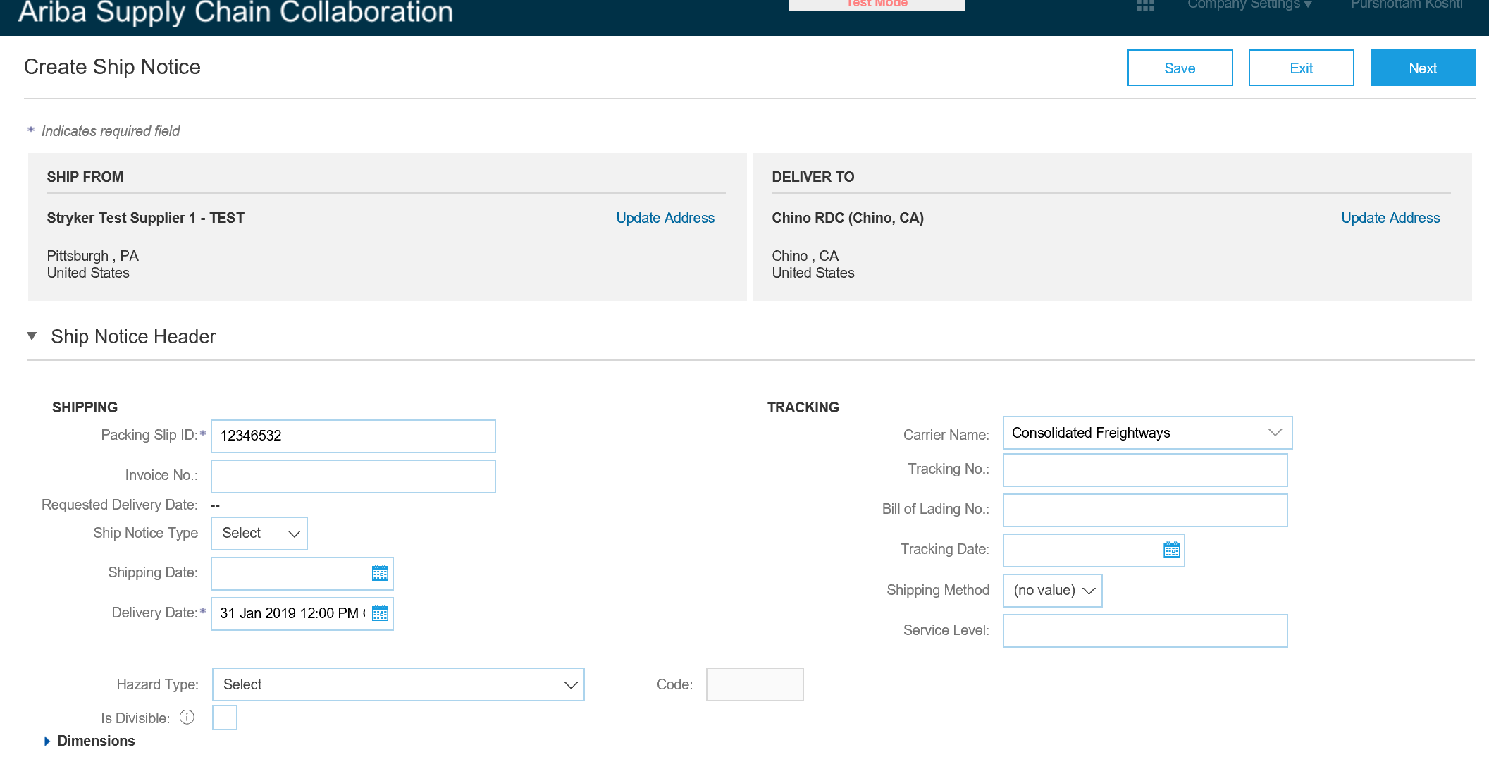
Create Ship Notice
Against a Purchase Order
Create Ship Notice using your Ariba account once items were shipped.
Multiple ship notices per purchase order might be sent. Click the Create Ship Notice button.
Click Update Address if either the Ship From or Deliver To addresses are incorrect
Enter the Packing Slip ID which is any number you use to identify the Ship Notice. You must use a unique ship notice number every time an ASN is created
Choose Carrier Name and then Tracking # and Shipping Method will appear
1
2
3
4

Slide 6
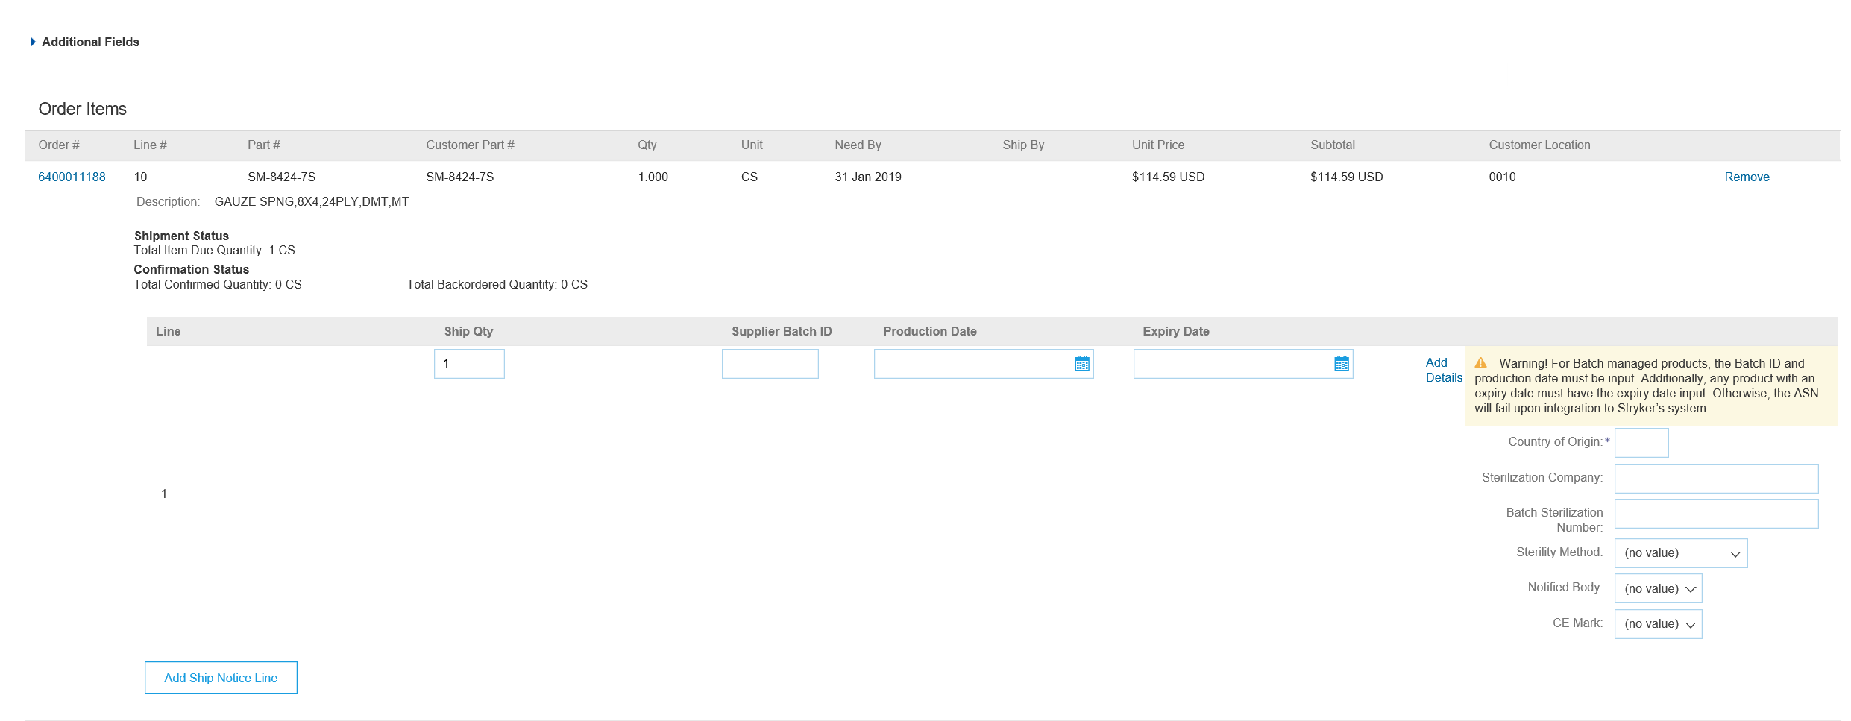
Create Ship Notice
For Serialized Product
Enter the Country of Origin (2 character alpha)
Click Add Details.
2
1

Slide 7
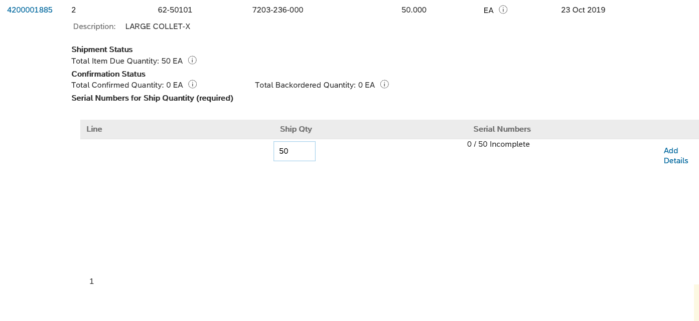
ASN Serial (Managed) Flag
  For serialized materials (within the order items section of ASN) verbiage will be present letting you know that serial numbers for the ship notice materials are required.
  Warning of serial flag
  Amount of serial numbers that need added for quantities
  Click Add details to add serial numbers.
1
2
3

Slide 8
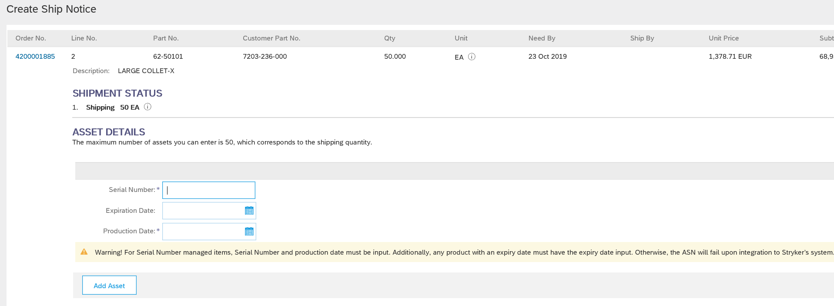
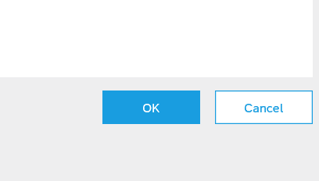
ASN Serial (Managed) Flag
  Add first serial number
  Add production date
  Add Expiration date (if exists)
  Click Add Asset to add additional lines for additional serial numbers
    EX: If 50 serial numbers are required, I will need to press Add asset 49 more times to make serial number, expiration date, and production date available for remaining 49 serial numbers
  Click Ok to save serial numbers
  Once back in ASN creation screen click next and submit to send ASN to Stryker.
1
3
2
4
5

Slide 9
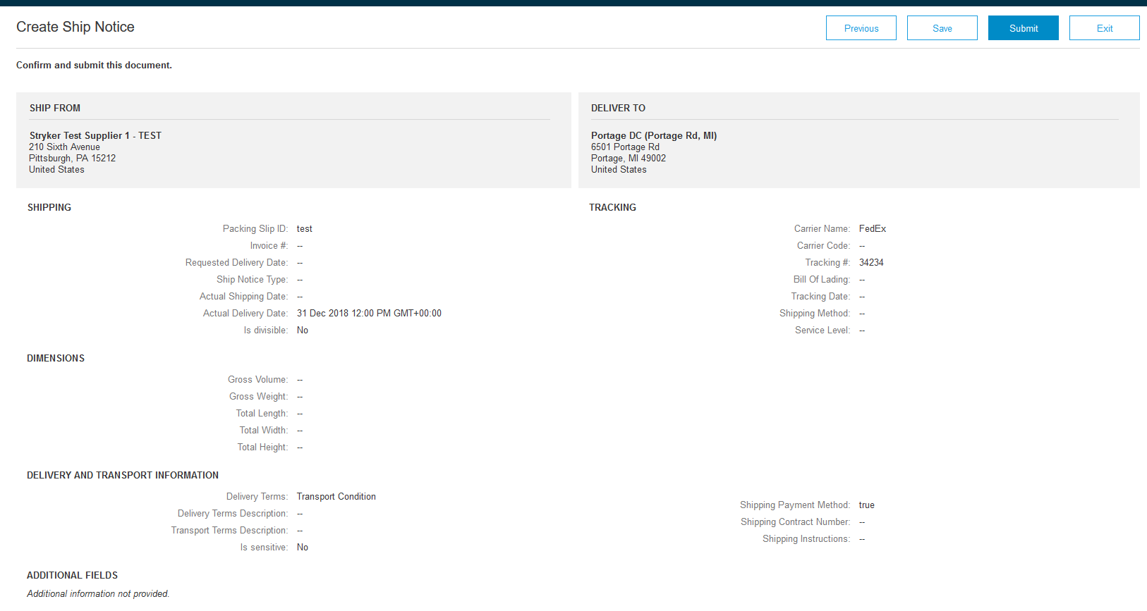
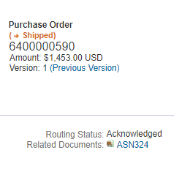
Submit Ship Notice
After reviewing your Ship Notice, click Submit to send Ship Notice to Stryker. Ship Notices provide improved communications to help avoid unnecessary calls to order support department.
After submitting your Ship Notice, the Order Status will be updated to Shipped. Submitted Ship Notices can be viewed from Outbox or by clicking the link under the Related Documents from the PO View.
1
2

Slide 10
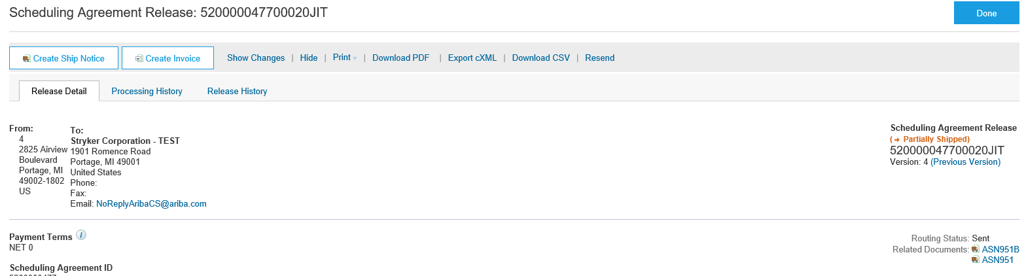
Create Ship Notice
Review Shipment Status
After submission, the order status associated with the PO/Scheduling Agreement Release will be updated to shipped/partially shipped and is viewable in your detail screen.
Review the Advance Ship Notice created by clicking the hyperlink next to the Related Documents label.
1
2

Slide 11
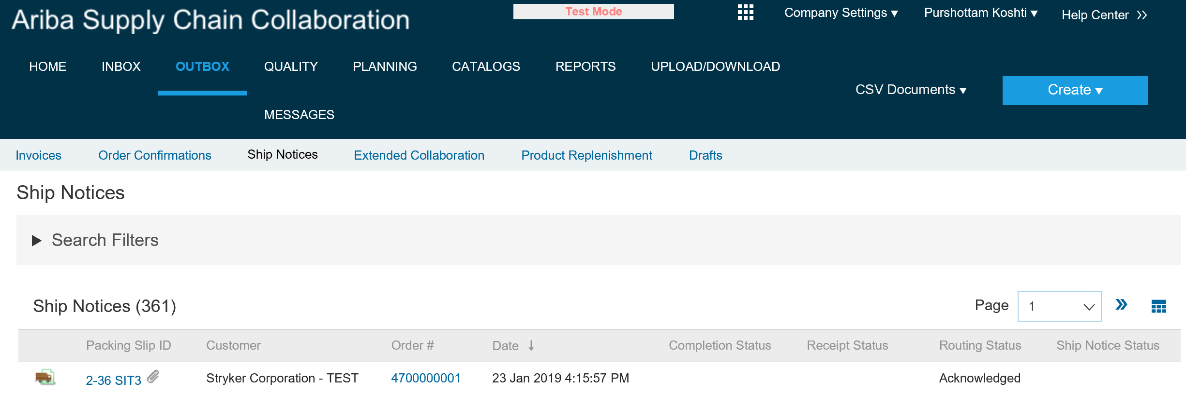
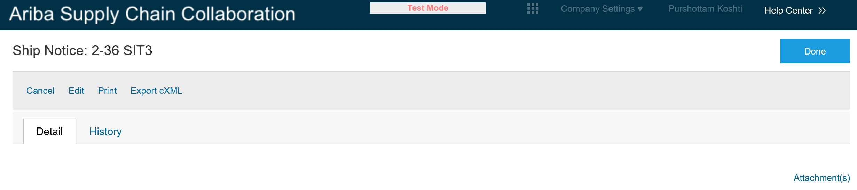
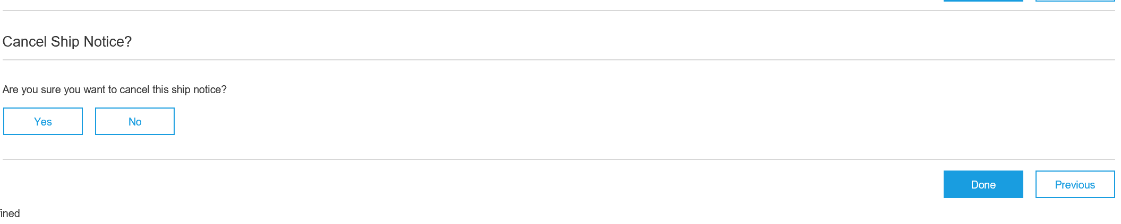
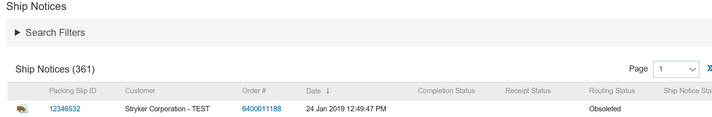
Advanced Ship Notice (Cancel)
From the OUTBOX, select the SHIP NOTICE tab.
To open previously submitted Ship Notice, CLICK on hyperlinked Packing Slip ID.
CLICK Cancel to cancel Ship Notice.
Click Yes to Cancel.
The ASN will now reflect a routing status of OBSOLETED.
1
2
3
4
5

Slide 12

Thank you for joining the
Ariba Network!

