Slide 1



Ship Notice Edit Training Guide
2023

Slide 2
Agenda
Scope of Products and Documents
Demo
  Ship Notice Edit

Slide 3
ASN Edit Callouts
Everything can be changed except packaging slip id
A Ship Notice cannot be canceled or edited if the goods receipt has been received in the Ariba Network and/or the PO has been invoiced.
A ship notice must be edited using the same system it was created in. A ship notice created with the Ariba Network user interface can be edited only in Ariba Network.

Slide 4
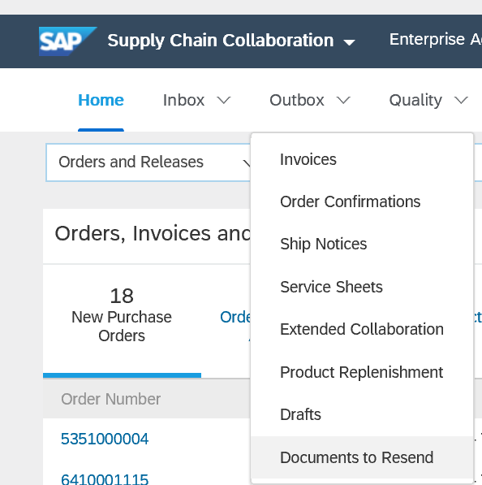
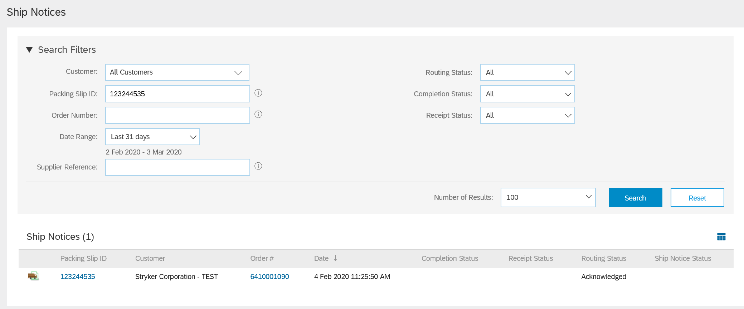
Advanced Ship Notice Edit
Click outbox tab and select Ship Notices
Type previously submitted packing slip ID and appropriate date range.
Click packing slip ID number to open details
1
2
3

Slide 5
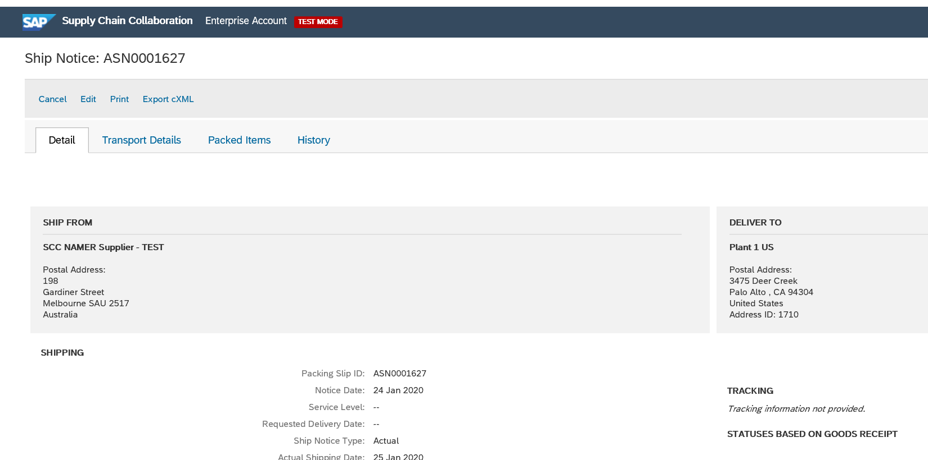
Advance Ship Notice Edit
Click Edit
1

Slide 6
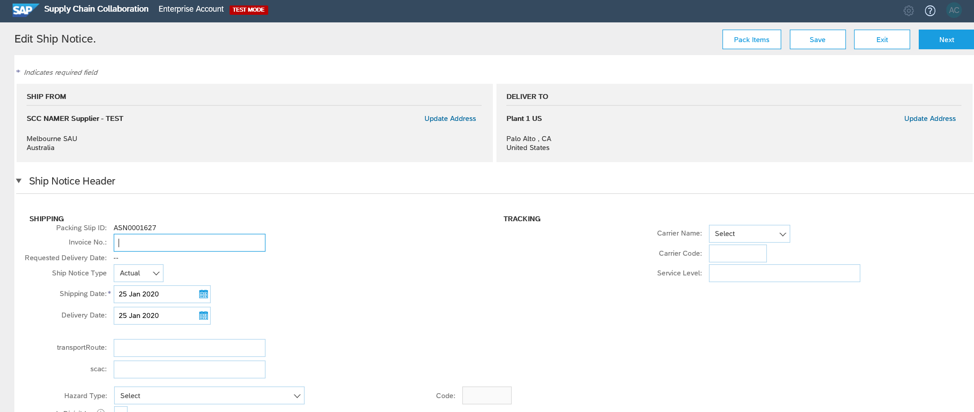
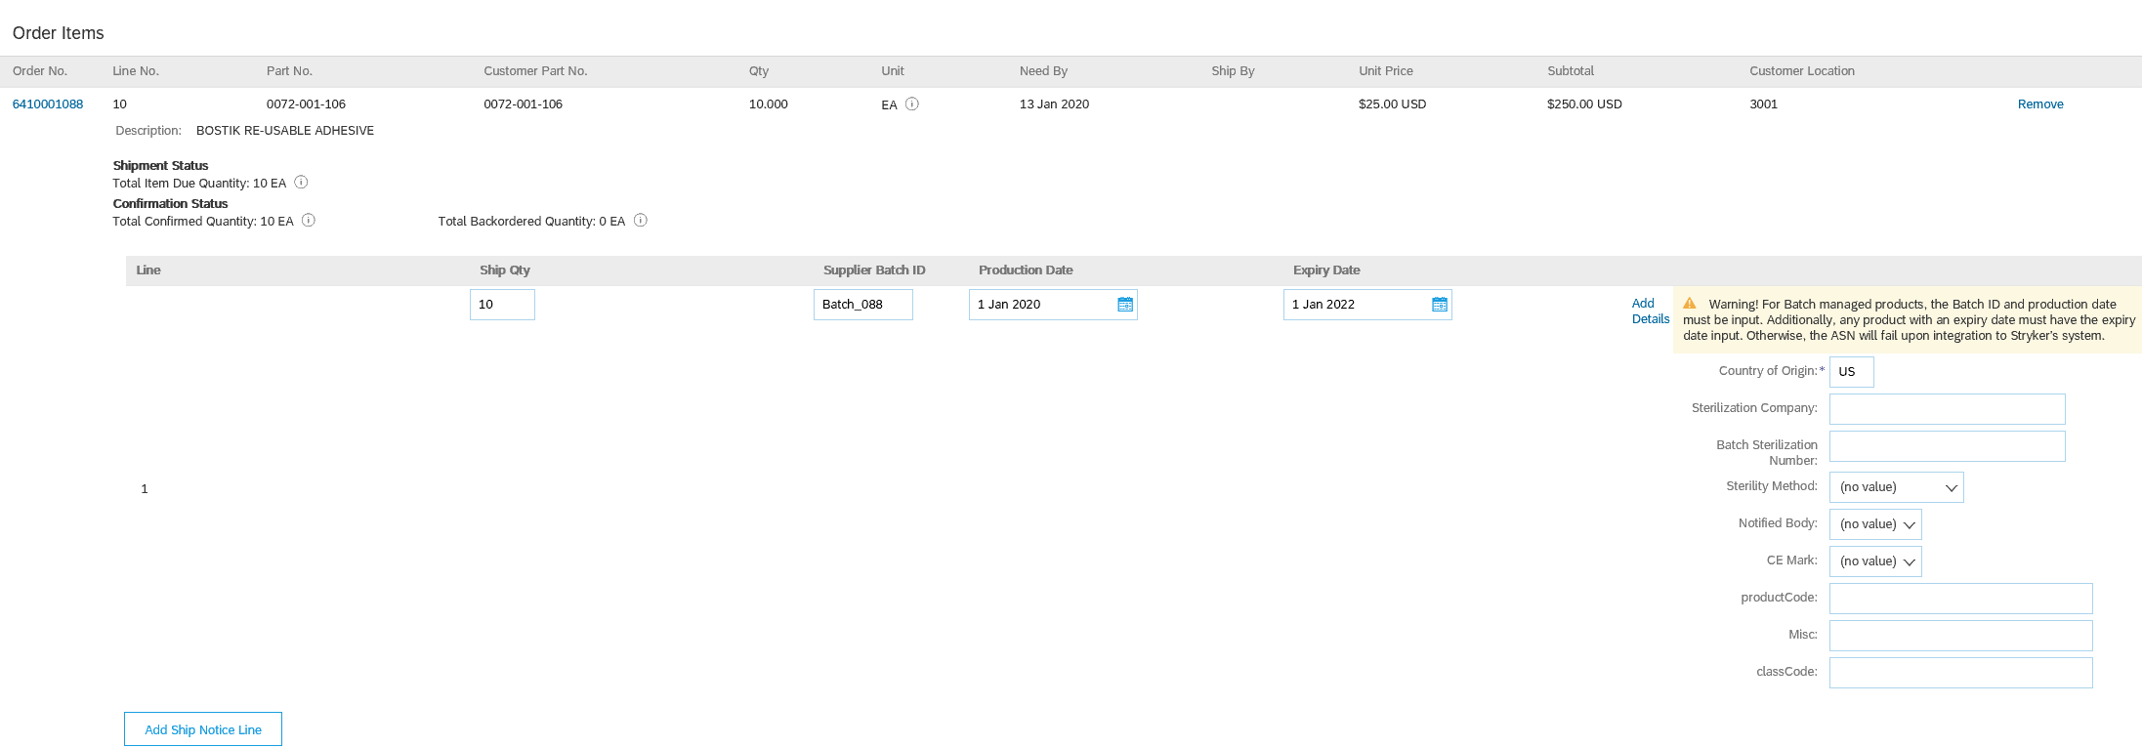
Advance Ship Notice Edit
Packing slip ID will automatically populate with previously submitted number (no action required)
Insert Carrier (tracking information)
Edit any field in need of correcting
  Ship quantity
  Supplier batch ID
  Production Date
  Expiration Date
  Country of origin
  Sterilization Company
  Sterility Method
  Notified body
  Asset serial numbers
  CE Mark
1
2
3

Slide 7
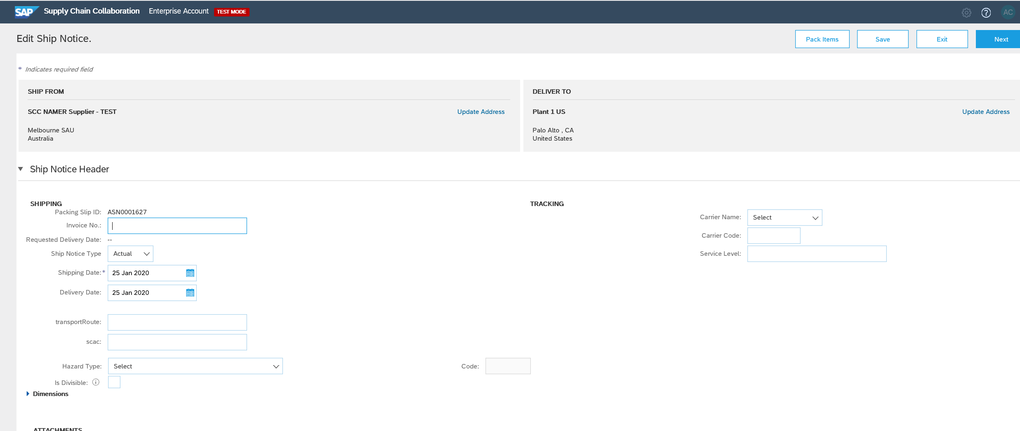
Advance Ship Notice Edit
Insert all mandatory fields (marked with an asterisk)
  Packing slip ID will be auto-populated with previously submitted number)
  Carrier Name and tracking number
  ASN line item updates
    Quantity
    Batch info
    Serial info
1
2

Slide 8

Thank you for joining the
Ariba Network!

