Slide 1



Order Confirmation Training Guide
2023

Slide 2
Agenda
Scope of Products and Documents
Demo
  Purchase Order Confirmations

Slide 3
Purchase Order Confirmation Call Outs
Purchase Order Confirmations must be submitted within 48 hours of PO receipt to inform Stryker the supplier has received the order and to communicate the estimated delivery date. Stryker buyers will regularly monitor POs missing order confirmations to hold suppliers accountable to submitting order confirmations.
  Purchase Order Confirmations should be created for all NEW/CHANGE PO’s as your scheduled GO LIVE date.
Delivery Date – can be edited and will be communicated to the Buyer if it is different than the need by date.
Purchase orders/Purchase order lines cannot be rejected by the supplier. If the supplier needs a line removed or a purchase order cancelled, they must contact Stryker directly.
Price - Cannot be changed by a supplier in the Ariba Network. Supplier must contact Stryker to correct the price and reissue a change purchase order. The original purchase order version will be obsoleted in the Ariba Network and the new version with the same purchase order number will be sent to AN.
Quantity- Supplier cannot change the quantity to be higher than the value on original PO.
No substitutions or backorders.

Slide 4
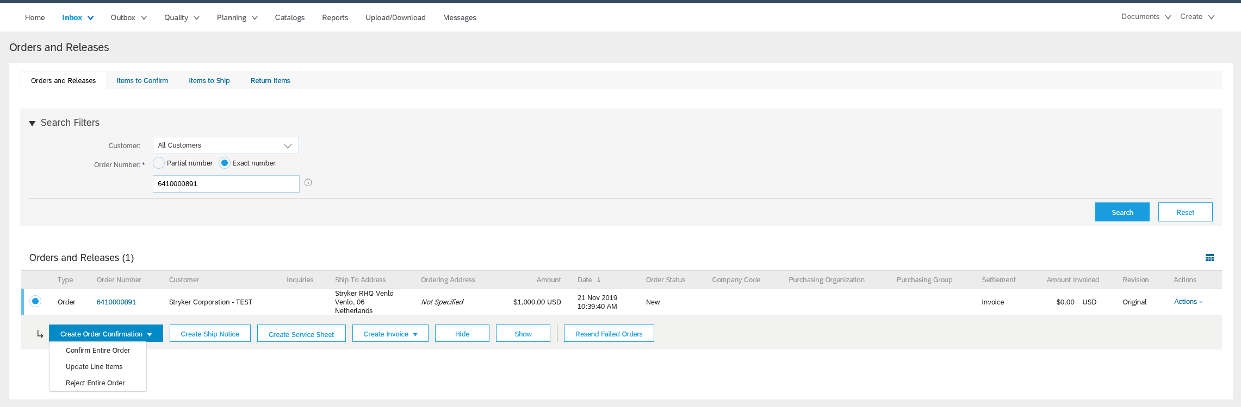
Create Purchase Order Confirmation (Confirm Entire Order)
Search for the Purchase Order in the Inbox in Orders and Releases.
Click the radio button for the order
Click Create Order Confirmation button
Click Confirm Entire Order (To confirm purchase order line items as is for quantity and delivery date)
1
2
3
4

Slide 5
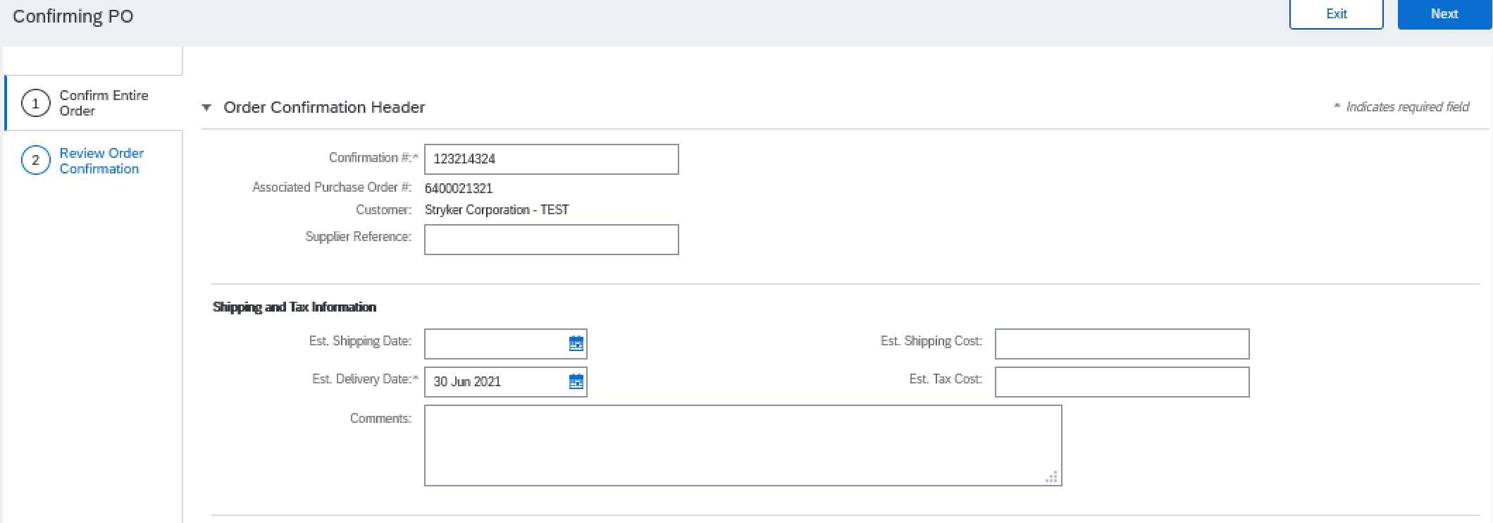
Create Purchase Order Confirmation (Confirm Entire Order)
Insert confirmation number
Click calendar icon and select estimated shipping date at header level (will be applied to all line items of order confirmation)
Click calendar icon and select estimated delivery date at header level (will be applied to all line items of order confirmation)
1
2
3

Slide 6
Create Purchase Order Confirmation (Update Line Items)
Search for the Purchase Order in the Inbox in Orders and Releases.
Click the radio button for the order
Click Create Order Confirmation button
Click Update Line Items (if you wish to change the quantity on the confirmation)
1
2
3
4

Slide 7
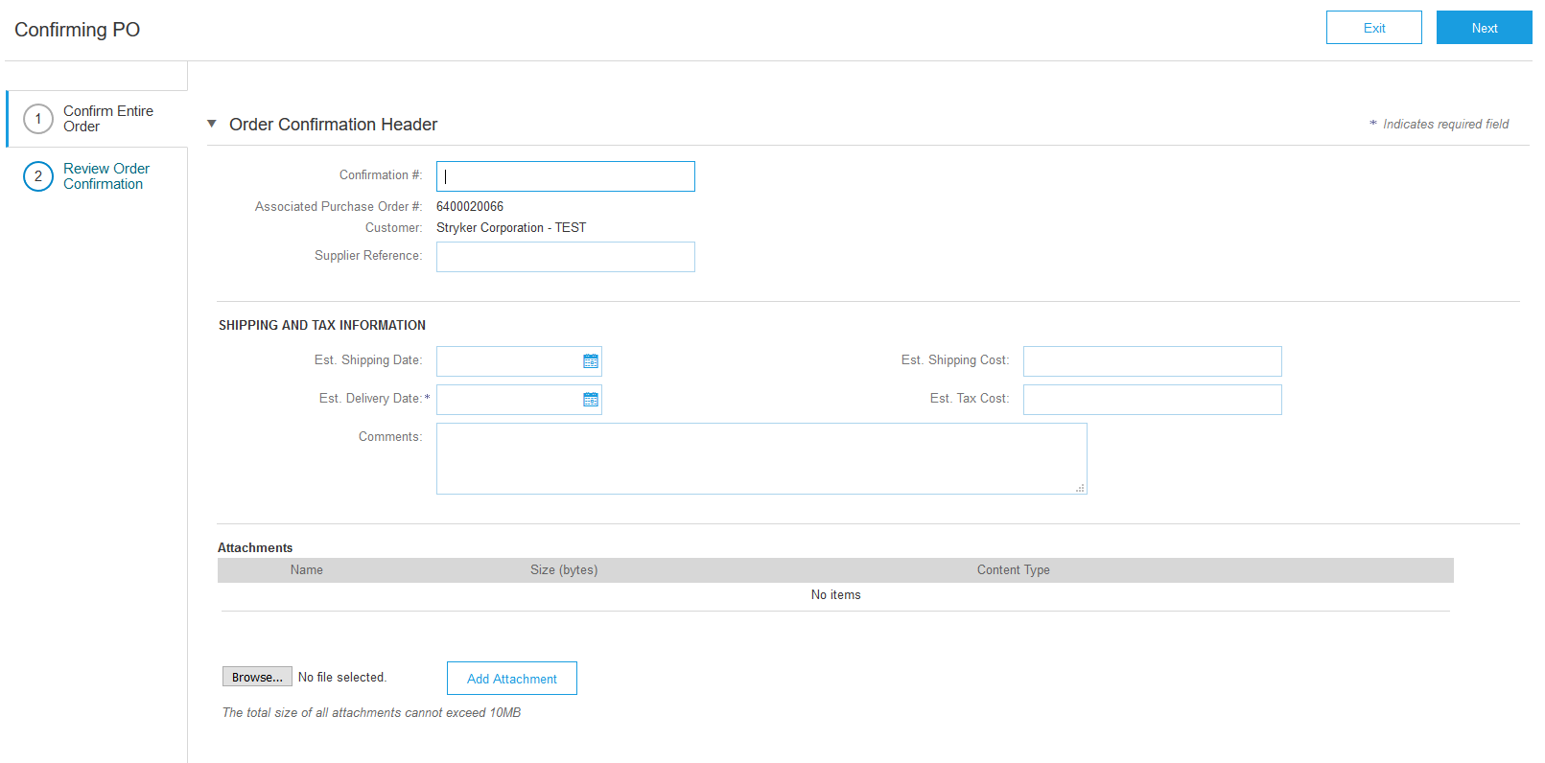
Create Purchase Order Confirmation
Header Information
Enter the Confirmation Number
Enter the Estimated Delivery Date (required)
1
2

Slide 8
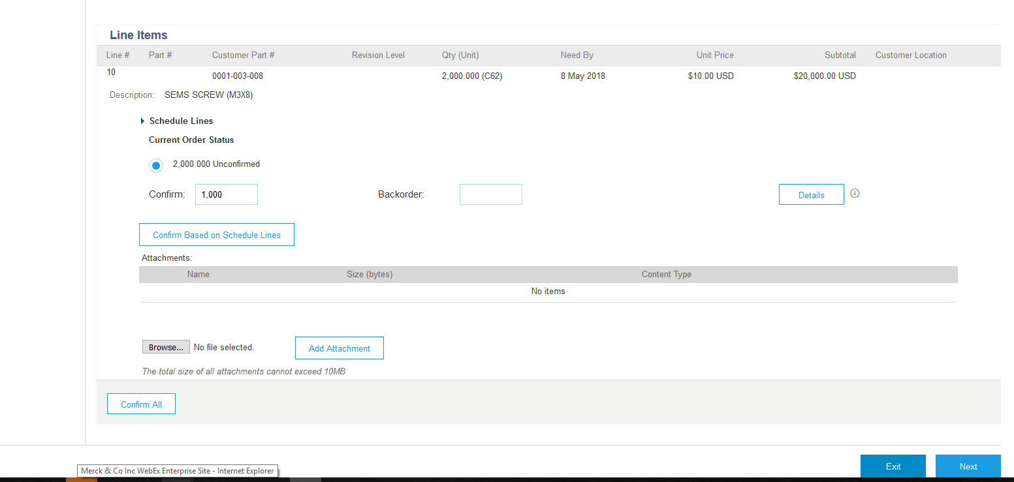
Create Purchase Order Confirmation
Detail Information – Update Line Items Option
Enter the quantity to confirm
Click Details button to update line item shipping date and delivery date
Click Next to go to reviewal page
1
2
3

Slide 9
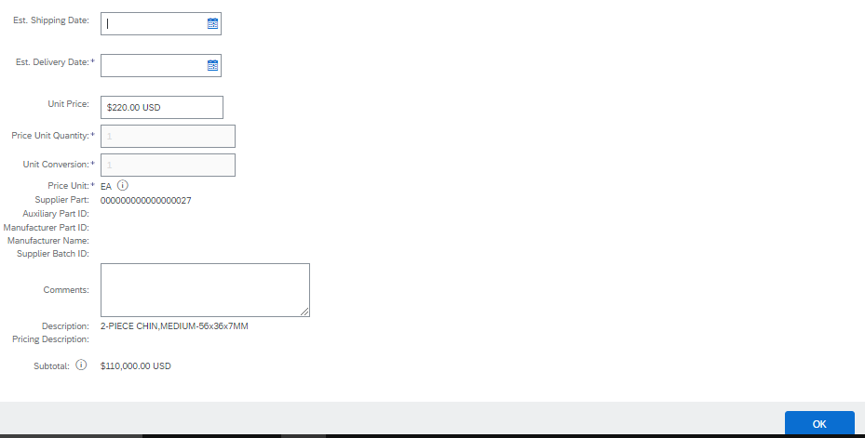
Create Purchase Order Confirmation
Detail Information – Update Line Items Option
Enter estimated shipping date for material
Enter estimated delivery date
Insert comment if there will be any delay in shipment
Click OK
1
2
3
4

Slide 10
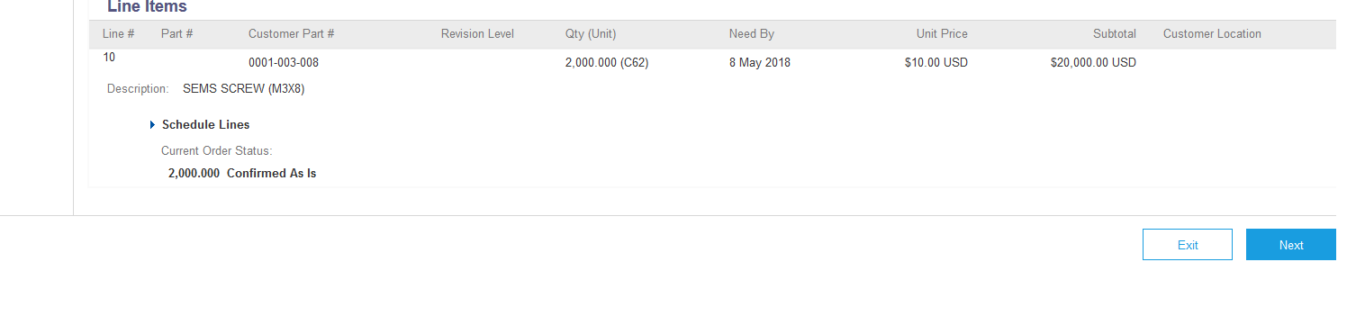
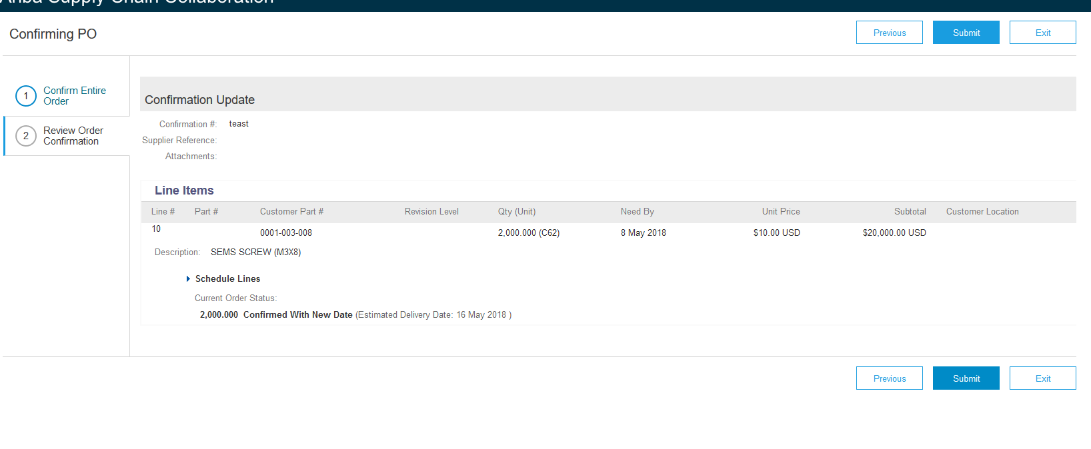
Create Purchase Order Confirmation
Detail Information – Update Line Items Option
Click Next to review the confirmation
Click Submit to send the confirmation to Stryker
1
2

Slide 11

Thank you for joining the
Ariba Network!

