Slide 1
Forecast and Forecast Commit Training Guide 2023

Slide 2
Agenda
Scope of Products and Documents
Demo
Forecast/Forecast Commitment (Supply Plan)

Slide 3
Supply Plan (Forecast and Forecast Commit)
Stryker extracts supply plan data from their SAP S4 system and sends it to the Ariba Network on a monthly basis (1x per month in second full week of the month).
Forecast commitment by supplier should be entered and submitted through Ariba by end of third full week of the month
Supplier logs onto Ariba Network to view the supply plan (called “Order Forecast”). The supply plan can be downloaded via CSV file.
The search filters can be used to view selective parts by location.
The default display will be daily. The supplier will need to select the bubble next to month in order to view the supply plan (=“Order Forecast”) in monthly buckets.
Stryker will be monitoring supplier compliance of the use of the Forecast Commit functionality through the Supply Chain Monitor on the Ariba Network; missing commitments, decommits, and shortages.
Commitments should be made on the dates that the product should arrive at Stryker’s facility (at the dock). (use the daily view filter)
Forecast commitments in Ariba will be used in the following ways:
In case of no commitments, the MRP calculated supply plan (=Order Forecast) will be used to create purchase orders
In case of overcommits, the MRP calculated supply plan (=Order Forecast) will be used to create purchase orders
In case of under-commits by supplier (in case of a constraint), the forecast commits from the supplier will be used to created purchase orders
You may get purchase orders for a total quantity that is less than you have committed. You will not get purchase orders in excess of what you have committed. In the case of extenuating circumstances, your buyer will discuss any additional business needs with you directly.
At this time, Stryker requests that you do not commit to a forecast quantity that is higher than what we have published. Please only commit to the forecast with a quantity that is of equal or lesser value, based on what you are truly able to commit to supplying.
As a supplier, to successfully submit the forecast commitment to Stryker, you will click save button to save quantity to planned shipment field. Once saved click “Send Data” button to send forecast commitment to Stryker ERP.

Slide 4
Forecasting (Search Filters)
Click Planning Dropdown Menu
Click Planning Collaboration sub tab
To expand Search Filters section, click arrow next to “Search Filters”
To view Forecasts, insert Forecast in “Process Type”
Click details icon in right hand side of material line
1
2
3
4
5
4

Slide 5
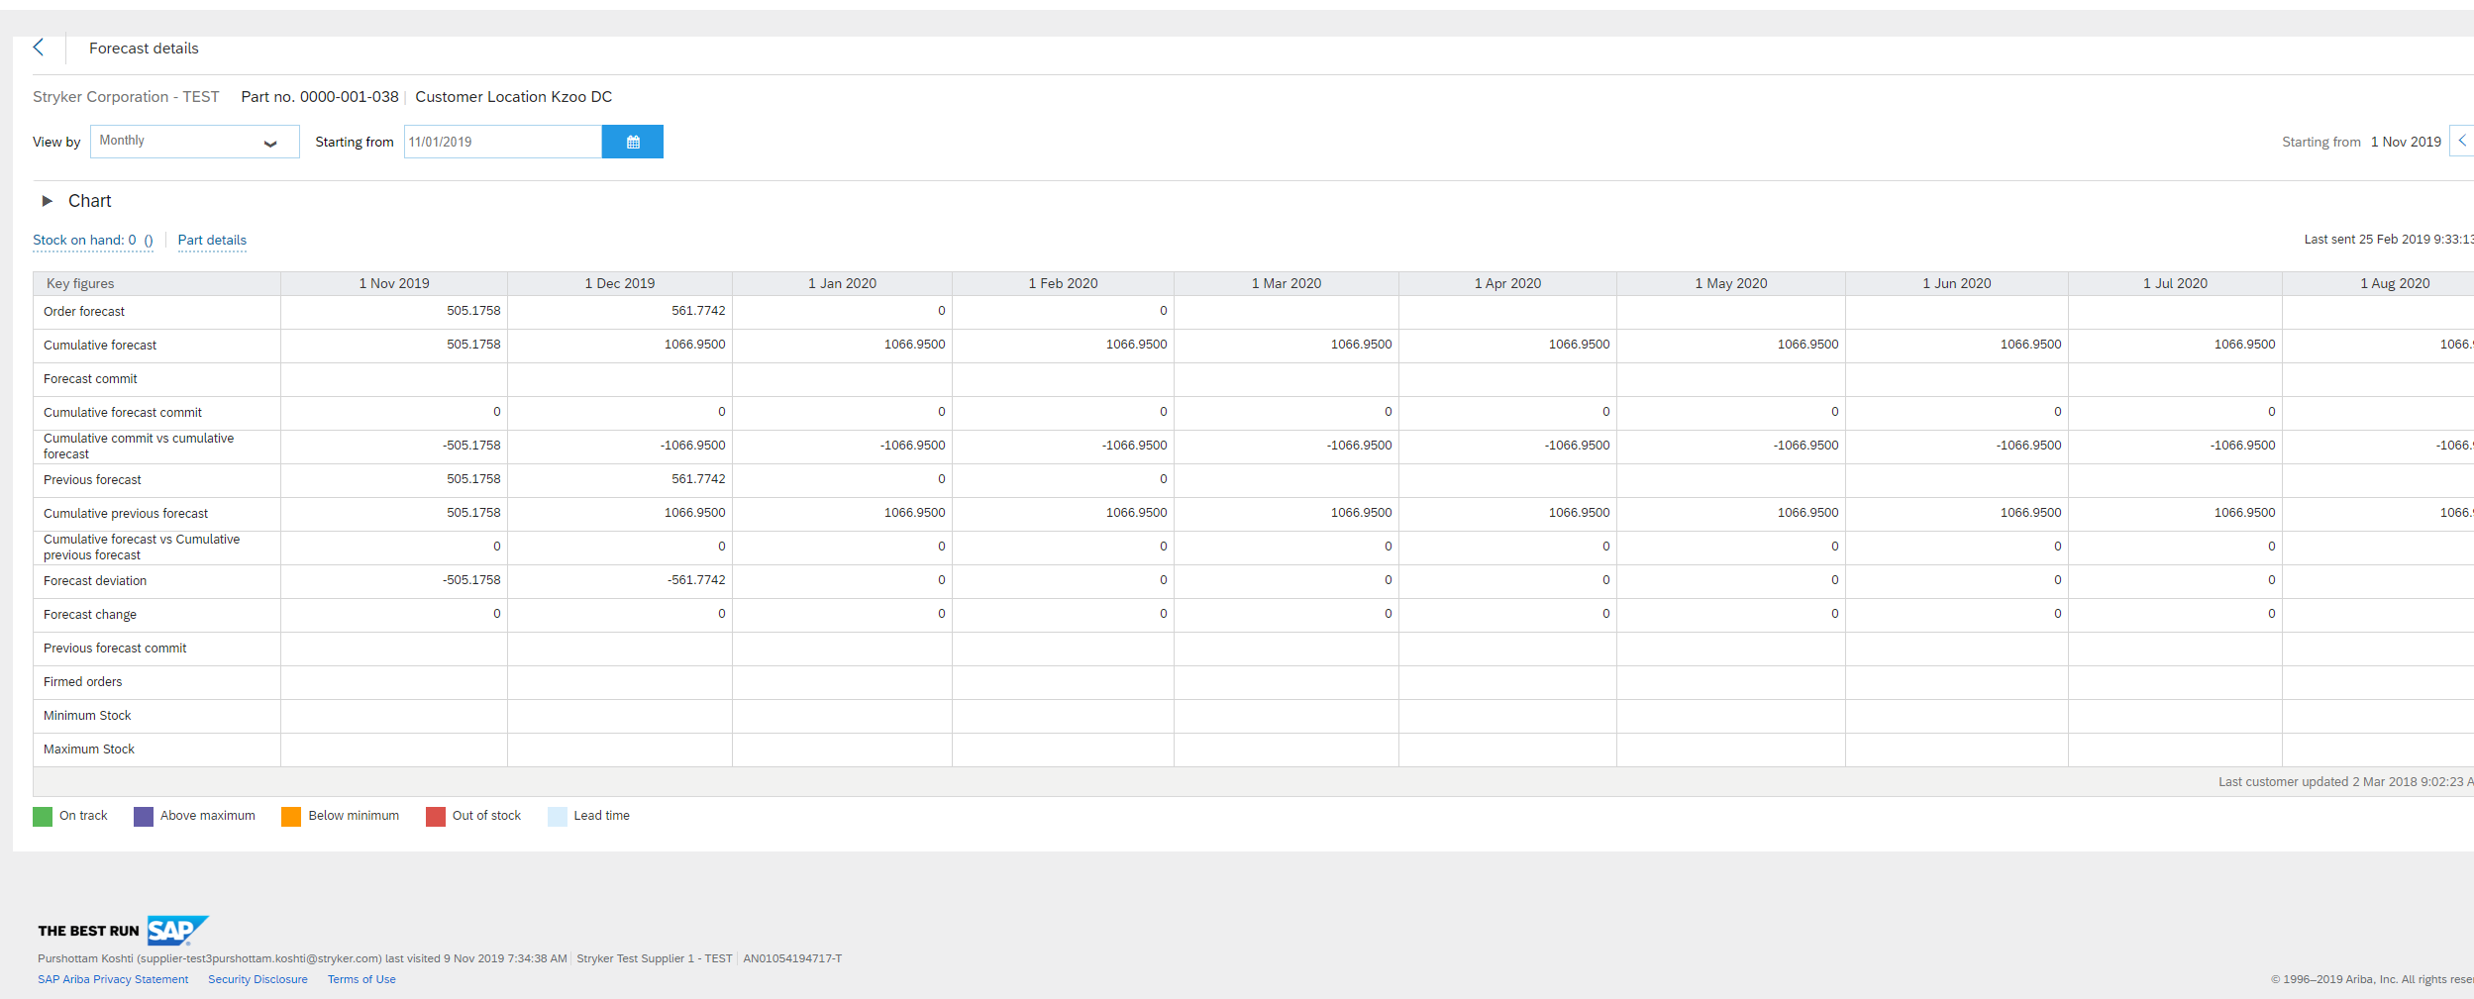
Forecasting (Search Filters)
Select Monthly from the View By dropdown menu.
View the forecast amount in “Order Forecast” column of the appropriate Month.
1
2
5

Slide 6
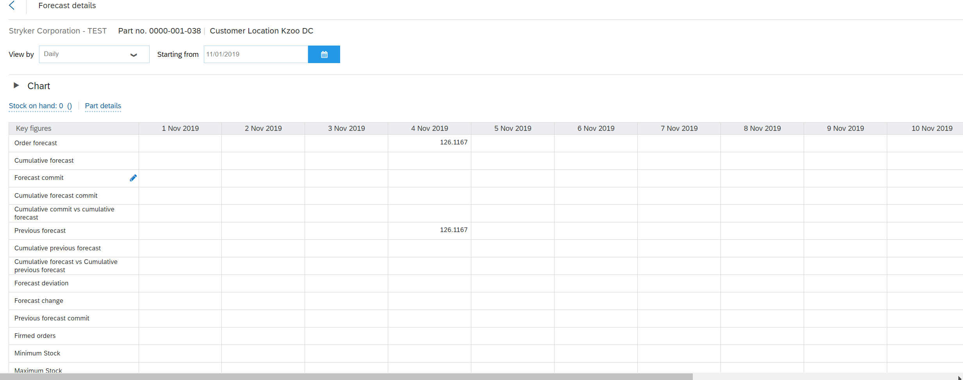
Forecast Commitments
After viewing the forecast demand in the monthly view, select DAILY view to enable entering forecast commit.
Click the blue pencil icon in forecast commit row to make fields editable.
1
2

Slide 7
Forecast Commitments
Enter quantity you will commit on the day the shipment is planned to arrive at Stryker plant
Click Save
Note: This records the commitment quantities, but does not send the commitment to the buyer. You can change the quantities committed any number of times before sending the commitment to the buyer.
1
2

Slide 8
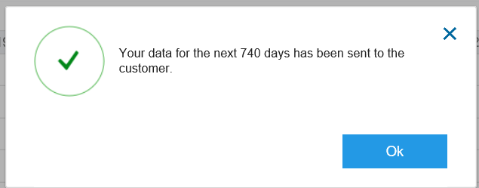
Sending Forecast Commitment to Stryker
View the saved committed quantity.
Click Send Data to send the committed quantity to Stryker.
Once the data has been sent, this notification will be received.
Note: Ariba Network sends the commitment to the buyer. Also, this disables the page icon so that you cannot send the commitment again. You can view the details of the commitment in the Product Replenishments section.
2
1
3

Slide 9
Thank you for joining the Ariba Network!

