Slide 1
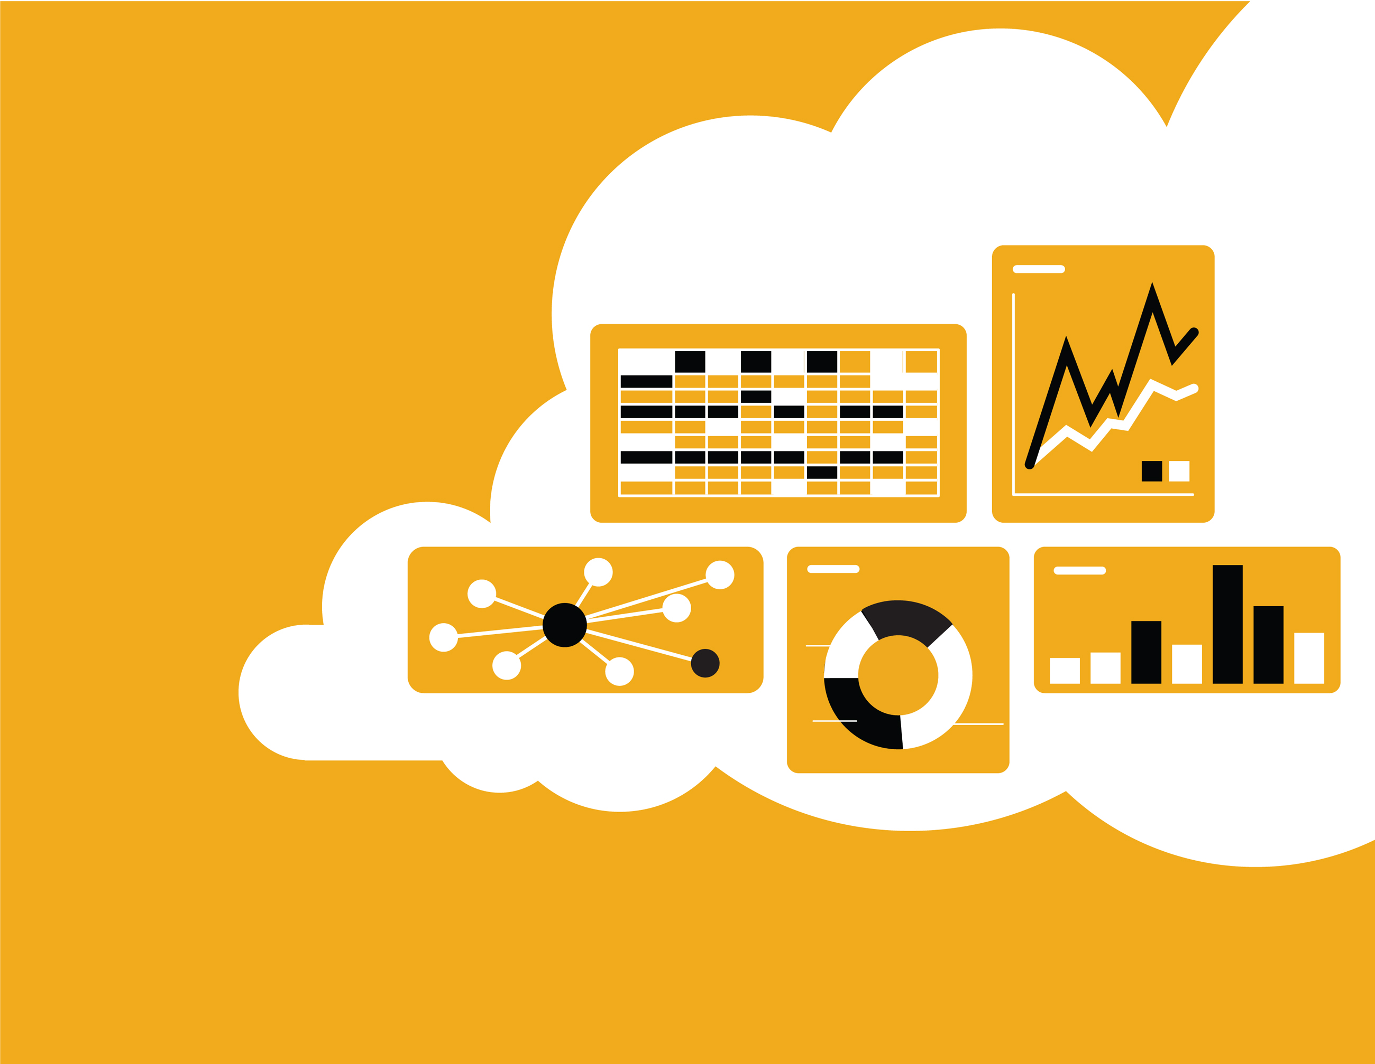


Invoice Training Guide
2023

Slide 2
Agenda
Scope of Products and Documents
Demo
  Invoices

Slide 3
Invoice Call Outs
Advanced Ship Notice must be created first before the item can be invoiced.
Payment term days will not take effect until after the goods receipt of the material (not the ASN).
Prices cannot be changed. Reach directly to Stryker in the case the price needs to updated and a new PO will be submitted.
Quantity to be invoiced will be what has been shipped and is still open for invoicing.
0 quantities will not be allowed.
Taxes section must be removed if you do not have any taxes.
Unit of Measure cannot be different from the PO.
Part number cannot be changed.
Invoice number can only be Alpha-Numeric with no special characters or spaces, and must be all uppercase.
Stryker Suggestion: To prevent any re-work Stryker recommends waiting to invoice until goods receipt has been received for line item. However, you are able to invoice once the ship notice has been submitted to Stryker.

Slide 4
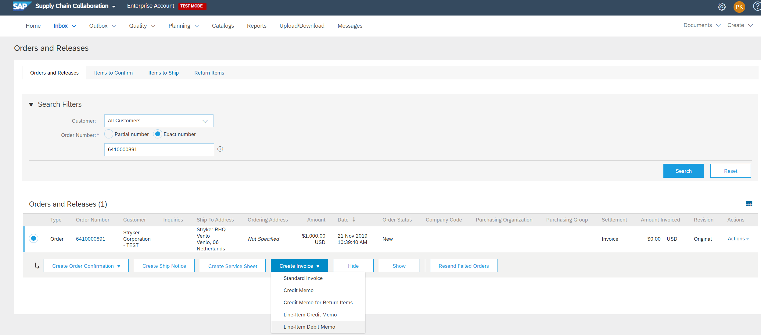
Invoice via PO Flip
To create a PO-Flip invoice (or an invoice derived from a PO that you received via Ariba Network):
From the inbox (orders and releases) select PO number you wish to invoice.
Click invoice button
Select Standard Invoice
1
2
3

Slide 5
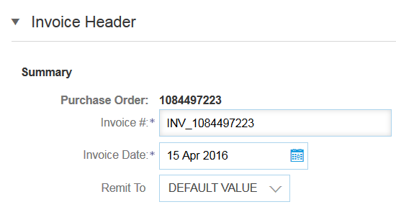
Invoice via PO Flip
Header
Invoice is automatically pre-populated with the PO data. Complete all fields marked with an asterisk and add tax as applicable.
Enter an Invoice # which is your unique number for invoice identification. The Invoice Date will auto-populate..
Scroll down to the Line items section to select the line items being invoiced.
1
2
Note: Attachments will remain online on the Ariba Network.
Note: Backdating invoices 1 day is allowed.

Slide 6
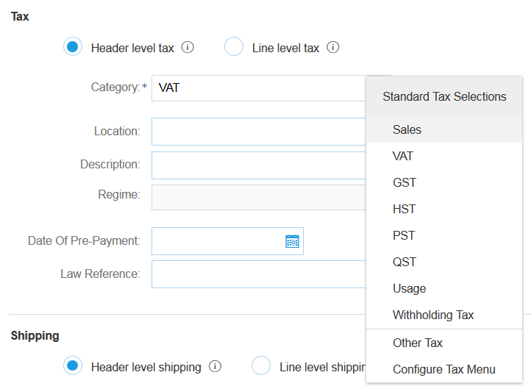
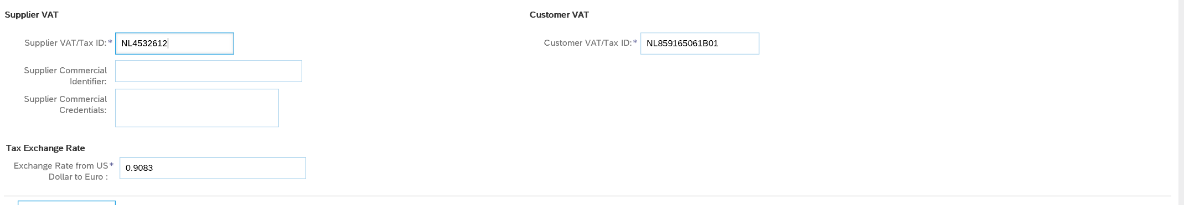
Invoice via PO Flip
Additional Tax Options (Header Level)
To configure additional tax options click Configure Tax Menu under the Tax Category drop down. Create new tax categories and as needed.
Select the Header Level to apply same tax rate to all line items.
Select Category within each line item, then either populate the rate (%) or tax amount and click update.
Enter Supplier VAT/TAX ID (Needs populated)
Customer VAT/TAX ID (automatically populates from purchase order)
1
2
3
4

Slide 7
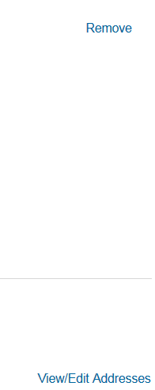
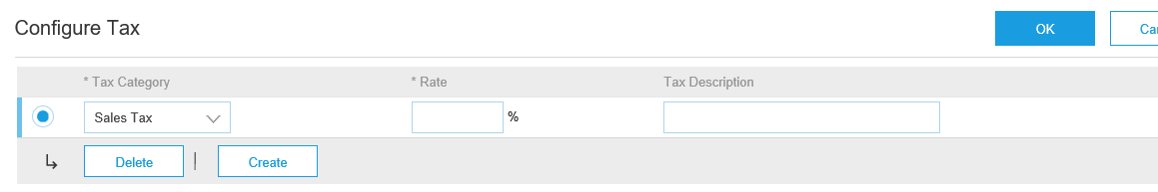
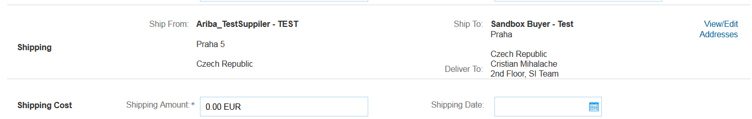
Invoice via PO Flip
Additional Tax Options & Line Item Shipping
To configure additional tax options click Configure Tax Menu under the Tax Category drop down. Create new tax categories and as needed.
Select the Line Item to apply different tax rates to each line item.
Click Line Item Actions > Add > Tax.
Upon refresh, the Tax fields will display
for each selected line item.
Click Remove to remove a tax line item, if not necessary.
Select Category within each line item, then either populate the rate (%) or tax amount and click update.
Enter shipping cost to the applicable line items if line level shipping has been selected.
1
3
2
4
5

Slide 8

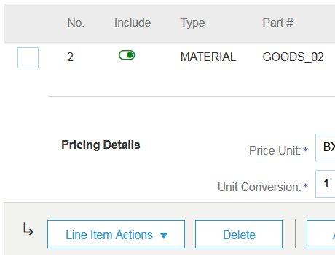
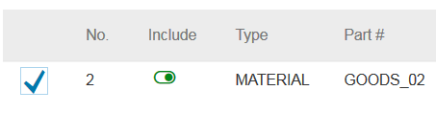
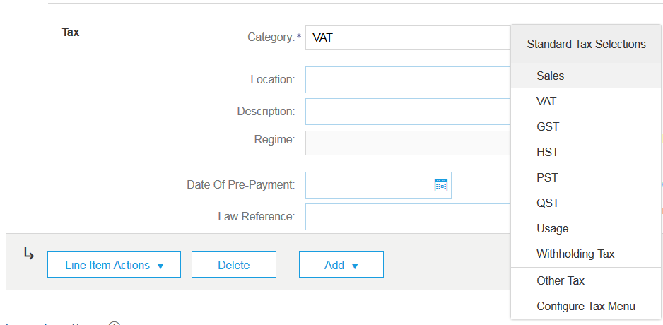
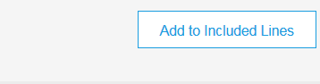
Invoice via PO Flip
Line Items
Line Items section shows the line items from the Purchase Order.
Review or update Quantity for each line item you are invoicing.
Click on the line item’s Green slider to exclude it from the invoice, if line item should not be invoiced OR click the check box on the left of the item and click Delete to remove the line item from the invoice. You can generate another invoice later to bill for that item.
Select the line item to which tax is to be applied using the Line Item # checkbox. To apply the same tax to multiple line items select those line items to be taxed at the desired rate.
To configure additional Tax Options within the Tax Category tool, use the Configure Tax Menu option.
Check Tax Category and use the drop down to select from the displayed options. Click Add to Included Lines.
Note:
Suppliers are only allowed to submit invoices less than or equal to the quantity that has been submitted on the ASN and physically shipped.
Tax and shipping are not expected as separate invoice line items, and should only be added as it aligns with your pricing agreement with Stryker.
1
2
3
4
5

Slide 9
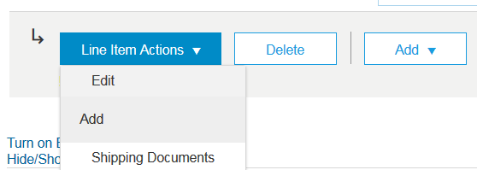
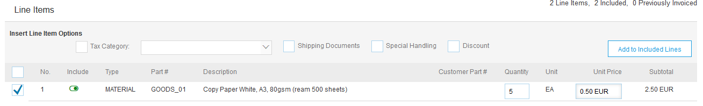
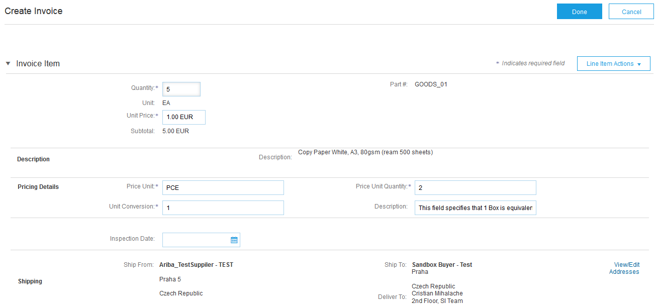
Invoice via PO Flip
Detail Line Items
Additional information can be viewed at the Line Item Level by editing a Line Item.
6
6

Slide 10
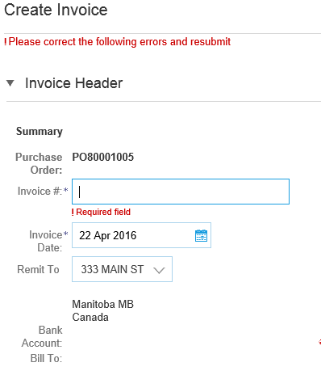
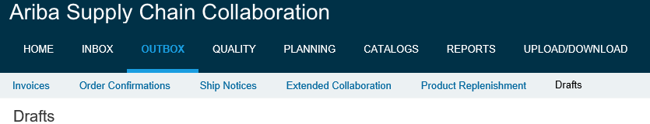
Review, Save, or Submit Invoice
PO-Flip Invoice
Review your invoice for accuracy from the Review page. Scroll down the page to view all line item details and invoice totals.
If no changes are needed, click Submit to send the invoice to Stryker.
If changes are needed, click Previous to return to previous screens and make corrections before submitting.
Alternatively, Save your invoice at anytime during invoice creation to work on it later.
You may resume working on the invoice by selecting it from Outbox>Drafts on your Home page.
You can keep draft invoices for up to 7 days.
4
Note: In the even of errors, there will be a notification in red where information must be corrected
5

Slide 11
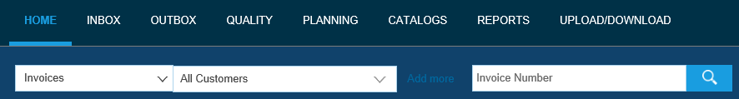
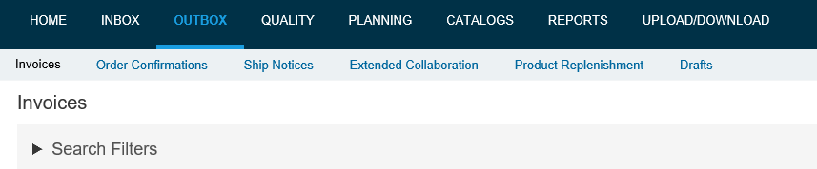
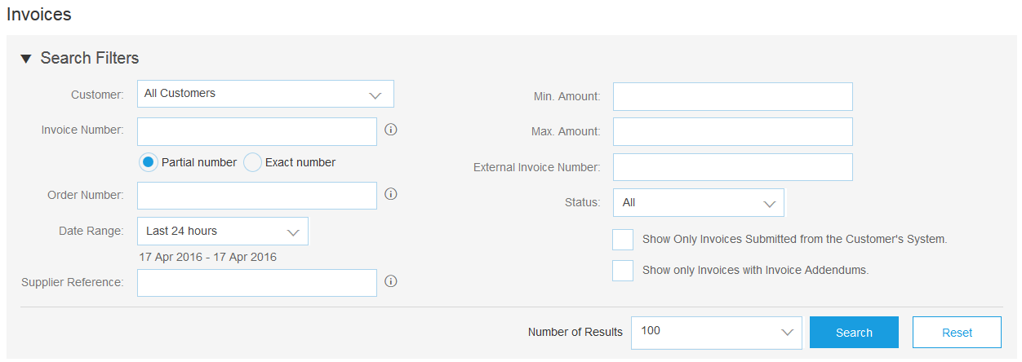
Search for Invoice
(Quick & Refined)
Quick Search:
From the Home Tab, Select Invoices in the Document type to search.
Select Stryker from Customer Drop down menu.
Enter Document # , if known. Select Date Range, up to 90 days for Invoices and Click Search.
Refined Search: Allows a refined search of Invoices within up to 90 last days.
Search Filters from Outbox (Invoices).
Enter the criteria to build the desired search filter.
Click Search.
1
2
3
5
6

Slide 12
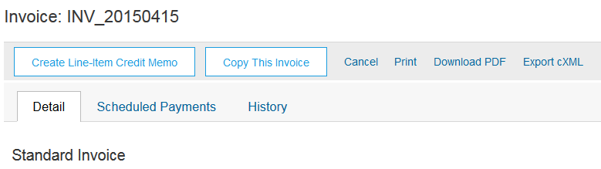
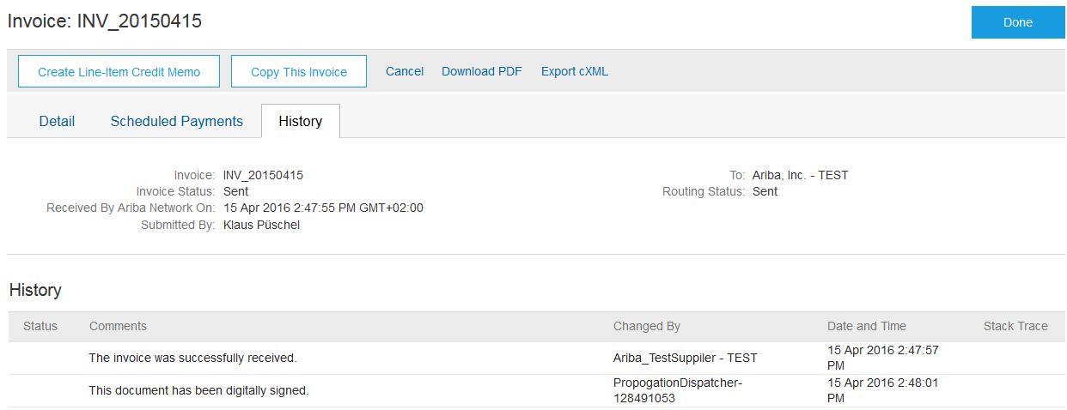
Review Invoice History
Check Status Comments
Access any invoice:
Click on the History tab to view status details and invoice history.
History and status comments for the invoice are displayed.
Transaction history can be used in problem determination for failed or rejected transactions.
When you are done reviewing the history, click Done.
1
4
2

Slide 13
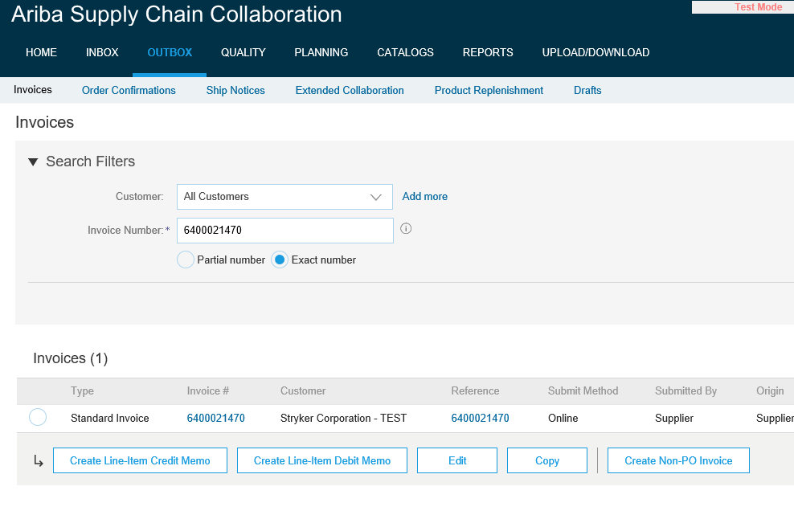
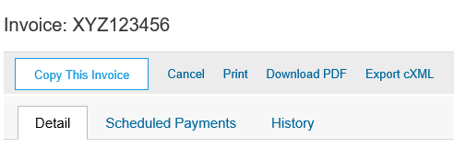
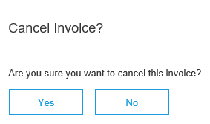
Modify an Existing Invoice
Cancel, Edit, and Resubmit
Click the Outbox tab.
In the Invoice # column, click a link to view details of the invoice.
Click Cancel. The status of the invoice changes to Canceled.
Click the Invoice # for the failed, canceled, or rejected invoice that you want to resubmit and click Edit.
Click Submit on the Review page to send the invoice.
1
2
4
3
3

Slide 14
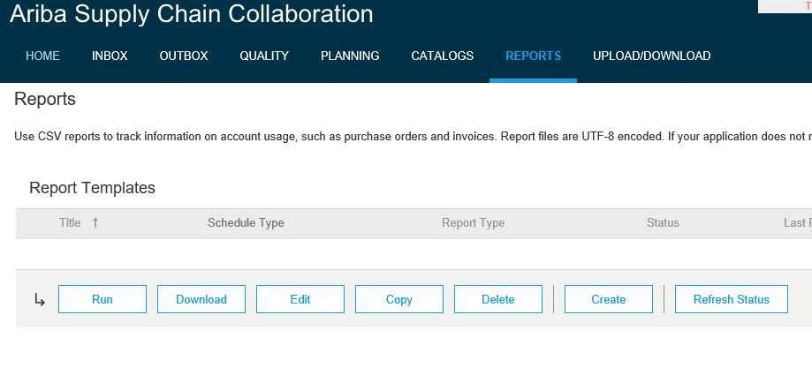
Download Invoice Reports
Learn About Transacting
Reports help provide additional information and details on transactions on the Network in a comprehensive format.
1
Click the Reports tab from the menu at the top of the page.
Click Create.
2
Invoice reports provide information on invoices you have sent to customers for tracking invoices over time or overall invoice volume for a period of time.
Failed Invoice reports provide details on failed and rejected invoices. These reports are useful for troubleshooting invoices that fail to route correctly.
Reports can be created by Administrator or User with appropriate permissions.
Bronze (and higher) members may choose Manual or Scheduled report. Set scheduling information if Scheduled report is selected.:

Slide 15
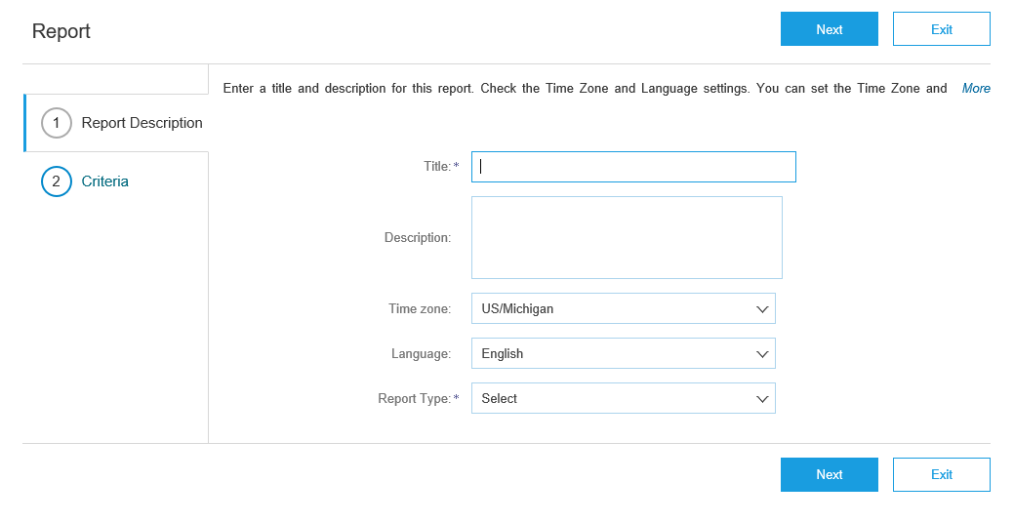
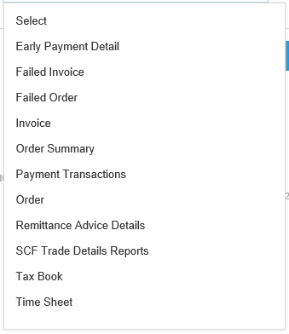
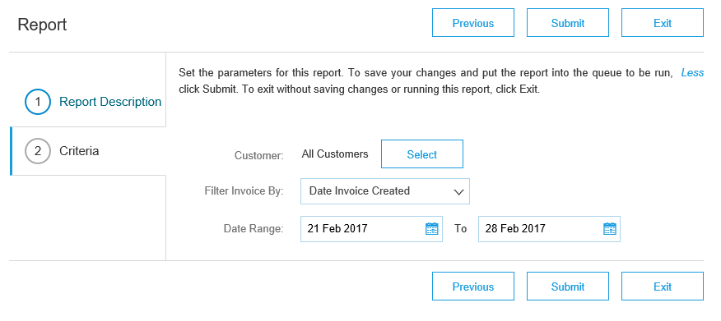
Invoice Reports
Enter required information. Select an Invoice report type — Failed Invoice or Invoice.
Click Next.
Specify Customer and Created Date in Criteria.
Click Submit.
You can view and download the report in CSV format when its status is Processed.
4
3
For more detailed instructions on generating reports, refer to the Ariba Network Transactions Guide found on the HELP page of your account.
5
6

Slide 16
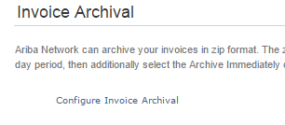
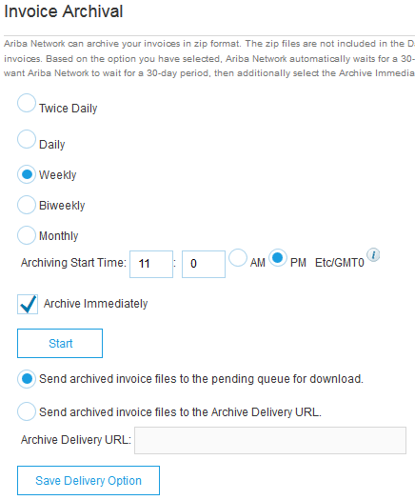
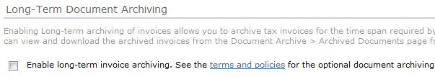
Invoice Archival
Configuring invoice archiving allows you to specify the frequency, immediacy, and delivery of zipped invoice archives. If you wish to utilize it, please follow these steps:
From the Company Settings dropdown menu, select Electronic Invoice Routing.
Select the tab Tax Invoicing and Archiving.
Scroll down to Invoice Archival and select the link for Configure Invoice Archival.
Select frequency (Twice Daily, Daily, Weekly, Biweekly or Monthly), choose Archive Immediately to archive without waiting 30 days, and click Start.
  If you want Ariba to deliver automatically archived zip files to you, also enter an Archive Delivery URL (otherwise you can download invoices from your Outbox, section Archived Invoices).
  Note: After Archive Immediately started you can either Stop it or Update Frequency any time.
You may navigate back to the Tax Invoicing and Archiving screen in order to subscribe to Long-Term Document Archiving for an integrated archiving solution. (More details within the Terms and Policies link.)
NOTE: Supplier archiving is not part of the Stryker Buyer Funded Program and is an optional add-on. That would be funded by the supplier.
3
4
5

Slide 17
Check Invoice Status
Routing Status To Your Customer
Check Status:
If you configured your Invoice Notifications as noted earlier in this presentation, you will receive emails regarding invoice status.
You can also check invoice status from the Outbox by selecting the invoice link.
Routing Status
Reflects the status of the transmission of the invoice to Stryker via the Ariba Network.
Obsoleted – You canceled the invoice
Failed – Invoice failed Stryker invoicing rules. Stryker will not receive this invoice
Queued – Ariba Network received the invoice but has not processed it
Sent – Ariba Network sent the invoice to a queue. The invoice is awaiting pickup by the customer
Acknowledged – Stryker invoicing application has acknowledged the receipt of the invoice

Slide 18
Check Invoice Status
Review Invoice Status With Your Customer
Invoice Status
Reflects the status of Stryker’s action on the Invoice.
Sent – The invoice is sent to the Stryker but they have not yet verified the invoice against purchase orders and receipts
Cancelled – Stryker approved the invoice cancellation
Approved – Stryker has verified the invoice against the purchase orders or contracts and receipts and approved if for payment
Rejected – Stryker has rejected the invoice or the invoice failed validation by Ariba Network. If Stryker accepts invoice or approves it for payment, invoice status updated to Sent (invoice accepted) or Approved (invoice approved for payment)
Failed – Ariba Network experienced a problem routing the invoice

Slide 19

Thank you for joining the
Ariba Network!

