Slide 1




Books and Records Requirements
Training
Description
To provide guidance related to maintaining complete and accurate supporting documentation for high risk activities, payments and accounts (e.g., expense reports, petty cash, etc.). Employees should undergo this training in order to better understand the importance of maintaining documentation and how to maintain adequate books and records.
How does this benefit you?
Maintaining accurate books and records will your company record business transactions in reasonable detail and maintain an adequate systems of internal accounting controls. Accurate books and records will assist you in effectively planning, budgeting, reporting and allocating resources.
Instructions
Provide periodic training to employee(s) responsible for maintaining books and records, including newly hired employees with such responsibilities.
Ensure training materials are available to employees as needed.
Utilize Attendance Sign-in Sheet(s) to record attendance for each training session.
Other documentation to consider
Attendance Sign-in Sheet
Books and Records Guidance

Slide 2
Books and Records Requirements

Slide 3
Benefits of Accurate Books
and Records
Readily able to respond to tax and regulatory inquiries.
Inquiries
Better able to make informed business decisions and identify potential opportunities.
Decisions
The following slides detail the types of documentation that should be retained for certain types of transactions. To the extent documentation is not available, you should document an explanation as to why it is unavailable.
Quickly able to produce documents in response to an audit (many contracts include an exercisable audit clause).
Audits
Easily able to separate books and records by manufacturer, which is often stipulated in contracts.
Records

Slide 4

Employee Expense Reports
At a minimum, the following documentation should be maintained:
Transportation documentation detailing expenses, class of travel.
Lodging and meals documentation detailing expenses, attendee(s) and title.
Expense approvals.
Original itemized receipts.
Business purpose.
Employee Expense Reports
Disbursements
Petty Cash
Grants, Donations, Exhibits, and Sponsorships
Licenses, Freight, Transportation, Custom Expenses
Sales Orders

Slide 5

Disbursements
At a minimum, the following documentation should be maintained:
Invoices detailing amounts, dates of service and the types of services or products received.
Internal approvals, purchase orders and proofs of payment.
Proofs of performance (e.g., delivery notices, materials).
Contracts, written agreements and addendums.
Correspondence.
Employee Expense Reports
Disbursements
Petty Cash
Grants, Donations, Exhibits, and Sponsorships
Licenses, Freight, Transportation, Custom Expenses
Sales Orders

Slide 6
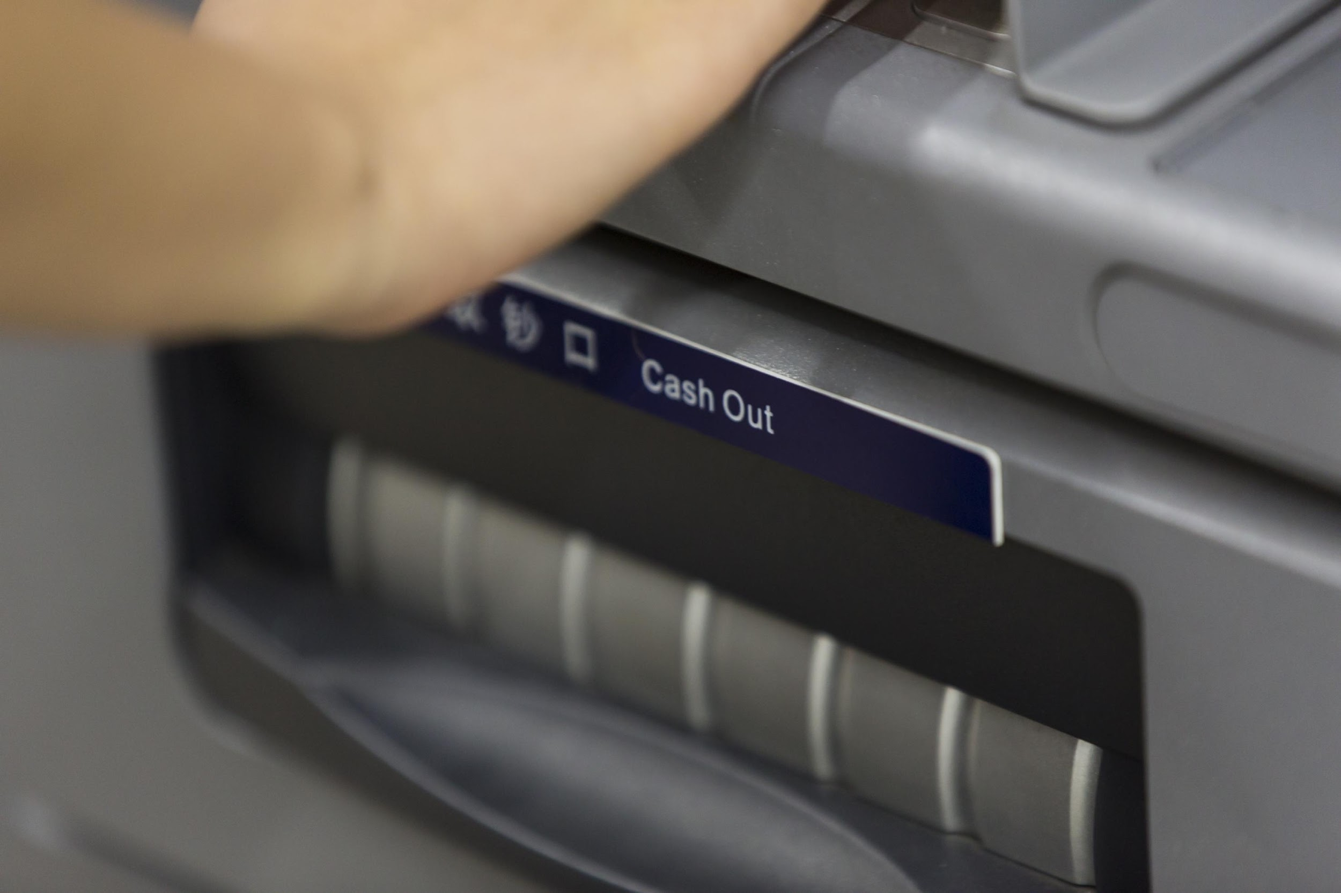
Petty Cash
At a minimum, the following documentation should be maintained:
Receipts.
Request vouchers, including intended use and amounts.
Approver sign-off and disbursement date.
Reconciliations (e.g., disbursed vs. spent) and evidence that unused funds were returned.
Employee Expense Reports
Disbursements
Petty Cash
Grants, Donations, Exhibits, and Sponsorships
Licenses, Freight, Transportation, Custom Expenses
Sales Orders

Slide 7

Grants, Donations and Sponsorships
At a minimum, the following documentation should be maintained:
Pre-approval documentation, including request forms and business justification.
Evidence of how the funds were utilized (e.g., agendas, white papers, research),
Transportation, lodging and meals documentation.
If event or conference, attendee lists, pictures of booths, etc.
Employee Expense Reports
Disbursements
Petty Cash
Grants, Donations, Exhibits, and Sponsorships
Licenses, Freight, Transportation, Custom Expenses
Sales Orders

Slide 8

Licenses, Freight, Transportation and
Custom Expenses
At a minimum, the following documentation should be maintained:
Freight forwarder / customs broker / agent agreement.
Customs / freight invoices and receipts.
Customs forms and price listings.
Third party payment remittance / wire transfer forms.
Government issued tax receipts.
Employee Expense Reports
Disbursements
Petty Cash
Grants, Donations, Exhibits, and Sponsorships
Licenses, Freight, Transportation, Custom Expenses
Sales Orders

Slide 9

Sales Orders
At a minimum, the following documentation should be maintained:
Customer purchase orders.
Sales invoices.
Shipping documentation.
Price listings inclusive of any provided discounts.
Evidence of payment received from the customer.
Employee Expense Reports
Disbursements
Petty Cash
Grants, Donations, Exhibits, and Sponsorships
Licenses, Freight, Transportation, Custom Expenses
Sales Orders

Slide 10
Key Takeaways
Sufficient supporting documentation to reflect the nature of the products sold and/or services provided
Detailed description of the services provided
Support agrees to rates in the contract
Services were for a legitimate and legal business purpose
Proper evidenced approval

